Slide 1
Critical Care Rehab
Cleo Dobson
Respiratory Physiotherapist
March 2020
Acknowledgments to Lisa Ronson (Specialised Respiratory Physiotherapist)

Slide 2
Contents
Guidelines
Effects of an ITU Stay
Rehabilitation + Equipment
Limitations

Slide 3
Quality Critical Care (DoH, 2005)
“Hospitals should develop patient-centered rehabilitation services to optimise the recovery of patients discharged from critical care units, integrating with primary care services after discharge from hospital”

Slide 4
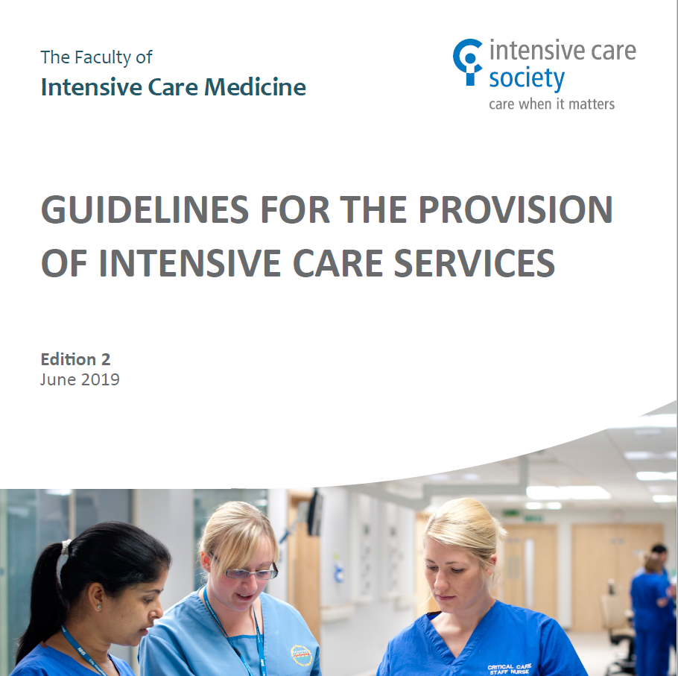
GPICS 2019

Slide 5
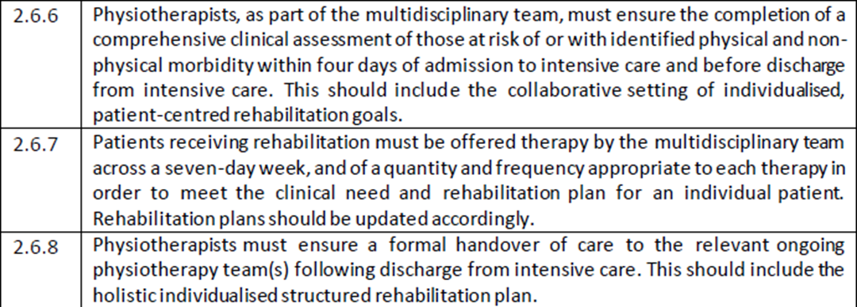
Physiotherapy specific
Notes:
It advises critical care units of staffing requirements and resources etc.
Also have recommendations for dieticians, SALT, nursing.

Slide 6
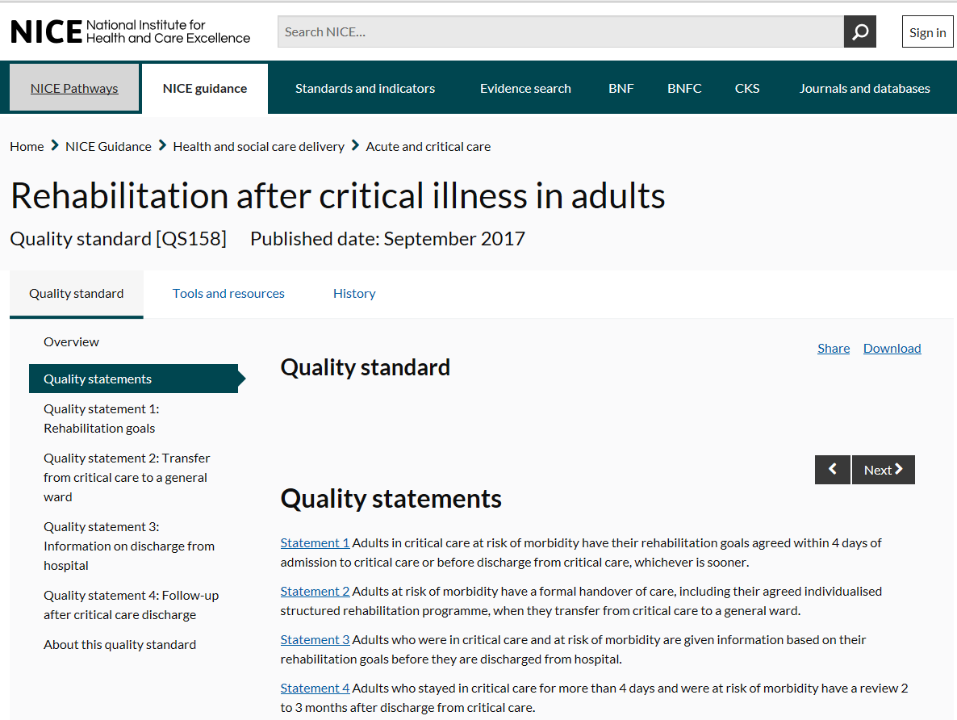
QS158 NICE guideline
Notes:
Talk through quality statement.
Quality statements physiotherapists need to adhere to.
Collect information about these statements.

Slide 7
NICE Quality Standards (QS158) - 2017
Standard 1:
Adults in critical care at risk of morbidity have their rehabilitation goals agreed within 4 days of admission to critical care or before discharge from critical care, whichever is sooner.
Standard 2:
Adults at risk of morbidity have a formal handover of care, including their agreed individualised structured rehabilitation programme, when they transfer from critical care to a general ward.
Standard 3:
Adults who were in critical care and at risk of morbidity are given information based on their rehabilitation goals before they are discharged from hospital.
Standard 4:
Adults who stayed in critical care for more than 4 days and were at risk of morbidity have a review 2 to 3 months after discharge from critical care.

Slide 8
110,000 people admitted to critical care units in England and Wales each year
75% survive to be d/c home but experience significant and persistent problems with physical and social functioning.
5-10% of patients that survive become chronically ill.
Evidence suggests that an individualised, structured rehabilitation programme should be provided with regular follow ups.
Notes:
Link in with early sedation holds to wake patients so actively moving – culture change
Also an increase in proteolysis in muscles in inflammatory disease states (eg sepsis)
Functional denervation due to reduced frequency and intensity of nerve firing. This reduces mitochondria numbers and oxidative capacity. Therefore when activity resumes the muscles will need to depend on glycolysis with lactate formation. So increased muscle weakness and increased post-exercise soreness.

Slide 9
Effects of bed rest
Musculoskeletal – weakness, muscle contractures, joint contractures
Muscles can atrophy by as much as 40% after the 1st week.
1% to 1.5% decline in strength per day.
Loss of antigravity muscles
Cardiac muscle
Atrophy of the diaphragm occurs in 18-69hrs

Slide 10
Respiratory – muscle weakness, altered VQ matching, less effective mucociliary action
Circulatory problems – increased fluid
Skin – pressure sores
Digestion – ineffective
Appetite affected
Decreased urine output
PEs/DVTs

Slide 11
Effects of a Prolonged ITU Stay
  Reduced exercise tolerance
  Persistent muscle weakness
  Reduced quality of life
  Neuropsychological impairments
  Impaired function
  Fatigue and anxiety
  Depression
  Panic Attacks
Impairments persist up to 5 years post discharge

Slide 12
Benefits of Exercise
Maintain muscle strength – increased energy
Maintain bone density
Maintain joint ROM
Improve CVS fitness – increased SV, increased RBC production, increased capillaries, efficient gas exchange, decreased lactic acid build up

Slide 13
Aid recovery of the respiratory system
– increased strength of intercostal muscles and diaphragm
- increased lung volumes
- increased number and diameter of capillaries a round alveoli
- improved VO2 max
- improved gas exchange
Aid return to function and daily life
Positive psychological benefits

Slide 14
MDT Involvement
GICU - Daily MDT 10am ward round.
CTITU – Twice a week round.
  PT, SALT, Nurse and Doctor
    Ventilator weaning
    Rehabilitation plan
    Seating and positioning plans
    Nutrition
    Communication
    Psychological problems
    Others – tissue viability

Slide 15
Rehabilitation
Early assessment to determine risk of developing morbidities. In depth assessment for at risk patients.
Agree short term and medium term rehab goals – family to be involved
Rehab – Prevention, Nutrition, Rehab Programme

Slide 16
Very Early Rehab
Prevention
  - Muscle length
  - Skin integrity
  - Positioning
Early sedation holds
Reverse Trendelenburg Positioning
- Orthostatic tolerance
- Antigravity muscle use
- Intubated
Sit on edge of bed
- Ax sitting balance/Obs
- Functional movement
- Sitting exercises and stretches

Slide 17
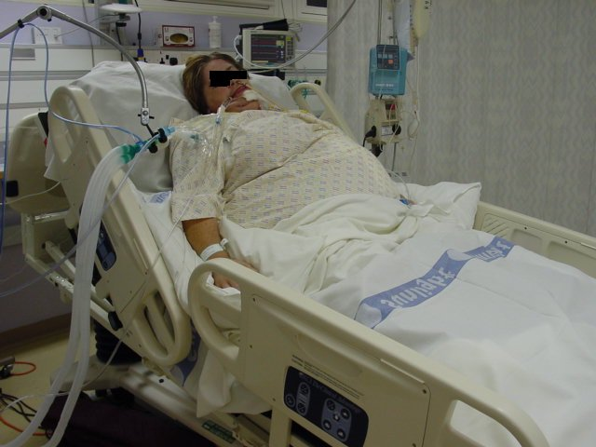

Slide 18
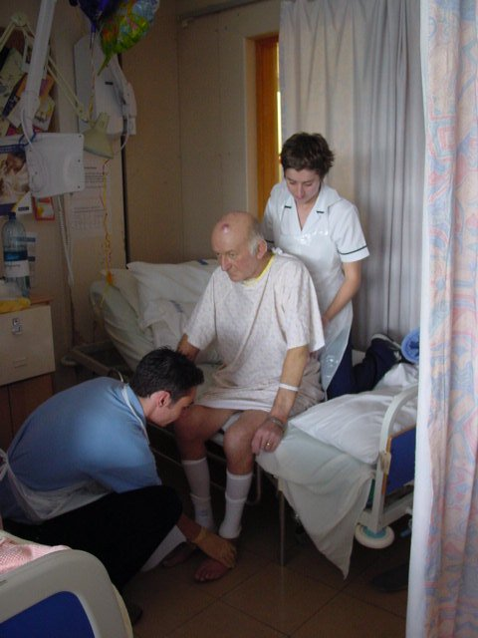

Slide 19
Sitting Out of Bed
Improved strength
Reduced pain and stiffness in joints
Increased lung volumes
Improved cough
Prevent pressure sores
Improved appetite
Reduced risk of aspiration on eating
Improved orthostatic tolerance
Improved mood
Improved participation
Improved sleep

Slide 20
REHABILITATION
Increase functional independence:
  Sitting : Rehab chairs, tilt-in-space chair
  Standing
        : Standing frame, Standing hoist, Rotastand, Frame, Handheld Assistance
  Transfers
  Mobility : Standing hoist, Frame, Crutches, Sticks

Slide 21
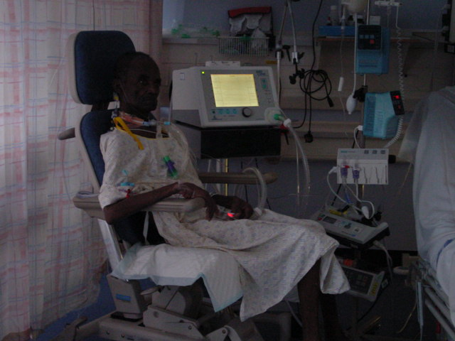

Slide 22
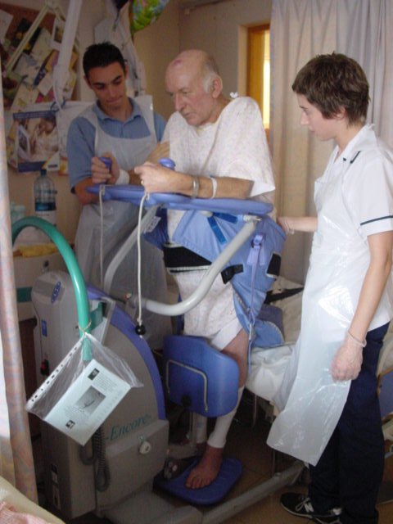
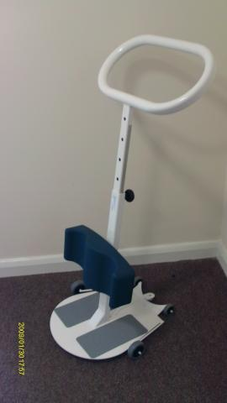

Slide 23
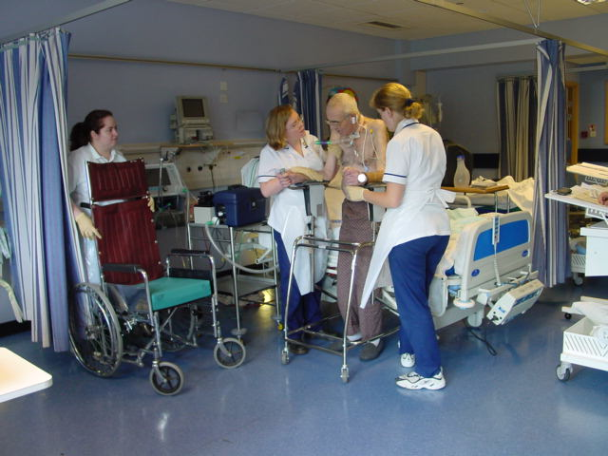

Slide 24
REHABILITATION
Exercise programme – weights, theraband
Tilt table
Motomed

Slide 25
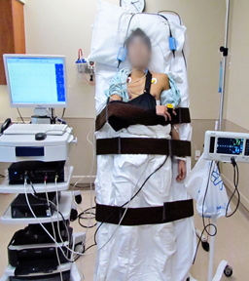
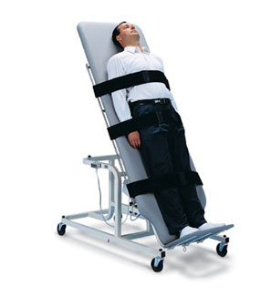

Slide 26
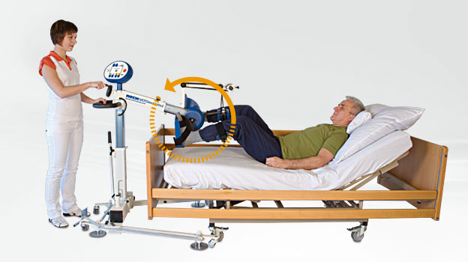
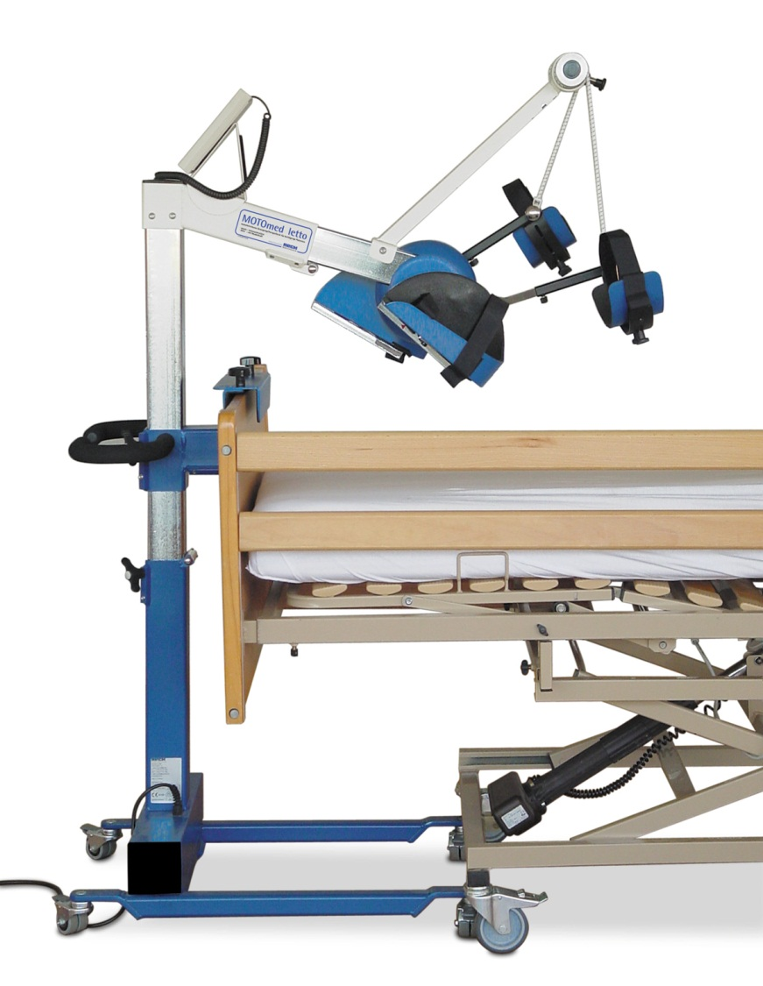
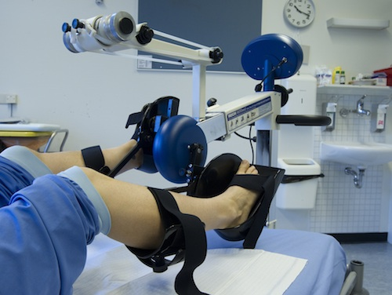

Slide 27
Limitations to Rehab
Absolute Contraindications:
Acute MI with ongoing dynamic changes on ECG
Unstable angina
Acute PE
Severe arrhythmias
Uncontrolled HTN, systolic > 250
DVT not on treatment
IABP
HR < 30-35bpm >150-180bpm
ICP monitoring
Acute deterioration in GCS
Unstable spine
24 hours post evacuation of SDH

Slide 28
Precautions/Considerations:
Pulmonary HTN
Brady/Tachyarrhythmias
Systolic Bp <90mmHg > 200mmHg
RR > 40
Inotropic support – Norad > 0.1, Milrinone
Temporary pacing wires
Blood glucose < 3
Hb < 8
Pain
Delirium
Fatigue

Slide 29
Staffing
Time constraints
Patients regularly off unit
Equipment
Patient participation
‘Gut feeling’

Slide 30
What is a Rehab Prescription
A patient document commenced on intensive care, that follows them through their hospital pathway.
Detailed on the document:
  Reason for admission
  Relevant patient information and suggested referral pathways
  Goals
  Discharge information

Slide 31
Rehab Prescription
Started in July 2017 - on going updates and versions
Covers QS1 + 2 – setting goals and handover to ward
When – should be started day 3 of admission
Who – anyone can start it
Where – Found on iClip in documentation
How – Fill in as much as able, encourage MDT
members to complete, goal setting
What support would you need for it?

Slide 32
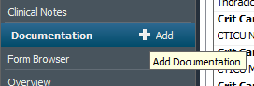
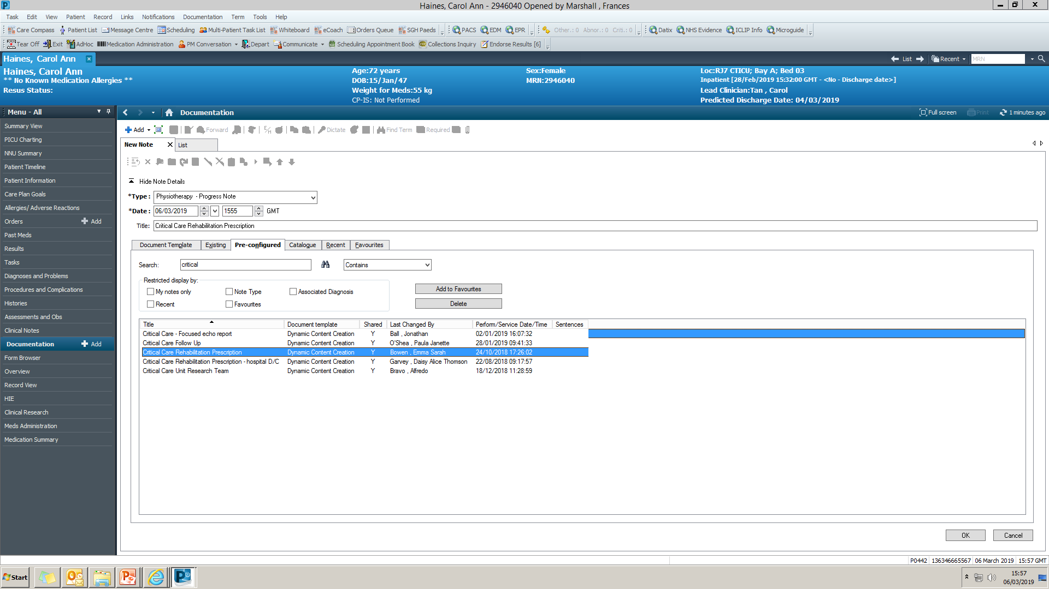
How to find the Rehab Prescription
On the Documentation Tab, click ‘Add’
- Select the ‘Pre-configured’ tab
In the search box, type critical
Select the title ‘Critical Care Rehabilitation Prescription’

Slide 33
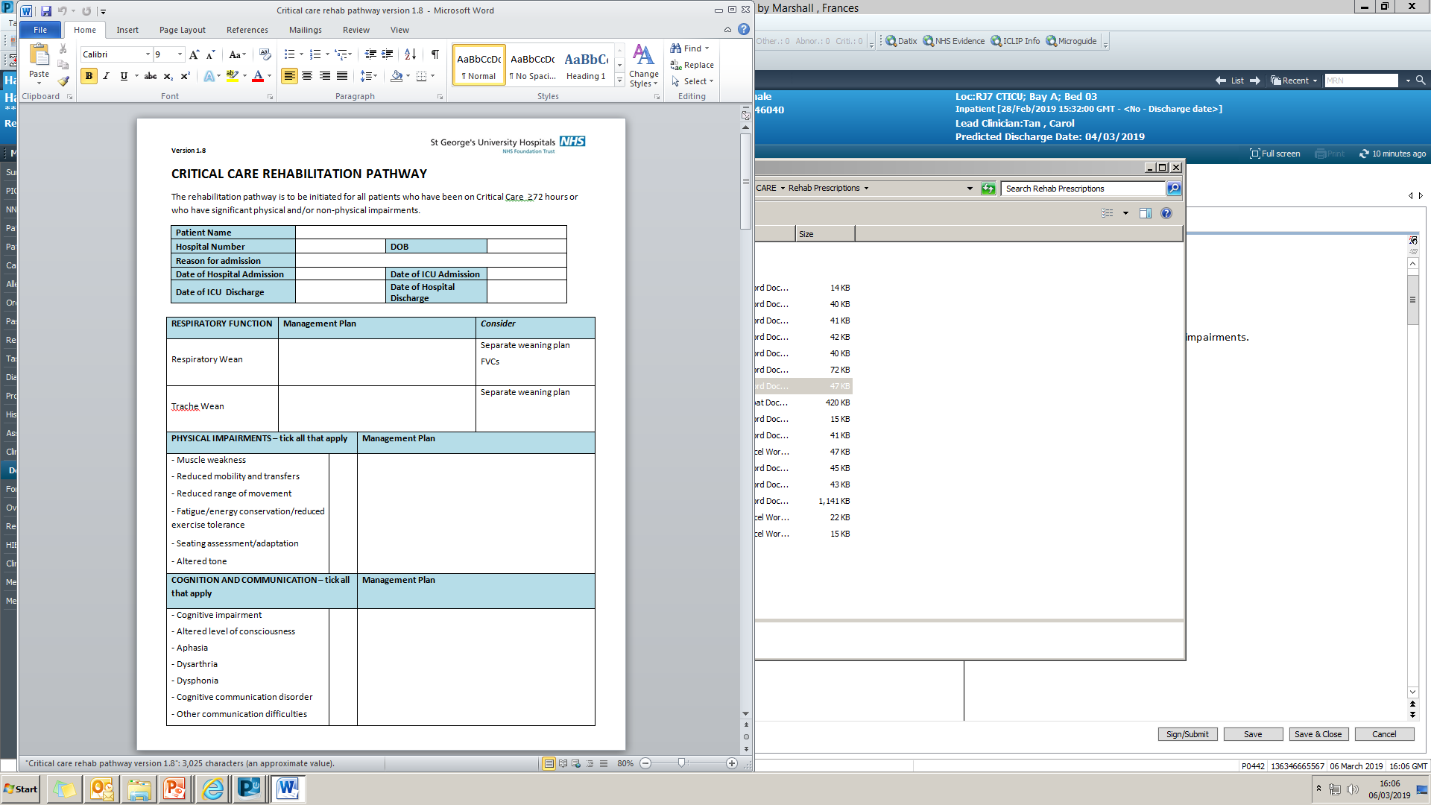
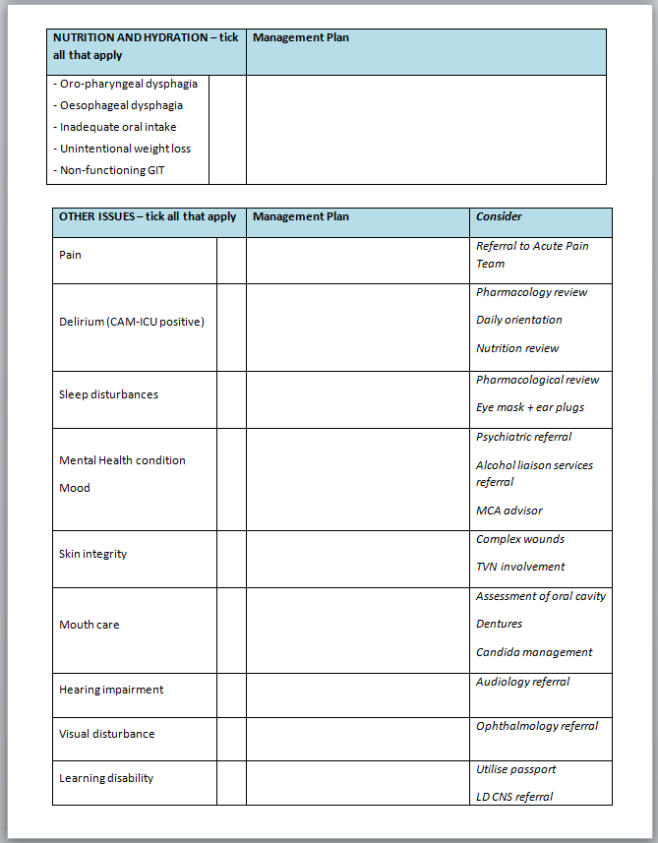

Slide 34
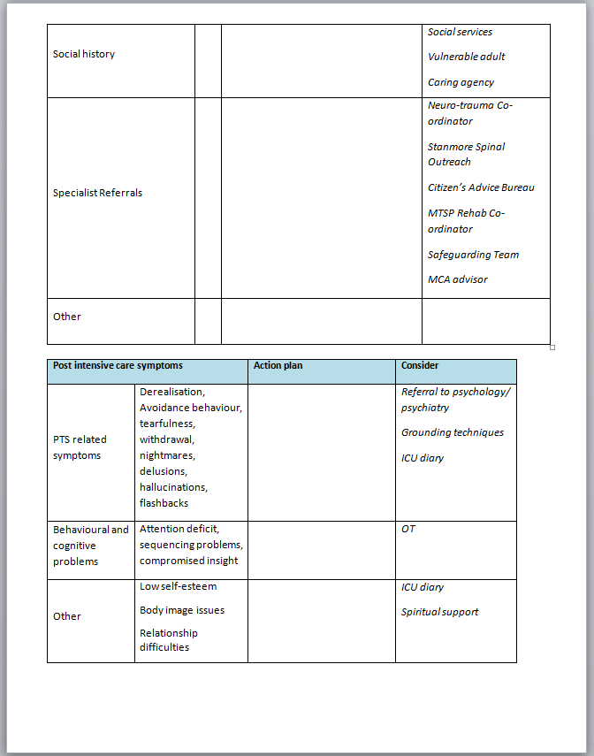
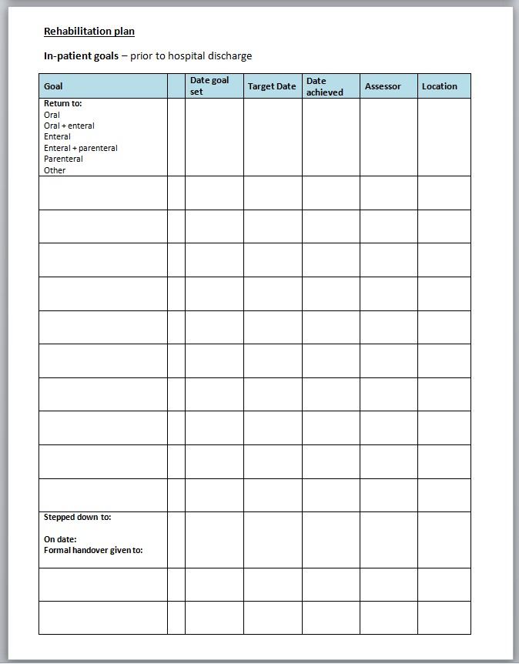

Slide 35
What Goals May you Want to Add
?

Slide 36
What are SMART goals
?
Notes:
Ask to give examples!

Slide 37
Working Progress
Improvements to compliance of MDT staff on the wards.
Improvements to the Discharge document to provide patients with the relevant information.
To make the rehab prescription more easily accessible.

Slide 38
Conclusion
Rehab should start as early as possible
Rehab can decrease all the negative effects of mechanical ventilation and bed rest
Should be MDT involvement
Goals should be set with family involvement
Barriers should be identified and strategies put in place

Slide 39

Questions?

Slide 40
References
Adler J. & Malone D. (2012) Early Mobilization in the Intensive Care Unit: A Systematic Review Cardiopulmonary Physical Therapy Journal 23 (1): 5-13
Bercker S., Weber-Carstens S., Deja M. et al (2005) Critical illness polyneuropathy and muopathy in patients with acute respiatory distress syndrome Critical Care Medicine 33: 711-715
Brahmbatt N., Murugan R., Milbrandt E. et al (2010) Early mobilization improves functional outcomes in critically ill patients Critical Care 14(5): 321
Burtin C., Clerckx P,m Robbeets C. et al (2009) Early exercise in critically ill patients enhances short-term functional recovery Critical Care Medicine 37 (9), 2499-2505
DeJonghe B., Sharshar T., Lefaucheur J. et al (2002) Paresis acquired in the intensive care unit: A prospective multicenter study JAMA 288:2859-2867
Herridge M., Cheung A., Tansey C. et al (2003) One-year outcomes in survivors of the acute respiratory distress syndrome New England Journal of Medicine 348: 683-693
Khan J., Harrison T., Rich M. et al (2006) Early development of critical illness myopathy and neuropathy in patients with severe sepsis Neurology 67: 1421-1425

