Slide 1
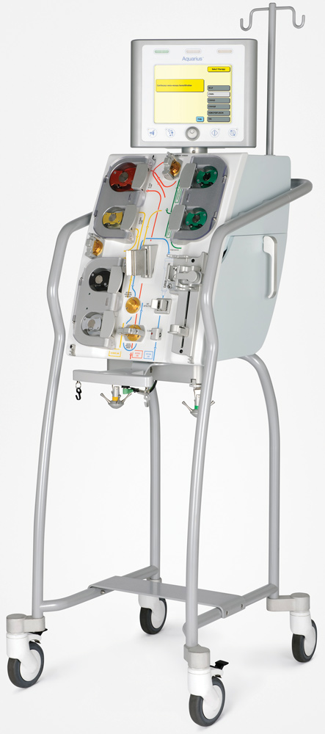
Modes & Principles of CRRT
*Continuous Renal Replacement Therapy
Catherine Jones
2019

Slide 2
Learning Outcomes
Understand PRINCIPLES of CRRT
  Ultrafiltration
  Convection
  Diffusion
Understand MODES of CRRT
  CVVH
  CVVHD
  CVVHDF

Slide 3
Principles of CRRT

Slide 4
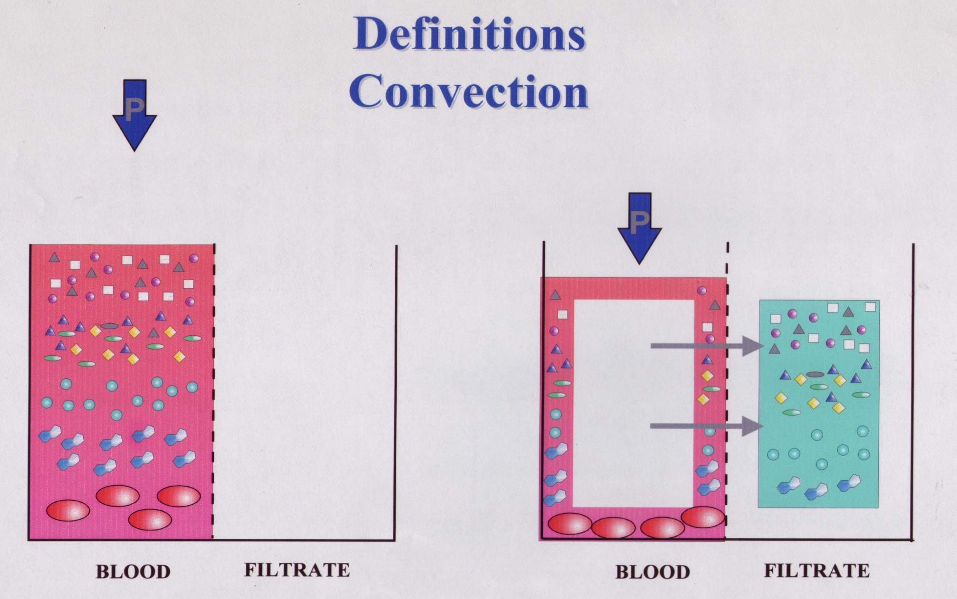
Plasma Water- Removal
Ultrafiltration
Plasma
Water

Slide 5
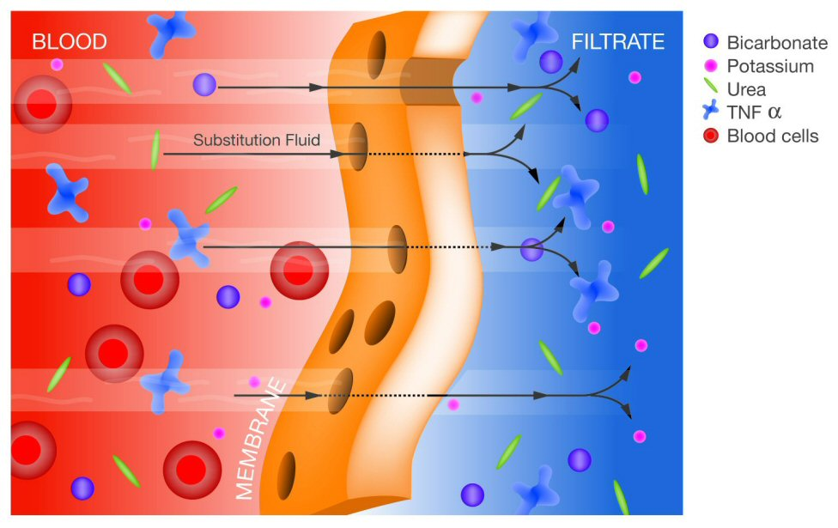
Convection
The movement of fluid across a semi-permeable membrane creating a solvent drag
Notes:
Pressure difference b/w blood & filtrate causes plasma water to move across
Causes Solvent Drag for small & middle molecules across membrane removing them from blood
Dependent on pressure gradient b/w blood & filtrate & membrane pore size

Slide 6
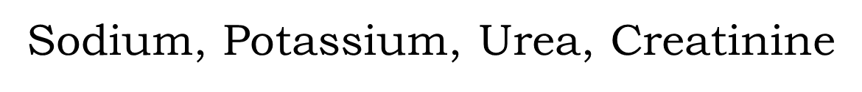
What are considered small-sized molecules?
FILTRATE
FILTRATE
FILTRATE
FILTRATE
Venous
ARTERIAL
Na
Return
ACCESS
Red blood cells, white blood cells,
bacteria and virus’ are larger & get left behind
Notes:
The size of the pores in the membrane determines what solutes can be washed to the other side. Small solutes such as amino acids, glucose, vitamins, small plasma proteins, ammonia, urea and electrolytes are able to move through the semipermeable membrane. This is in contrast to the larger molecules such as blood cells, most plasma proteins and platelets, which are too large to cross the membrane. (Tortora and Grabowski 2000:961)

Slide 7
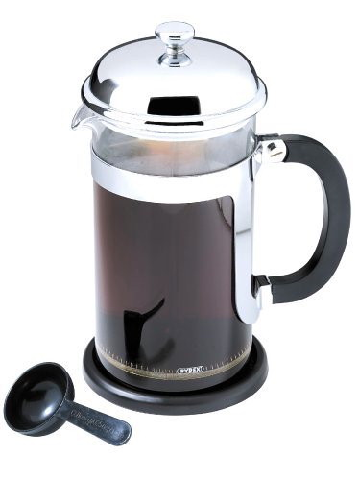
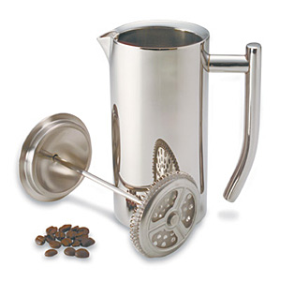
CONVECTION
MOVEMENT OF FLUID ACROSS A SEMI-PERMEABLE MEMBRANE CREATING SOLUTE DRAG
“ACTIVE TRANSPORT MECHANISM”
GOOD FOR SMALL AND MIDDLE SIZE MOLECULES
Notes:
This filtration process is much like the making of espresso or cappuccino. In a cappuccino machine, water is forced under pressure through a fine sieve containing ground coffee; the filtrate is the brewed coffee

Slide 8
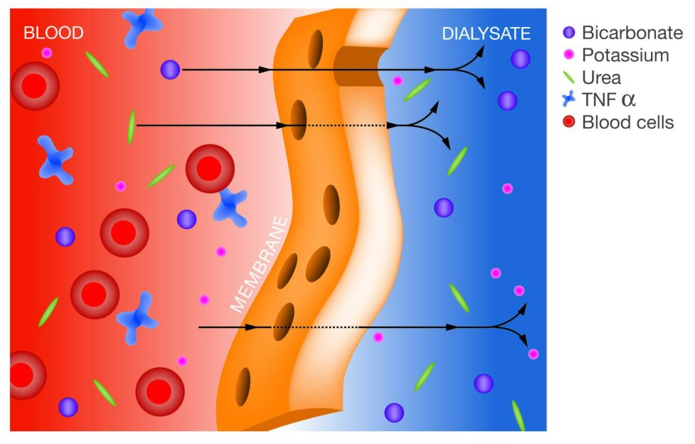
Diffusion
The movement of solutes across a semi-permeable membrane through a concentration gradient
Notes:
Movement of solutes from an area of high concentration to an area of low concentration until the concentration of solutes is equalised on both sides of the membrane.

Slide 9
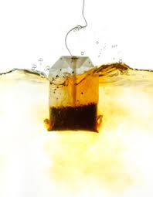
Diffusion
“PASSIVE TRANSPORT MECHANISM”
SIZED MOLECULES GOOD FOR SMALLER
Notes:
The Diffusive rate is dependent upon
a) The Size of the solute (bigger molecules move more slowly than smaller ones)
b) The distance across which diffusion takes place (the shorter the distance, the quicker the process). I.e. the thicker the membrane the slower the movement of solutes
c) Pore size and surface area of the membrane

Slide 10
Dialysate Flow Same as Blood
3 3 3 3.5 3 4 2.5 2
3 3 3 4 4.5 5 6 6.5
3 3 3 3.5 3 4 2.5 2
Notes:
Equilibrium is reached in the middle of the filter and no more net transport occurs across the filter

Slide 11
Counter Current Principal
2 2.5 3 3.5 4 4.5 5 5.5
2.5 3 3.5 4.0 4.5 5 6 6.5
2 2.5 3 3.5 4 4.5 5 5.5

Slide 12
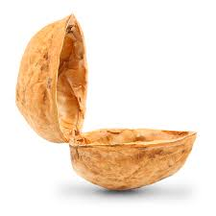
In a nutshell…
Waste & Solutes removed by Diffusion & Convection
Water removed by Ultrafiltration

Slide 13
CRRT Modes

Slide 14
CVVH
Continuos Veno-Venous Haemofiltration

Slide 15
CVVH
Blood is circulated through a highly permeable haemofilter via an extracorporeal circuit
Plasma water, small and middle sized solutes are pulled from the patients blood and into the waste/filtration bag by ultrafiltration and convection (solute drag)
Fluid is replaced into the patients blood at an equal or lower rate to achieve desired fluid loss

Slide 16
Convection/Ultrafiltration
The movement of plasma water across a semi-permeable membrane creates a solute drag.
As fluid is pulled across the membrane solutes dissolved in the fluid are taken with it.
Small and middle sized molecules are removed

Slide 17
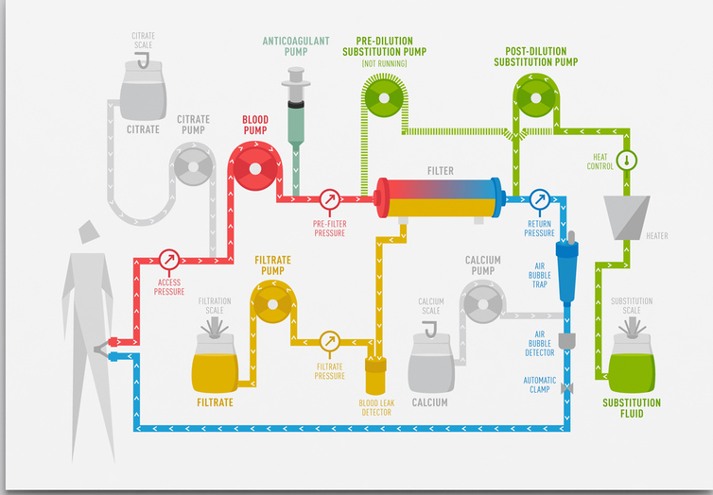

Slide 18
CVVHD
Continuos Veno-Venous HaemoDialysis

Slide 19
CVVHD
Blood is circulated through a highly permeable haemofilter or dialyser via an extracorporeal circuit
Small solutes diffuse out of the patients blood and into the dialysate solution, or out of the dialysate solution and into the patients blood eg electrolytes

Slide 20
Diffusion
The movement of solutes across a semi-permeable membrane through a concentration gradient
Small sized molecules are removed

Slide 21
Counter Current Principal
2 2.5 3 3.5 4 4.5 5 5.5
2.5 3 3.5 4.0 4.5 5 6 6.5
2 2.5 3 3.5 4 4.5 5 5.5

Slide 22
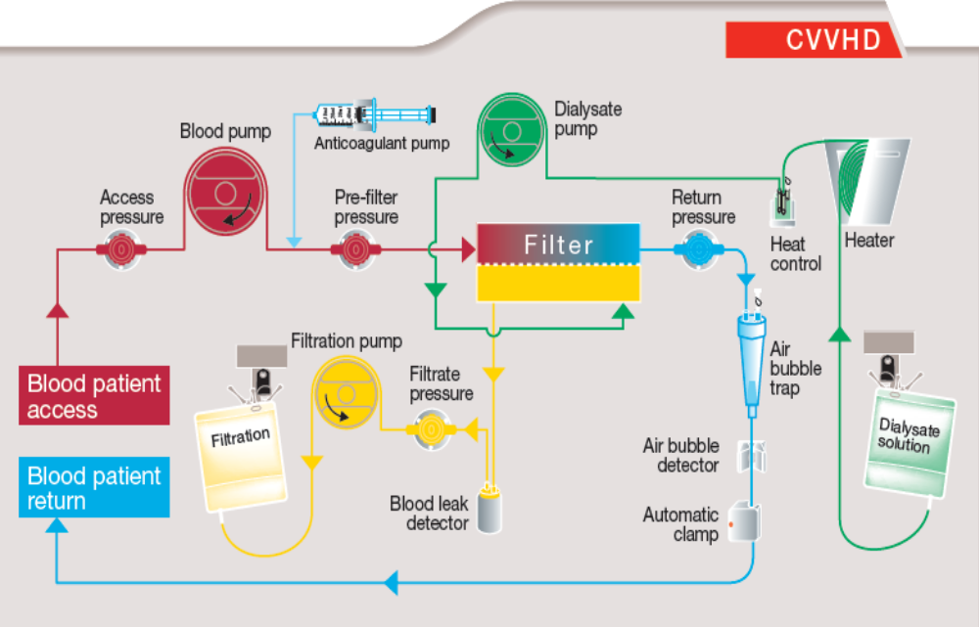
Continuous Veno-venous Haemodialysis

Slide 23
CVVHDF
Continuos
Veno-Venous Haemo-DiaFiltration

Slide 24
CVVHDF
Blood is circulated through a highly permeable haemofilter via an extracorporeal circuit
Plasma water, small and middle sized molecules are removed from the patients blood by ultrafiltration and convection.
Small solutes diffuse from the patients blood into a dialysate solution
Some fluid is replaced into the patients blood to achieve desired fluid balance

Slide 25
Diffusion and Convection
The movement of solutes across a semi-permeable membrane through a concentration gradient
The movement of fluid across a semi-permeable membrane creating solute drag
As fluid is pulled across the membrane solutes dissolved in the fluid are taken with it
Small and middle sized solutes are removed

Slide 26
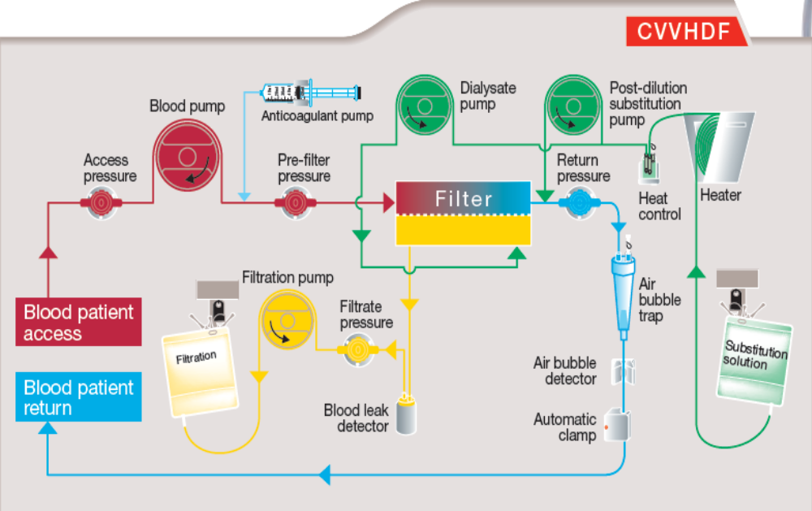
Continuous Veno-Venous Haemodiafiltration
Notes:
During CVVHDF blood is driven through a highly permeable haemofilter using veno-venous access and integral pump. A dialysis solution is delivered in a counter-current direction to the blood flow within the fluid compartment. The Ultrafiltrate rate is in excess of the patients desired weight loss. Solute clearance is both convective and diffusive. Replacement fluid is required to obtain desired fluid balance pumped either post or pre-filter.

Slide 27
Summary
The kidney works hard to maintain homeostasis
CRRT can replace some but not all of these functions through removal of water & solutes
It takes time & practice to get the hang of renal replacement therapy concepts & delivery
So…

Slide 28


Slide 29
CONVECTION
When a solution is moving (ultrafiltration), the solutes dissolved will move also (solvent drag). The faster the flow the better the clearance.
The Solute Transport is directly proportional to the solvent transport (the solvent transport in turn, depends on the pressure gradient). Also influenced by the permeability (pore size) of the membrane.
For middle-size solutes, where diffusion is slow, convection is the sole principle transport mechanism.
The clearance of the solute is dependent on
a) The amount of ultrafiltration
b) The concentration of the solute in plasma
c) The sieving characteristics of the membrane for the solute
Notes:
When a solution is moving (ultrafiltration), the solutes dissolved will move also (solvent drag). The faster the flow the better the clearance.
The Solute Transport is directly proportional to the solvent transport (the solvent transport in turn, depends on the pressure gradient). Also influenced by the permeability (pore size) of the membrane.
For middle-size solutes, where diffusion is slow, convection is the sole principle transport mechanism.
The clearance of the solute is dependent on a) The amount of ultrafiltration
b) The concentration of the solute in plasma
c) The sieving characteristics of the membrane for the solute

Slide 30
SCUF
Slow Continuos UltraFiltration

