Slide 1
Renal Anatomy & Physiology
Catherine Jones
June 2019

Slide 2
Learning Outcomes
To understand basic functions of renal system
To revise anatomy & physiology of kidney in health

Slide 3
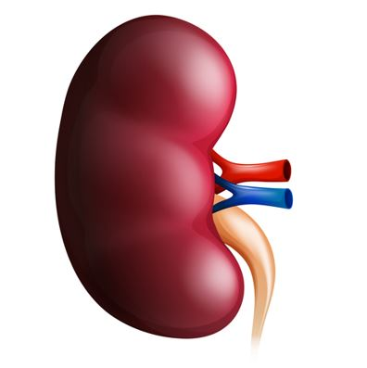
FUNCTIONS OF THE KIDNEY???
Notes:
Many, many functions so if the kidney goes wrong it has multisystemic effects
6 bloods; 2 hormones & waste

Slide 4
Functions of the Kidney: 6 Bloods
  Regulation of blood ions
    Na+; K+; Ca2+; Cl-
  Regulation of blood pH
    Excretes variable amount of H+ ions into urine
    Conserves HCO3- (buffers H+ ions)
  Regulation of blood volume
    Ultrafiltration / reabsorption of water
  Regulation of blood pressure
    Through adjustment of blood volume..
    Activation of RAAS & renin secretion
  Regulation of blood osmolarity
    Control of water & solute loss
  Regulation of blood glucose
    Role in gluconeogenesis
Notes:
Fluid Balance
Ultrafiltration/Reabsorption of H20
Electrolyte Balance
Reabsorption/Excretion of ions Ca, Na, K+, PO4, Cl
Acid Base Balance
Variable loss of hydrogen ions; able to conserve HCO3 – important buffer of H+
Waste Excretion
Drugs
Metabolic by-products – Amonia & Urea from deanimation of amino acids; bilirubim from breakdown of Hb; nitrogen, Urea, Creatinine)
Blood Pressure regulation
RAAS pathway (Na retention & Vasoconstriction)
Erythropoiten synthesis
Stimulates bonemarrow to produce RBCs
Vitamin D synthesis
Regulation of calcium
Gluconeogensis – non-carbs to form glucose here glutamine amino acid

Slide 5
Functions of the Kidney: 2 Hormones
  Production of Calcitrol
    Active form of Vit D – helps to regulate calcium homeostasis
  Production of Erythropoietin
    Stimulates production of RBCs
Notes:
Fluid Balance
Ultrafiltration/Reabsorption of H20
Electrolyte Balance
Reabsorption/Excretion of ions Ca, Na, K+, PO4, Cl
Acid Base Balance
Variable loss of hydrogen ions; able to conserve HCO3 – important buffer of H+
Waste Excretion
Drugs
Metabolic by-products – Amonia & Urea from deanimation of amino acids; bilirubim from breakdown of Hb; nitrogen, Urea, Creatinine)
Blood Pressure regulation
RAAS pathway (Na retention & Vasoconstriction)
Erythropoiten synthesis
Stimulates bonemarrow to produce RBCs
Vitamin D synthesis
Regulation of calcium
Gluconeogensis – non-carbs to form glucose here glutamine amino acid

Slide 6
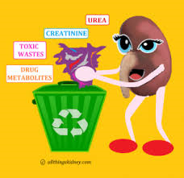
Functions of the Kidney: Waste
  Formation of Urine facilitates removal of waste – substances that have no useful function in the body
    Ammonia & Urea from breakdown of amino acids
    Bilirubin from breakdown of HB
    Creatinine from muscle metabolism
    Foreign substances – diet,drugs..
Notes:
Fluid Balance
Ultrafiltration/Reabsorption of H20
Electrolyte Balance
Reabsorption/Excretion of ions Ca, Na, K+, PO4, Cl
Acid Base Balance
Variable loss of hydrogen ions; able to conserve HCO3 – important buffer of H+
Waste Excretion
Drugs
Metabolic by-products – Amonia & Urea from deanimation of amino acids; bilirubim from breakdown of Hb; nitrogen, Urea, Creatinine)
Blood Pressure regulation
RAAS pathway (Na retention & Vasoconstriction)
Erythropoiten synthesis
Stimulates bonemarrow to produce RBCs
Vitamin D synthesis
Regulation of calcium
Gluconeogensis – non-carbs to form glucose here glutamine amino acid

Slide 7
ANATOMY OF THE KIDNEY
Notes:
Many, many functions so if the kidney goes wrong it has multisystemic effects

Slide 8
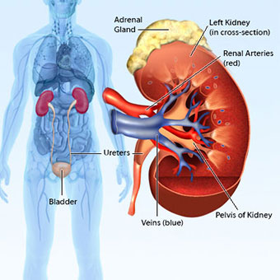
2 bean shaped organs
Located above the waist between the peritoneum & posterior wall of abdomen - Retroperitoneal
Located b/w last thoracic & 3rd lumbar vertebrae – partial protection from ribs
Size of a fist or bar of soap– 110-170g.
Receive 1.2l blood every minute
  72L per hour
    1728L per day
25% Cardiac output!
Notes:
Rib cage offers some protection to kidneys
Right kidney slightly lower than left because of the liver

Slide 9
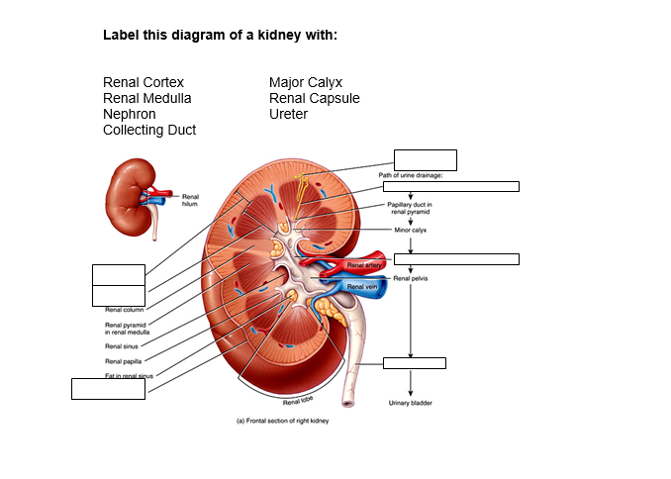

Slide 10
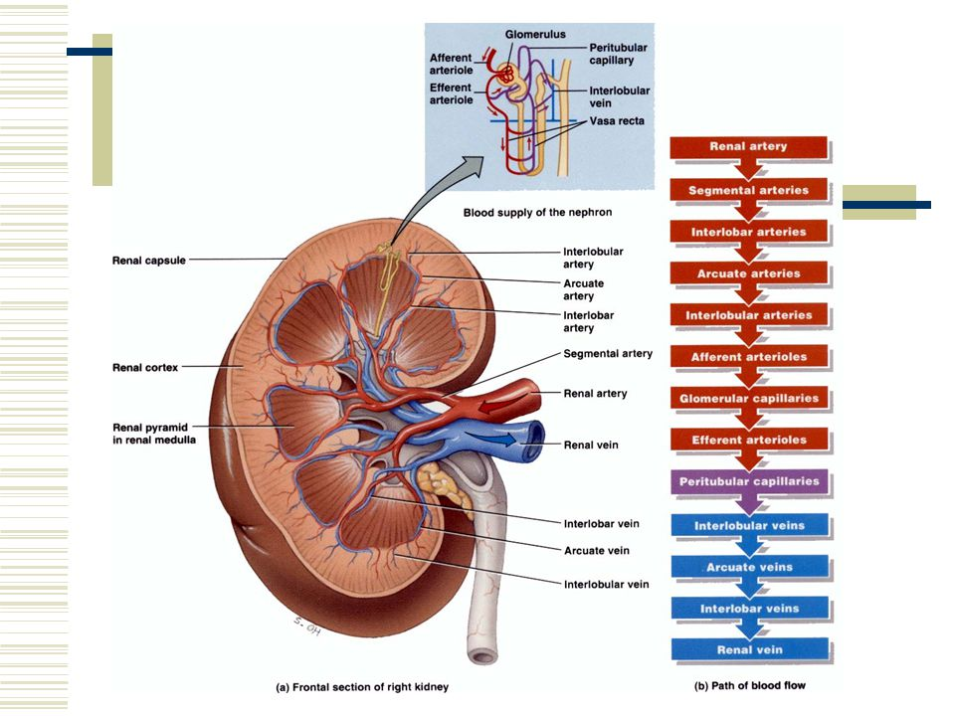
BLOOD SUPPLY

Slide 11
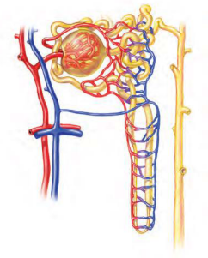
The Nephron
Functional unit of the kidney
About I million nephrons within each kidney
Each nephron contains
  Renal Corpuscle (Glomerulus & Bowmans Capsule) where blood plasma is filtered
  Renal Tubule which collects filtrate
Notes:
Cortical nephron
70-80% of nephrons
Glomerulus in outer cortical layer
Shorter loop of henle
Juxtamedullary
20-30% of nephrons
Glomerulus closer border b/w cortex & medulla
Longer loop of henle

Slide 12
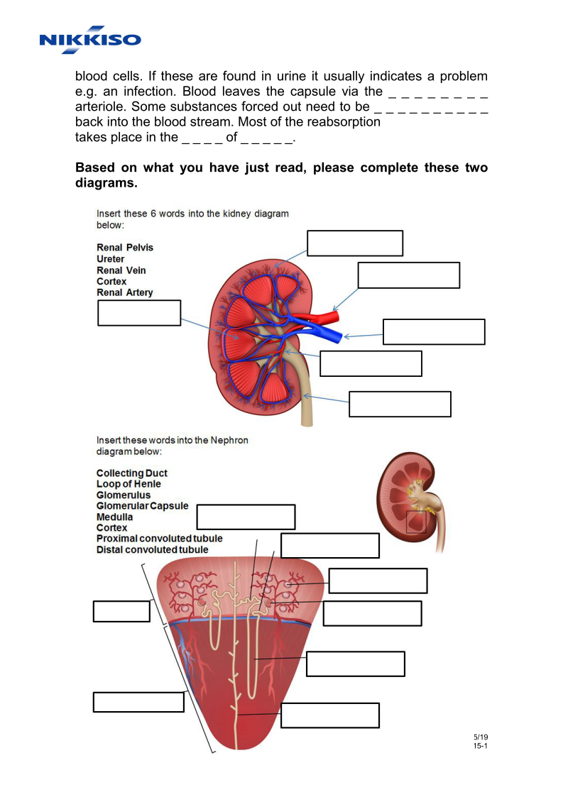
Notes:
Renal Tubule consists of :
Proximal convoluted tubule important for helping kidneys to reabsorb water/solutes
Loop of henle (Descending & Ascending Limbs)
Distal Convoluted tubule
2 types:
Corticol nephron
Juxtamedullary nephron
Cortical nephron
70-80% of nephrons
Glomerulus in outer cortical layer
Shorter loop of henle
Juxtamedullary
20-30% of nephrons
Glomerulus closer border b/w cortex & medulla
Longer loop of henle

Slide 13
OVERVIEW OF RENAL PYSIOLOGY
Notes:
Many, many functions so if the kidney goes wrong it has multisystemic effects

Slide 14
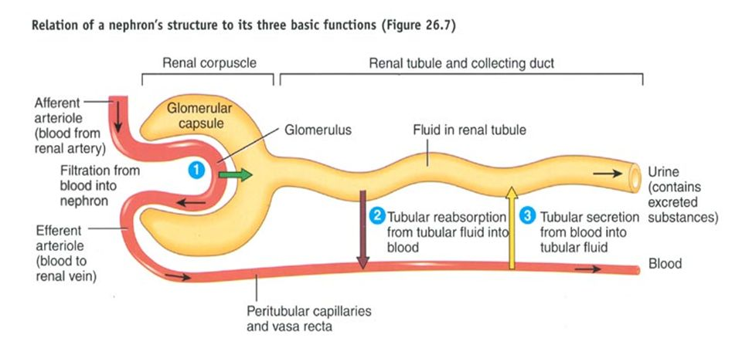
Each Nephron performs 3 Basic Functions:
GLOMERULAR FILTRATION
TUBULAR REABSORPTION
TUBULAR SECRETION

Slide 15
Glomerular Filtration
blood flows through the afferent arteriole into the glomerular capsule.
It is here that water and most solutes in plasma pass from blood across the wall of the glomerular capillaries into the glomerular capsule. Blood leaves the capsule via the efferent arteriole.

Slide 16
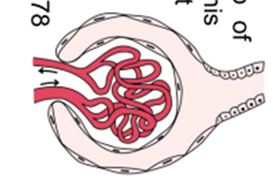
Glomerular Filtration
Large Capillary tuft in glomerulus provides large surface area for filtration
Filtration membrane is thin & porous allowing passage of smaller solutes
Afferent arteriole has a larger lumen than the efferent arteriole.
  Blood flow into the glomerulus is faster than flow out
  Creates pooling – hydrostatic pressure.
  Pushes fluid & solutes out to tubules - FILTRATION
Notes:
Produces about 180 litres of filtrate per day; Only 1.5-2 litres out as urine
Impermeable to molecules >70,000 daltons – prevents passage of RBC, platelet, plasma proteins

Slide 17
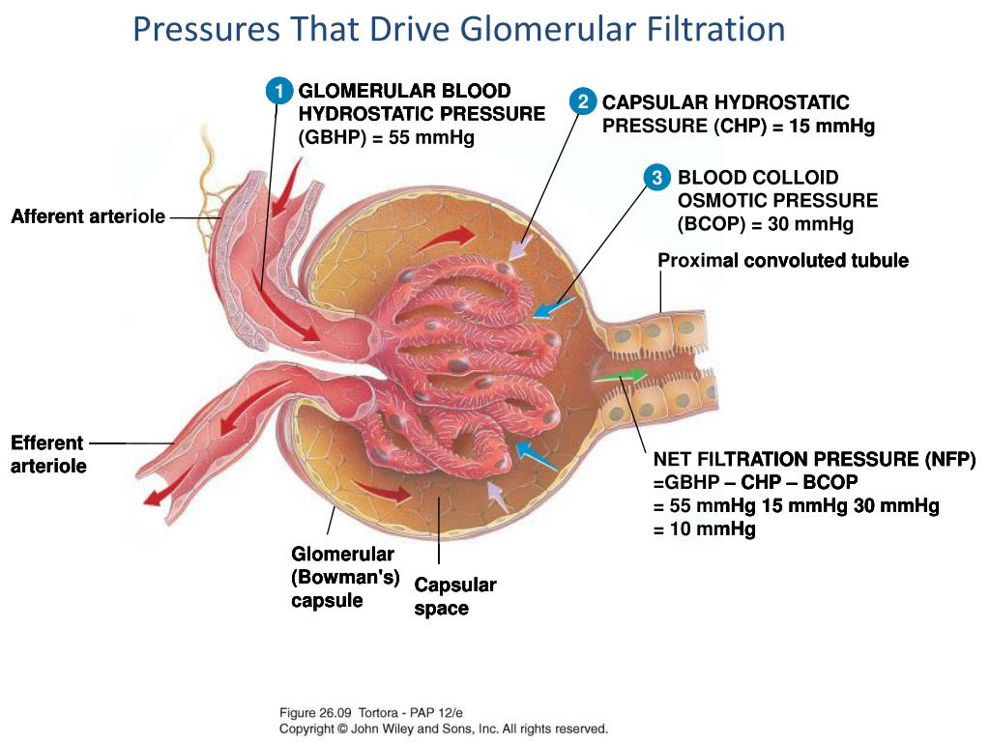

Slide 18
SO, WHAT HAPPENS IF….
Your patients’ BP falls…?
If the hydrostatic pressure of blood in glomerulus falls until it is equal to or less than the sum of capsular & osmotic pressures – filtration can’t occur

Slide 19
Glomerular Filtration Rate (GFR)
Amount of filtrate produced in renal corpuscle of both kidneys
  Men –125ml/min; Women 105 ml/min
Homeostasis requires fairly constant GFR
  TOO HIGH? Filtrate passes too quickly through renal tubules leaving insufficient time for reabsorption on necessary substances
  TOO LOW? Nearly all filtrate substances reabsorbed resulting in inadequate excretion of waste products

Slide 20
2.
Tubular Reabsorption
this system returns most of the filtered water and many of the filtered solutes back to the blood. In fact about 99% of the approximate 180 litres of filtrate is returned to the blood stream. Solutes that are reabsorbed, both actively and passively include:
HC⁰³
Phosphate
Amino Acids
Glucose
Ca²
Na
Cl
Urea
K⁺
Notes:
Most filtered water & some solutes are REABSORBED from tubule to blood.
Mostly happening in proximal convoluted tubule – 65% filtered water

Slide 21
3.
Tubular Secretion
as fluid moves along the tubule and through the collecting duct, waste products, (such as excess ions and drugs) are added into the fluid.
(Tortora and Grabowski, 2000:914-915)
Notes:
As fluid moves along the tubule waste products, drugs, excess ions are secreted from blood to the tubules.
End product is urine – 1-2litres per day excreted

Slide 22
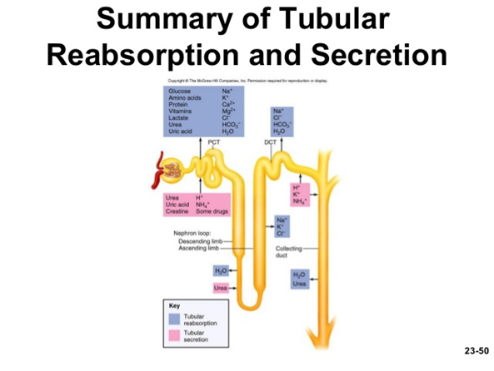

Slide 23
Hormonal Regulation of Tubular Reabsorption & Secretion
Renin-Angiotensin-Aldosterone System (RAAS)
Anti Diuretic Hormone (ADH)
Atrial Natriuretic Peptide (ANP)

Slide 24
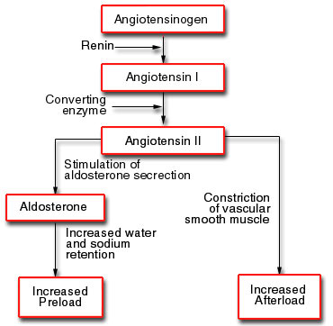
Renin-Angiotensin-Aldosterone System
Notes:
Angio 2:
Decreases GFR by constricting afferent arteriole
Promotes reabsorption of Na+ , Cl & H20 in PCT
Stimulates adrenal cortex to release ALDOSTERONE.
Aldosterone:
Reabsorn Na+, Cl, Secrete K+ ---- excrete less water ---- Increased Blood volume

Slide 25
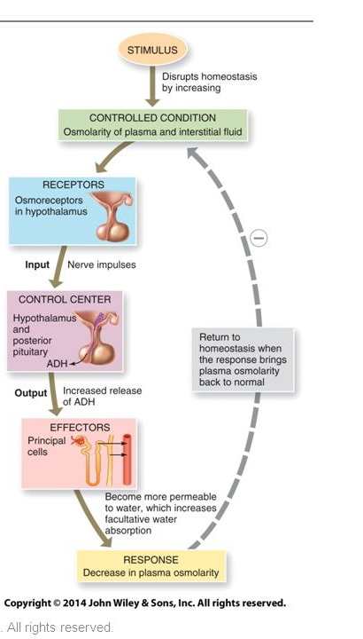
Anti Diuretic Hormone (Vasopressin)
Osmoreceptors detect increase in osmotic pressure i.e. water concentration decreases
ADH released
Stimulates water reabsorption

Slide 26
Atrial Natriuretic Peptide
Increase in blood volume prompts release of ANP from heart
Inhibits reabsorption of Na+ & water in PCT & collecting duct
Suppresses the secretion of aldosterone & ADH
Increases excretion of Na+ & increases diuresis
Decreases blood volume & blood pressure

Slide 27
Summary
The kidney works hard to maintain homeostasis
CRRT can replace some but not all of these functions through removal of water & solutes
It takes time & practice to get the hang of renal replacement therapy concepts & delivery
So…

Slide 28
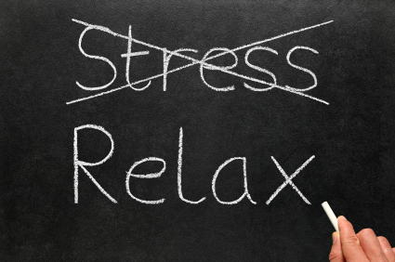

Slide 29
CONVECTION
When a solution is moving (ultrafiltration), the solutes dissolved will move also (solvent drag). The faster the flow the better the clearance.
The Solute Transport is directly proportional to the solvent transport (the solvent transport in turn, depends on the pressure gradient). Also influenced by the permeability (pore size) of the membrane.
For middle-size solutes, where diffusion is slow, convection is the sole principle transport mechanism.
The clearance of the solute is dependent on
a) The amount of ultrafiltration
b) The concentration of the solute in plasma
c) The sieving characteristics of the membrane for the solute
Notes:
When a solution is moving (ultrafiltration), the solutes dissolved will move also (solvent drag). The faster the flow the better the clearance.
The Solute Transport is directly proportional to the solvent transport (the solvent transport in turn, depends on the pressure gradient). Also influenced by the permeability (pore size) of the membrane.
For middle-size solutes, where diffusion is slow, convection is the sole principle transport mechanism.
The clearance of the solute is dependent on a) The amount of ultrafiltration
b) The concentration of the solute in plasma
c) The sieving characteristics of the membrane for the solute

Slide 30
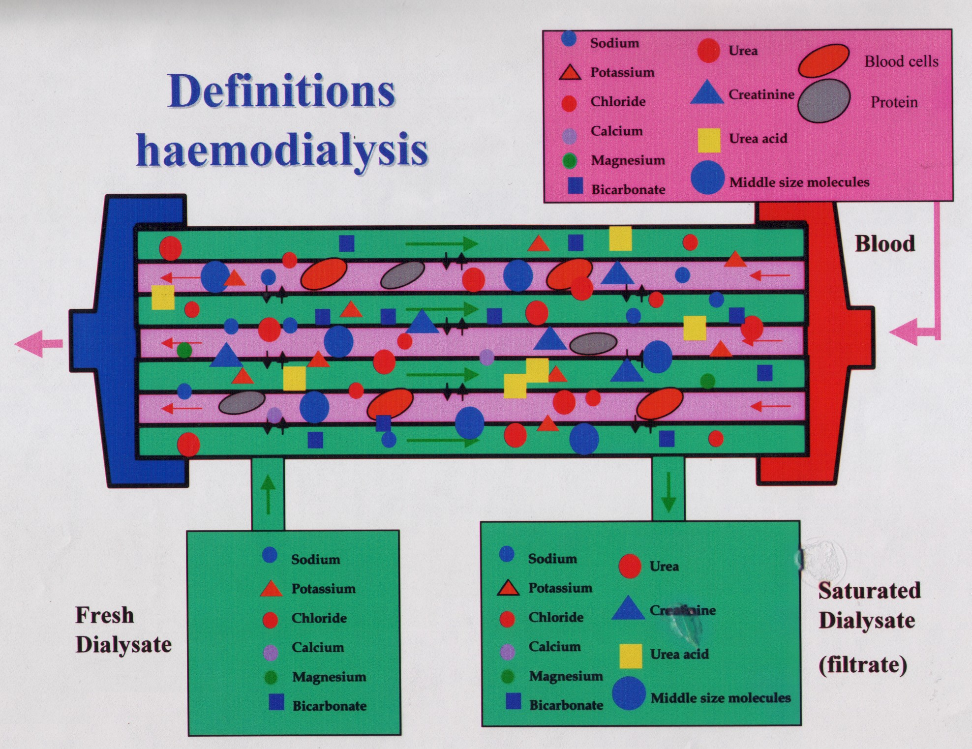
Notes:
What are considered small-sized molecules?
Sodium, Potassium, Chloride, Calcium, Magnesium, Bicarbonate – all contained within dialysate/replacement fluid
Urea + Creatinine
The unit of measurement of the solutes is Daltons (da) sometimes shown as Kilo-dalton (Kda)
What are considered middle-sized molecules?
Inflammatory Mediators + Cytokines + certain drugs

Slide 31
Structure
Notes:
Renal cortex – outer layer
Renal medulla – inner layer made up of pyramid like cones
Renal cortex & medulla house the million nephrons that live in the kidneys
Urine formed by the nephrons drains to renal pelvis (via collecting duct; papillary duct; minor & major calyx)
Ureter then takes wee from renal pelvis to the bladder,
Blood supply in through renal artery & out through renal vein

Slide 32
Control of GFR:
Renal Autoregulation
  Myogenic Mechanism:
  Increase stretch on smooth muscle of afferent due to ↑ BP → contraction of smooth muscle reducing diameter of afferent arteriole → reduced GFR
  Tubuloglomerular Feedback:
  Tubular Cells lying close to afferent/efferent arterioles sense rapid delivery of Na+ & Cl- through system due to ↑ BP → Inhibits release of Nitroc Oxide (NO) → afferent arteriole contriction
Neural Regulation
Hormonal Regulation

Slide 33
Tubular Reabsorption
The largest amount of solute & water reabsorption happens in the proximal convoluted tubules which is always permeable to water.
Water/Solutes are reabsorbed to nearby peritubular capillaries
Na+ & Cl- move across increasing solute concentration in peritubular blood causing water to also move across from filtrate to blood by osmosis
Notes:
PCT reabsorption reduces filtrate by 75-80%

Slide 34
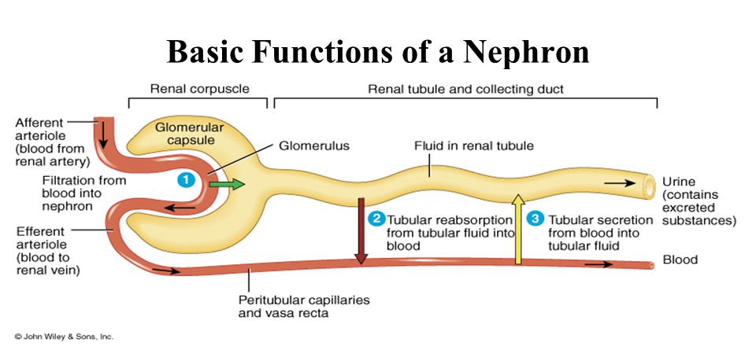

Slide 35
