Slide 1
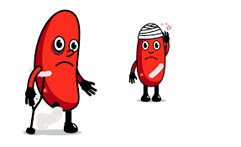
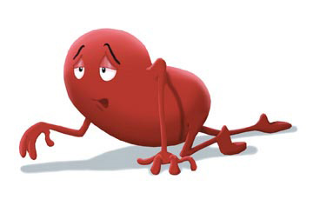
ACUTE KIDNEY INJURY & CHRONIC KIDNEY DISEASE
Notes:
Critically ill pts will either present with AKI as single organ failure ie primary problem or develop AKI as part of MOF

Slide 2
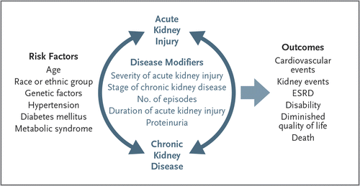
Relationship between AKI & CKD
Chawla et al (2014) Acute Kidney Injury & Chronic Kidney Disease as Interconnected Sydromes NEJM 371 58-66
Notes:
AKI & CKD have similar risk factors Age, race, diabetes
Pre-existing CKD is important risk factor for AKI can increase risk of developing AKI by 10times
AKI is a risk factor for CKD even when there is no pre-existing disease & regradless of cause of AKI – even mild cases of AKI can go on to develop new CKD; where there is existing CKD there is an increased lomg term risk of ESRF & excess mortality
3. Bothe are risk factors for CVS events – MI; vessel occlusion
Most important risk factor for AKI is CKD

Slide 3

CHRONIC KIDNEY DISEASE
Definition & Staging
Causes
Complications
Management
Notes:
Critically ill pts will either present with AKI as single organ failure ie primary problem or develop AKI as part of MOF

Slide 4
Definition
‘CKD is defined as abnormalities of kidney structure or function, present for ˃3 months, with implications for health’
KDIGO (2012) Clinical Practice Guideline for the Evaluation and Management of Chronic Kidney Disease Kidney International Supplements 3
Notes:
Most causes of CKD are irreversible with a life-long course, and treatment aimed at slowing progression to kidney failure.

Slide 5
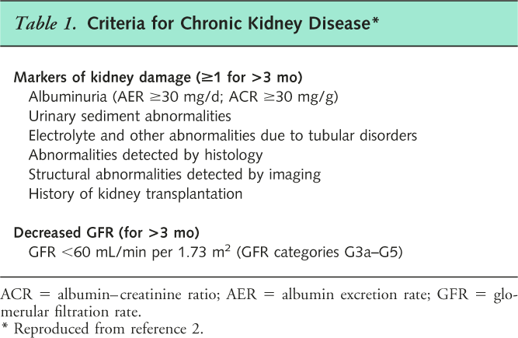
Definition

Slide 6
eGFR Calculator
from the UK CKD eGuide on the Renal Association website
eGFR CalculatorCreatinine: micromol/l
Age: years
Sex: MaleFemale
Race: Black Other

Slide 7
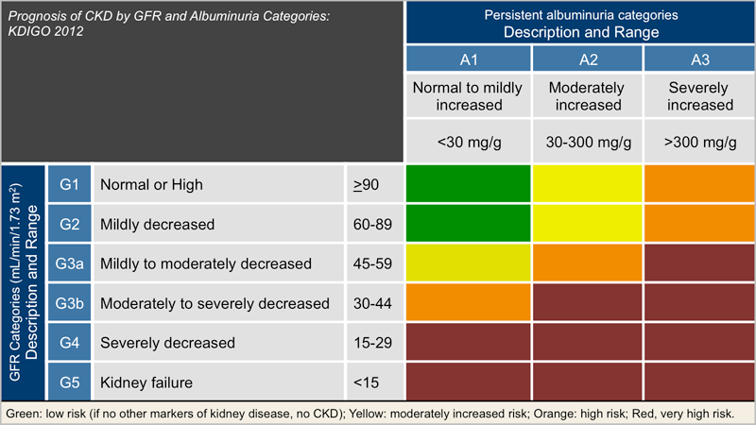
STAGING OF CKD
1.2.1: We recommend that CKD is classiﬁed based on cause, GFR category, and albuminuria category (CGA).

Slide 8
Stages of chronic kidney disease from NICE CG 169
Stage | eGFR (ml/min/1.73m²⁾ | Desciption | Qulaifier
1 | >90 | Kidney damage, normal or increased GFR | Kidney damage (presence of structural abnormalities and /or persistant haematuria, proteinuria or microalbuminuria) for > 3 months
2 | 60-89 | Kidney damage, mildly reduced GFR
3A 3B | 45-49 30-44 | Moderately reduced GFR +_ other evidence of kidney damage | GFR <60ml/min for >3 months +_ kidney damage
4 | 15-29 | Severely reduced GFR+_ other evidence of kidney damage
5 | <15 | Established kidney failure

Slide 9
Classification of CKD by Diagnosis
Diabetic Kidney Disease
Glomerular diseases (autoimmune diseases, systemic infections, drugs, neoplasia)
Vascular diseases (renal artery disease, hypertension, microangiopathy)
Tubulointerstitial diseases (urinary tract infection, stones, obstruction, drug toxicity)
Cystic diseases (polycystic kidney disease)
Diseases in the transplant (Allograft nephropathy, drug toxicity, recurrent diseases, transplant glomerulopathy)

Slide 10
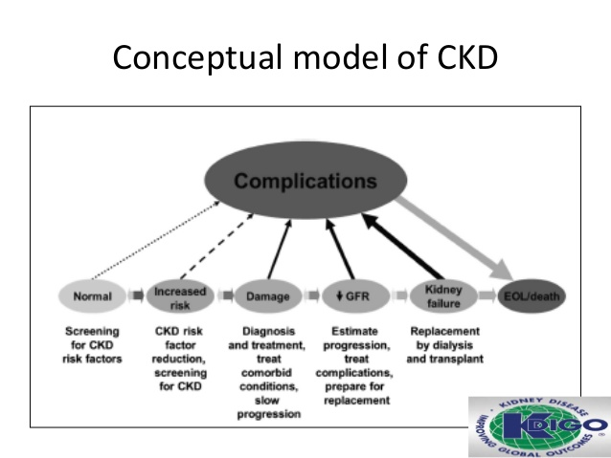
Notes:
Figure 1|Conceptual model of CKD. Continuum of development, progression, and complications of CKD and strategies to improve outcomes. Horizontal arrows between circles represent development, progression, and remission of CKD. Left-pointing horizontal arrowheads signify that remission is less frequent than progression. Diagonal arrows represent occurrence of complications of CKD, including drug toxicity, endocrine and metabolic complications, cardiovascular disease, and others such as infection, cognitive impairment, and frailty. Complications might also arise from adverse effects of interventions to prevent or treat the disease. CKD, chronic kidney disease; EOL, end-of-life care and/or conservative management; GFR, glomerular filtration rate. Adapted from Levey AS, Stevens LA, Coresh J.6 Conceptual model of CKD: applications and implications. Am J Kidney Dis. 2009; 53:S4-16 with permission from the National Kidney Foundation; accessed http://download.journals. elsevierhealth.com/pdfs/journals/0272-6386/PIIS02726386080 17186.pd

Slide 11
What kills you in CKD?
CVS Events
Sepsis
Fluid overload
Hyperkalaemia
Coma

Slide 12
Side Effects of CKD
Cardiovascular
Hypertension
Heart Failure
Dysrhythmias
Pericarditis
Anaemia
Prolonged bleeding
Neurological
Neuropathy
Twitching
Tremor
Reduced visual acuity
Itching

Slide 13
Side Effects
Skeletal
Renal Osteodystrophy
Bone pain
Growth retardation
Other
Compromised Immunity
Infertility
Diarrhoea and Vomiting
Haematuria
Notes:
Osteodystropy – defective bone development

Slide 14
Renal Osteodystrophy
↓ vitamin D
conversion ↓Ca²⁺ ↑PO₄²⁻
Hyperparathyroidism
Bone Resorption
(to normalise serum Ca)
Osteoporosis, Bone Cysts, Fractures
Notes:
Kidneys no longer make calcitriol from vit D and also fail to excrete PO4

Slide 15
NICE CG 157
Management of hyperphosphataemia in patients with stage 4 or 5 CKD is required.
High serum phosphate levels can directly and indirectly increase parathyroid hormone secretion, leading to the development of secondary hyperparathyroidism.
Left untreated, secondary hyperparathyroidism increases morbidity and mortality and may lead to renal bone disease, with people experiencing bone and muscular pain, increased incidence of fracture, abnormalities of bone and joint morphology, and vascular and soft tissue calcification.
Hyperphosphataemia in chronic kidney disease NICE clinical guideline 157

Slide 16
Conservative Management
BP Control
Diabetes management
Dietary and fluid restrictions
Erythropoeitin
Relief of itching and GI symptoms
Treat metabolic bone disease
Conservative management may slow progression to ERF but cannot prevent it.

Slide 17
Management of Established Renal Failure
All of the above plus one of:
Peritoneal Dialysis
Haemodialysis
Transplantation
Notes:
Recipients are given one kidney
It must be a tissue-type match (= longer cold ischemic time except in live donation)
Lifelong immunosupression & monitoring
The first implant will last for 10 - 15 years if all goes well
Subsequent transplants will last for shorter and shorter periods.

Slide 18
ACUTE KIDNEY INJURY
Definition & Staging
Incidence & Outcome
Causes
Complications
Management
Notes:
Critically ill pts will either present with AKI as single organ failure ie primary problem or develop AKI as part of MOF

Slide 19
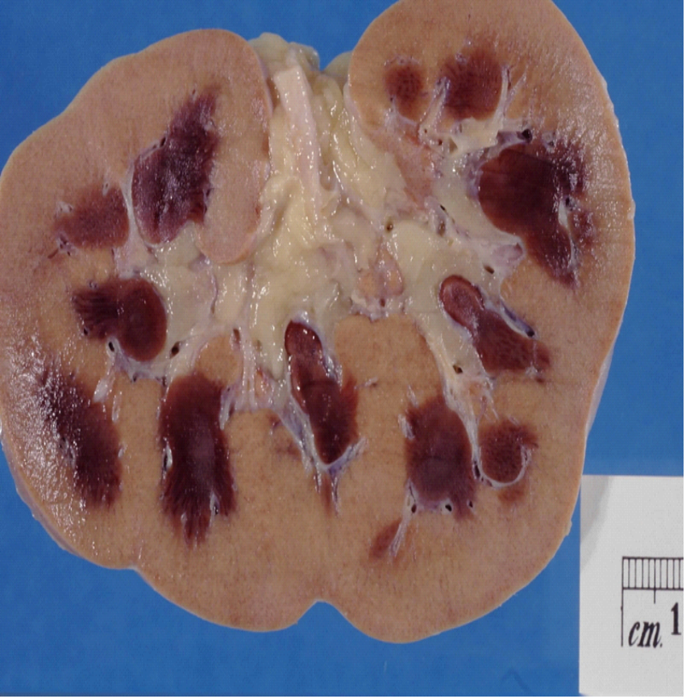
Definition
“Rapid loss of kidney function resulting in failure to maintain fluid, electrolyte and acid base homeostasis”
(The Renal Association 2010)

Slide 20
What is happening in the body?
Increased urea and creatinine
Decreased urine output
LATER SIGNS
metabolic acidosis
increased potassium
increased extracellular fluid

Slide 21
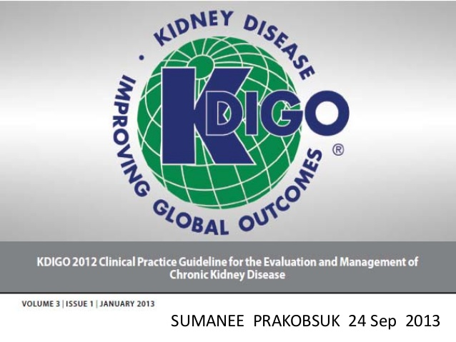
Definition: KDIGO 2012
  Serum creatinine ↑ by ≥ 26µmol/L in 48hours or
  Serum creatinine ↑ by ≥ 1.5 times baseline in a week (known or presumed) or
  Urine Output < 0.5ml/kg/hr for over 6 hours
Notes:
Increase in Screat of 26 umol idependently associated with mortality.
Relationship b/w U/O, GFR, tubular injury is complicated. Low U/O can be a sign of renal success as kidneys respond to hypovolaemia by concentrating & holding onto volume.
Broad def proposed by KDIGO hopes to catch whole spectrum from kidney injury to impairment.
Small changes in kidney function are important & associated with changes to short term & longterm mortality

Slide 22
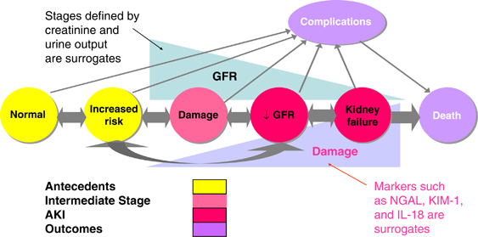
Conceptual model for AKI
KDIGO (2012) Clinical Practice Guideline for Acute Kidney Injury Kidney International 2
Notes:
Conceptual model for AKI. Red circles represent stages of AKI. Yellow circles represent potential antecedents of AKI, and the pink circle represents an intermediate stage (not yet defined). Thick arrows between circles represent risk factors associated with the initiation and progression of disease that can be affected or detected by interventions. Purple circles represent outcomes of AKI. “Complications” refers to all complications of AKI, including efforts at prevention and treatment, and complications in other organ systems. AKI, acute kidney injury; GFR, glomerular filtration rate. Adapted from Murray PT, Devarajan P, Levey AS, et al. A framework and key research questions in AKI diagnosis and staging in different environments. Clin J Am Soc Nephrol 2008; 3: 864–868 with permission from American Society of Nephrology45 conveyed through Copyright Clearance Center, Inc.; accessed http://cjasn.asnjournals.org/content/3/3/864.full
Circles on horizontal axis depict stages in development
AKI is defined as loss of kidney function & Decreased GFR. The staging of severity based on SCr & U/O as surrogates for GFR are shown in triangle above the circles – Acknoeldges that GFR can be compromised before this shows up in SCr & U/O

Slide 23
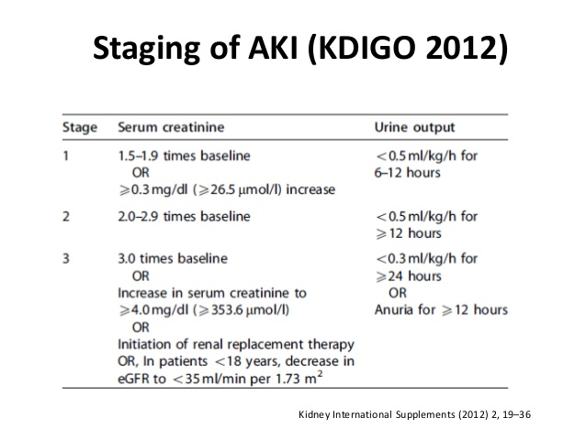

Slide 24
Incidence & Outcomes
Difficult to ascertain due to historical prolonged discussion relating to criteria to define AKI (RIFLE; AKIN)
Chertow et al (2005) Acute Kidney Injury, Mortality, Length of Stay, and Costs in Hospitalized Patients JASN 16
No such thing as a little bit of renal failure!
Rise in SCr | Multivariate OR Hospital Mortality | Increase LOS
≥ 26.4 umol/L | 4.1
≥ 45 umol/L | 6.5 | 3.5 days
≥ 90 umol/L | 9.7 | 5.8 days
≥ 180 umol/L | 16.4 | 7.9 days

Slide 25
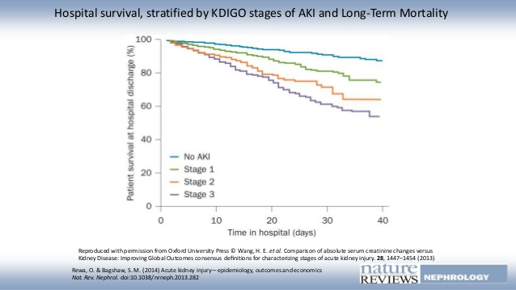
Correlation between AKI classification and outcome

Slide 26
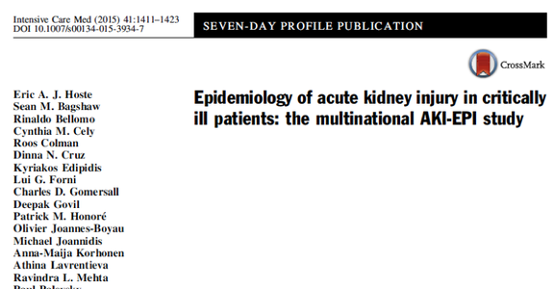
Incidence & Outcomes
Prospective international study in 97 centres during 1st week of ICU stay – 1,802 patients.
KDIGO Stage | 0ccurence Rate | Mortality (Odds ratio)
1 | 18.4% (331 pts) | 2.19
2 | 8.9% (161 pts) | 3.88
3 | 30% (540 pts) | 7.18
Notes:
2015

Slide 27
Aetiology
Cause | %
Sepsis | 40.7%
Hypovolaemia | 34.1%
Drug Related | 14.4%
Cardiogenic Shock | 13.2%
Hepatorenal Failure | 3.2%
Obstruction of urine outflow | 1.4%
Hoste et al (2015) Epidiemiology of acute kidney injury in critically ill patients: the multinational AKI-EPI study ICM 41

Slide 28

Causes of AKI
‘It is axiomatic that patients always be managed according to the cause of their disease, & thus it is important to determine the cause of AKI wherever possible’

Slide 29
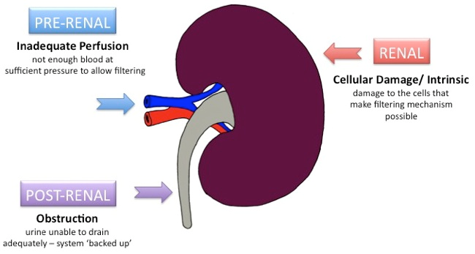
Causes of AKI
https://www.ole.bris.ac.uk/bbcswebdav/institution/Faculty%20of%20Health%20Sciences/MB%20ChB%20Medicine/Year%203%20Medicine%20and%20Surgery%20-%20Hippocrates/Renal%20-%20Acute%20Kidney%20Injury/Causes1.jpg
Notes:
Definitions & staging don’t incorporate the diagnostic importance of cause of AKI. This is important as it will determine the treatment

Slide 30
Pre-renal
Renal hypoperfusion due to reduced blood volume, flow or pressure:
Cause | Example
Hypovolaemia | Fluid loss, burns, GI losses, sepsis, pancreatitis
Cardiogenic factors | Arrhythmia, heart failure, valvualr dysfunction
Obstructive shock | Tamponade, pulmonary embolus
Welch (2017) ‘Renal Problems’ in Critical Care Nursing science & practice 3rd Ed Adam et al eds P.247-276
Notes:
Kidneys are good at maintaining renal blood flow via auto regulation. Feedback mechanisms will prompt the afferent/efferent arterioles to squeeze or sag in response to BP.

Slide 31
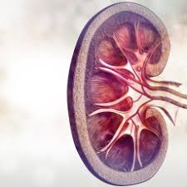
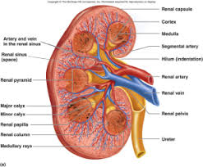

Renal/Intrinsic
Related to kidney itself:
Cause | Example
Acute Tubular Necrosis (ATN) | Unrelieved pre-renal causes, Nephrotoxins e.g. contrast, heavy metals, aminoglycoside antibiotics (Gent)
Cortical necrosis | Nephrotic Syndrome, renal artery occlusion/emboli, pyelonephritis, glomerulanephritis,.
Acute Interstitial Nephritis | Penicillins, cephalosporins, rifampicin, NSAIDS
Notes:
ATN – name suggests histological diagnosis bit this doesn’t happen in reality as no biopsies taken (bellomo et al 2012) Common cause of AKI in ICU due ischaemic hit to kidney in MOF following prolonged/profound pre renal failure. Suggested by the persistence of AKI despite resolution of blood flow/volume/pressure to kidney.

Slide 32
Post-renal
Problem with urine outflow from the kidney:
Cause | Example
Intra-ureteral | Calculi, crystals (uric acid), tumour, clot
Extra-ureteral | Retroperitoneal Fibrosis, tumour, aneurysm
Bladder Obstruction | Prostatic hypertrophy, bladder tumour, clot, calculi,

Slide 33
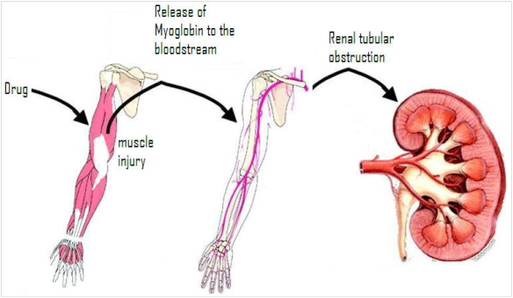
Special Cases: Rhabdomylisis
Breakdown of skeletal muscle following reperfusion:
  Crush injury, Temperature extremes, drug use or persistent exertion (inc. seizures)
Associated with compartment syndrome
Release of myoglobin causes mechanical obstruction and chemical damage in the kidney leading to renal failure
Cell damage also releases K⁺ & Creatinine Kinase
Craig (2009) emedicine http://emedicine.medscape.com/article/827738-overview

Slide 34
Rhabdomyolysis
Principles of Treatment:
  Fluid Resuscitation
  Correct compartment Syndrome
  Alkalinasation of Urine
  Support Polyuria (>300ml/hr)
Bellomo et al (2012) Acute Kidney Injury The Lancet 380 756-761

Slide 35
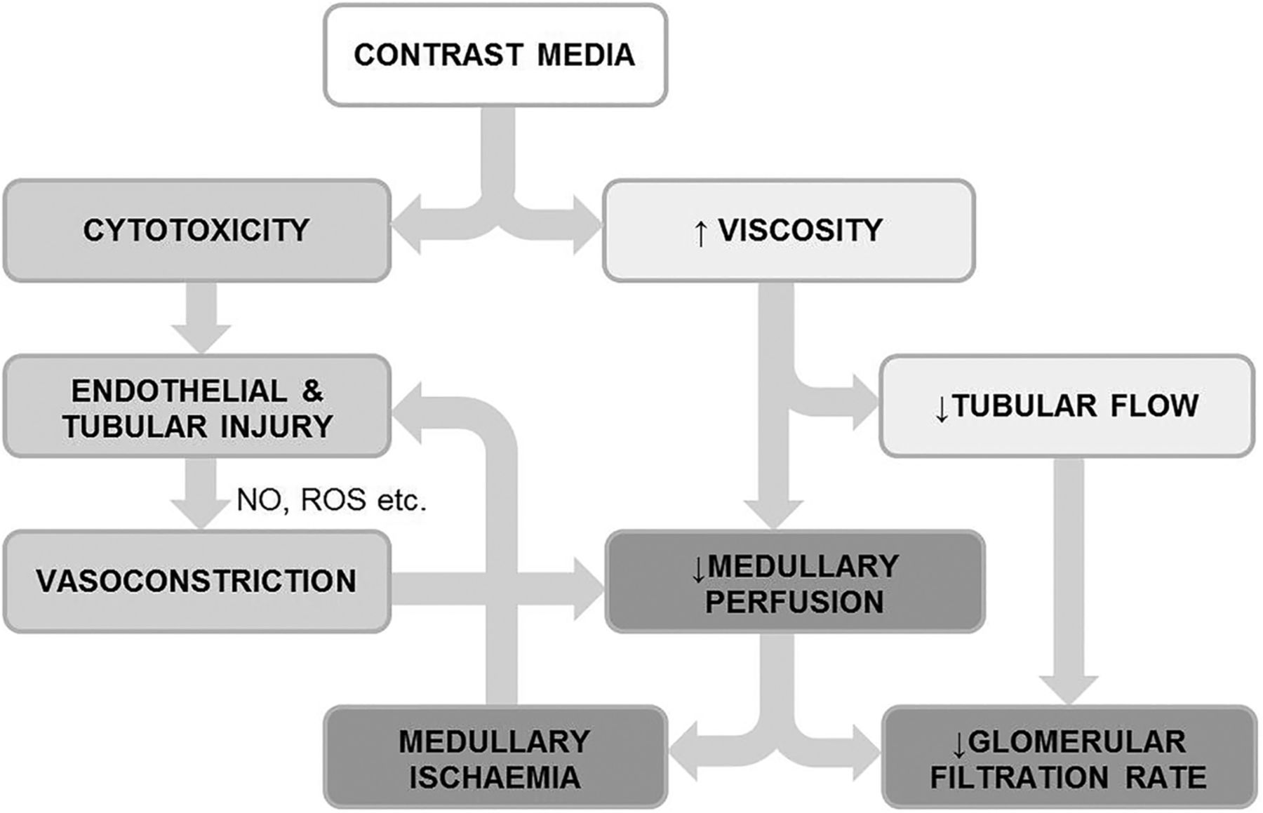
Special Cases: CI-AKI
Rear et al (2014) Contrast-induced nephropathy following angiography and cardiac interventions BMJ Learning
Notes:
?? Contrast Associated – AKI??
Follows administration of iodinated contrast
Pre-hydrate, nac, 1.4% nabicarb

Slide 36
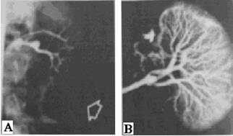
Special Cases: Hepato-renal Syndrome
‘The occurrence of renal failure in a patient with advanced liver disease in the absence of other causes of renal failure.’ (EASL; 2010)
Treatment:
  Terlipressin & Albumin
  TIPS
  CRRT
  Transplant
Notes:
Profound renal vasoconstriction
Need to exclude hypovolaemia, parenchymal renal disease, nephrotoxic drugs.
Terli/albumin – unsuccessful 54% pts
Kidneys will work immediately following transplant???

Slide 37
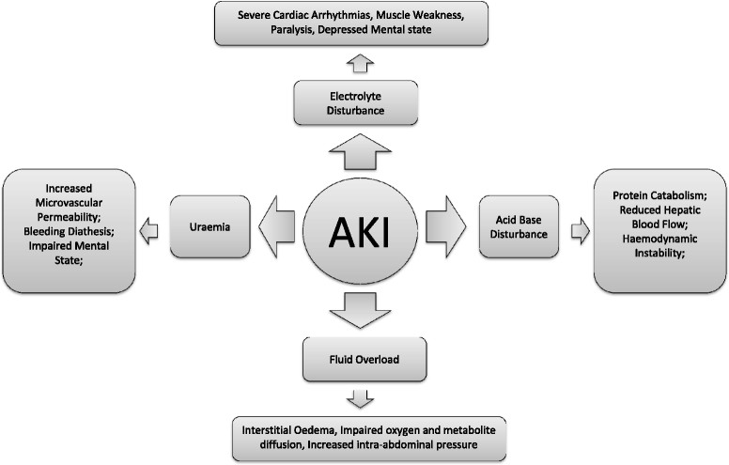
Complications of AKI
Doyle & Forni (2016) Acute Kidney Injury short & long term effects Critical Care 20
Notes:
Retention of uraemic toxins leading to altered mentation & even coma, tendency to bleed due to abnormal renal function – not number but how well they clump
Fluid Overload – salt/H2O retention happens early 2ndry RAAS activation
Acid Base Disturbance – failure of tubules to produce HCO3
Electrolyte disturbance – hyperkalaemia (hyponatraemia, hyperphosptaaemia)
DRUG ACCUMULATION – as GFR drops renal clearance of drugs will also decline - morphine

Slide 38
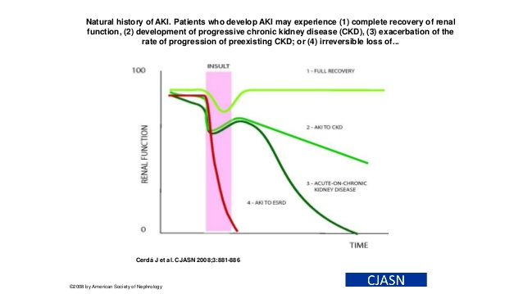
Complications

Slide 39

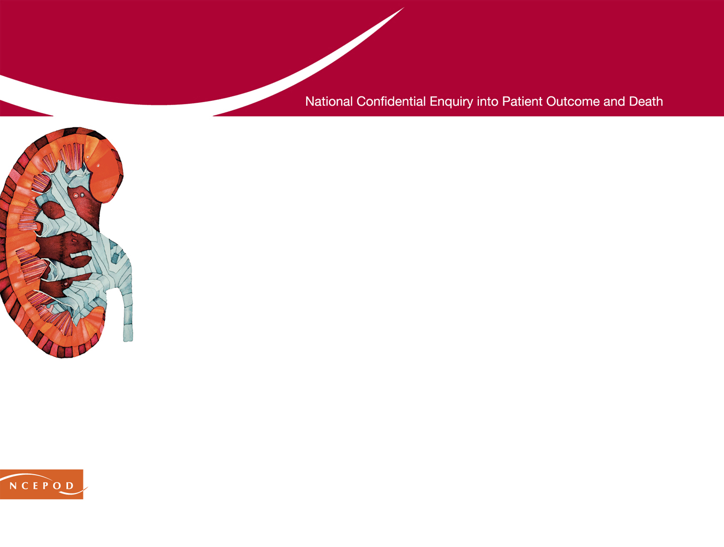
NCEPOD: Key findings
AKI avoidable in 14% of cases
Only 50% of patients received “good care”
Post admission AKI: poor recognition and care
24% did not receive adequate senior review
    Quality of care in this group was judged to be less good
85% did not have documented evidence of
critical care outreach involvement
June 2009
Notes:
Presenter notes:
Key points to raise
In 2009, the National Confidential Enquiry into Patient Outcome and Death (NCEPOD) reported the results of an enquiry into the deaths of 549 adult patients who died with acute kidney injury in hospital.
The study excluded patients receiving palliative care.
Systemic deficiencies in the care of patients who died from acute kidney injury were identified.
This report led to the Department of Health's request for NICE to develop its first guideline on acute kidney injury in adults and also, importantly, in children and young people.

Slide 40
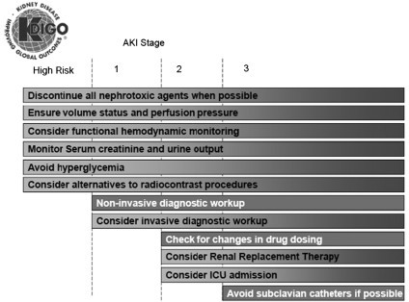
Management
Notes:
Stage based management to reflect broad principles of care for all AKI but need to look for cause & put in cause specific interventions.

Slide 41

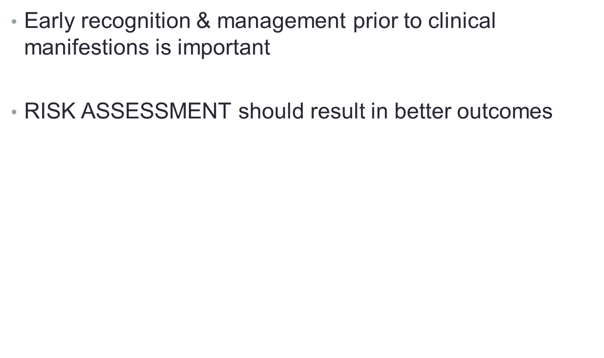
1.
Notes:
Stage based management to reflect broad principles of care for all AKI but need to look for cause & put in cause specific interventions.

Slide 42
Who is at risk?? (NICE CG 169)
EGFR<60ml/min
Heart failure
Liver disease
Diabetes
History AKI
Oliguria <0.5 ml/kg/hr
Neurological injury / cognitive deficit
Hypovolaemia
Use of drugs with nephrotoxic potential
Iodniated contrast < 1 week
Symptoms of obstruction
Sepsis
EWS increasing
Over 65

Slide 43
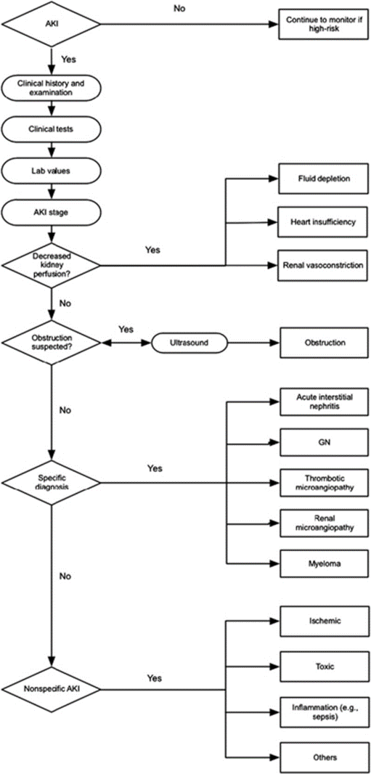
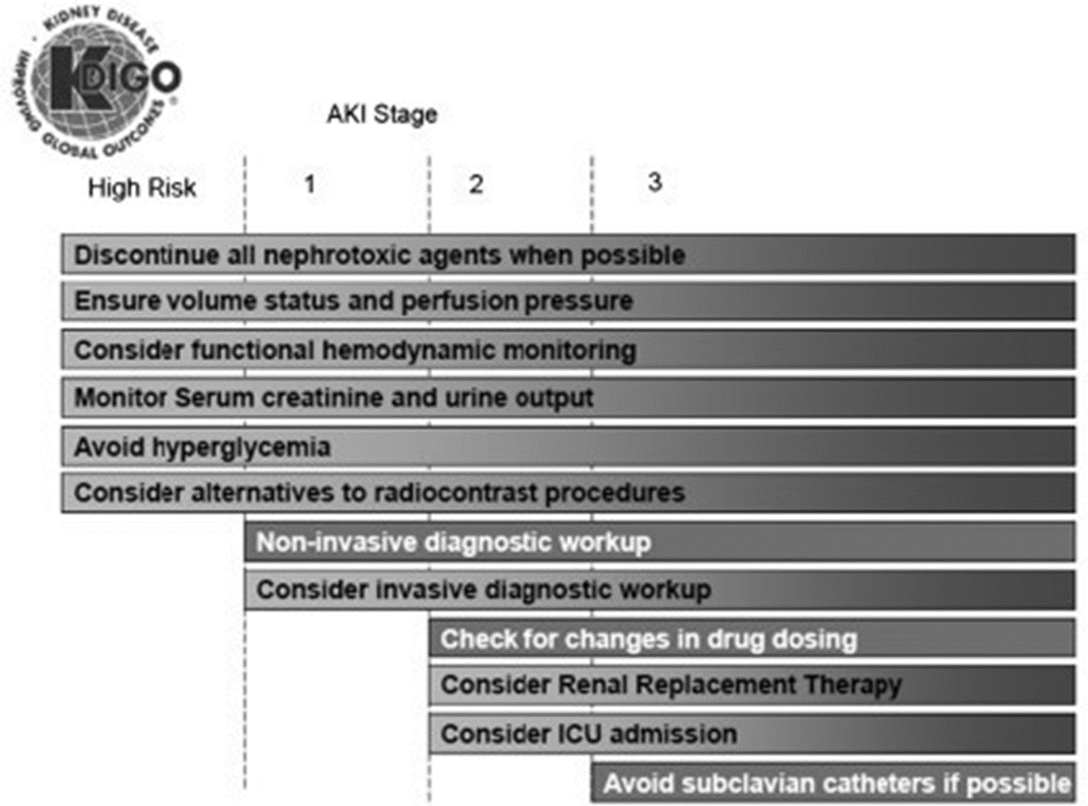
2. Investigate & Identify Cause

Slide 44
3. Initiate Cause Specific Treatments
Rhabodomyolysis
  Early/aggressive hydration; urinary alkalisation & fasciotomies if compartment syndrome evident
Abdominal Compartment Syndrome
  Dependent on cause – eg drain ascites, open the abdo
Acute Vascultis
  Immunosuppression +/- plasma exchange
Malignant Hypertension
  BP Control
Drug Induced Nephritis
  Stop Drugs
Obtsructuve Uropathy
  Relive obstruction; consider nephrostomies

Slide 45

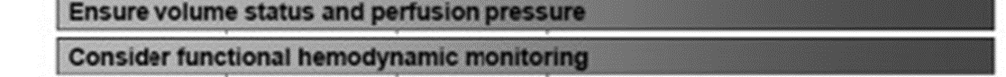
4. Optimise renal perfusion
Notes:
Three bears principle:
Not too much, not too little, just enough
Consider pressors if sustained low bp
Considor inotrope if CO problematic – Dynamic rather than static monitoring..

Slide 46
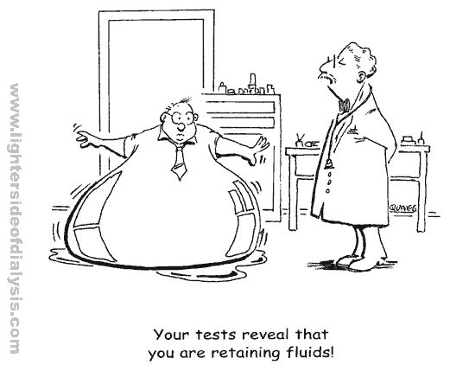
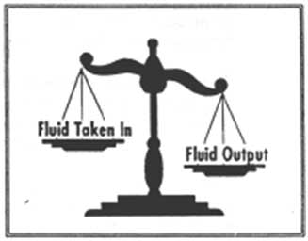
Fluids – problem & solution
Type
Volume
Parameters
Notes:
Type?
Saline strictly contraindicated and should be limited in all other treatment i.e. drug infusions,
Causes hyperchloreamia which reduces blood flow through the kidneys
Volume
Association b/w fluid overload, Venous congestion becoming more known to impact on renal function through increased intrarenal hydrostatic pressure & increased intratubular pressure
BUT can help to resolve issues provoking pre-nal failure
Parameters
Flow monitoring & dynamic response ie SV
STRICT, STRICT, STRICT fluid balance chart

Slide 47
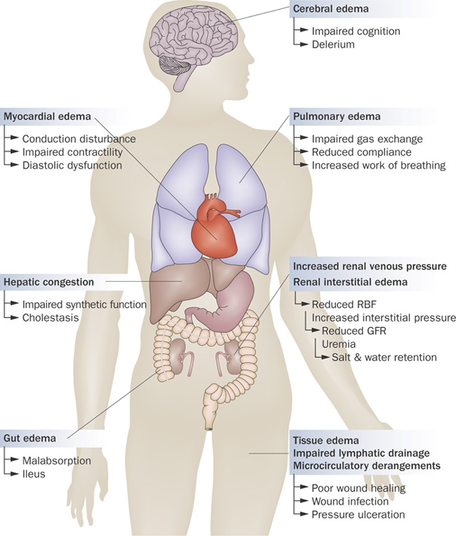
5. Monitor & Manage complications
Fluid Overload
Multi-System problem
Prowle et al (2009) Fluid Balance & Acute Kidney Injury Nature Reviews Nephrology 10

Slide 48
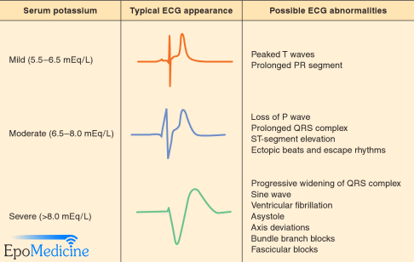
5. Monitor & Manage complications
Treat Hyperkalemia
  Cardiac Protection – Calcium Chloride
  Redistribute K+ back to cells – Insulin/Dextrose; Salbutamol; Sodium Bicarbonate
  Remove excess K+ - diuresis; CRRT
  Treat/correct underlying Cause

Slide 49
Summary
AKI & CKD are inter-related
All patients coming to ICU require vigilant monitoring of renal function
Prevention is definitely better than Cure..
..because even a little bit of renal impairment can impact long term mortality/morbidity

Slide 50
QUESTIONS???
Notes:
Critically ill pts will either present with AKI as single organ failure ie primary problem or develop AKI as part of MOF

Slide 51
CHRONIC KIDNEY DISEASE

Slide 53
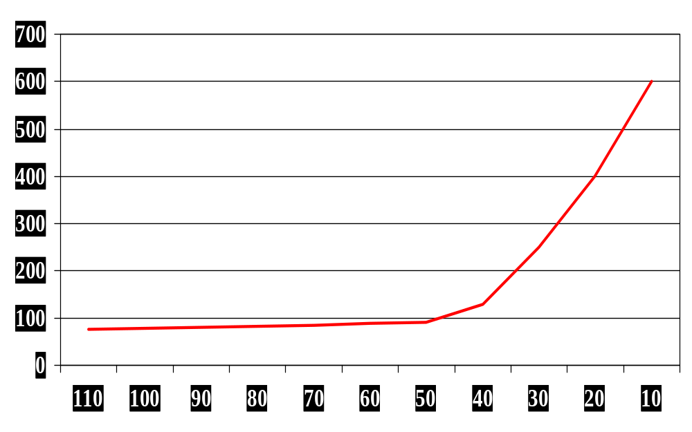
Interpreting Biochemistry
Creatinine
Glomerular Filtration Rate

Slide 54

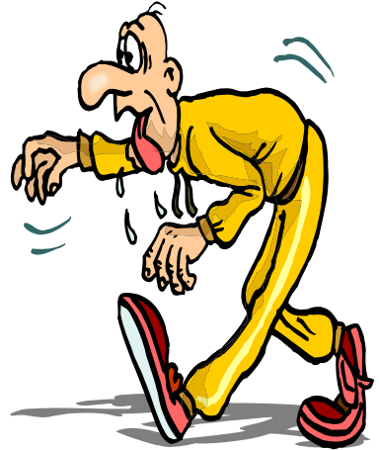
Biochemistry and Gender
Men have higher % muscle mass
Creatinine level also depends on how much meat you have eaten
Women therefore may have a dramatically lower creatinine at the same level of kidney impairment

Slide 55
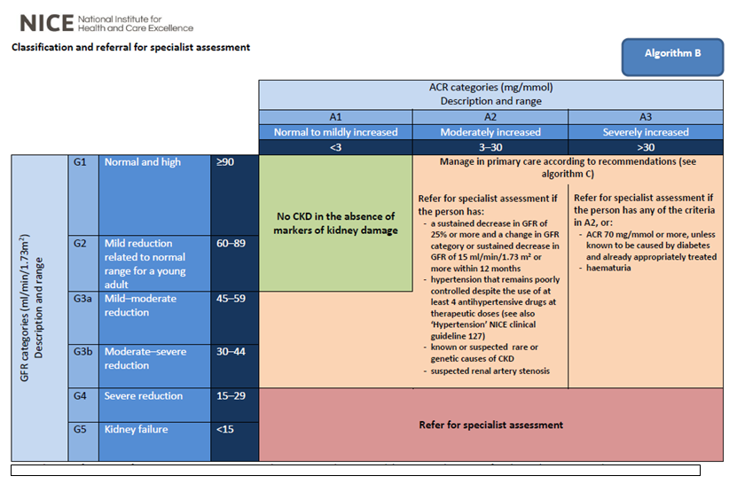

Slide 56
Renal Transplantation
Recipients are given one kidney
It must be a tissue-type match (= longer cold ischemic time except in live donation)
Lifelong immunosupression & monitoring
The first implant will last for 10 - 15 years if all goes well
Subsequent transplants will last for shorter and shorter periods.

Slide 57
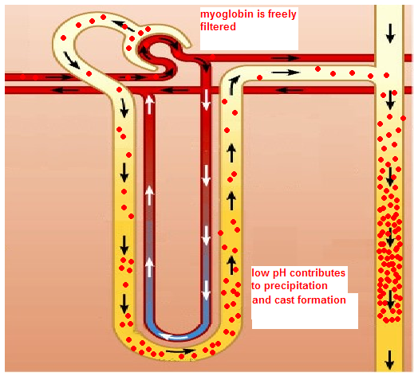
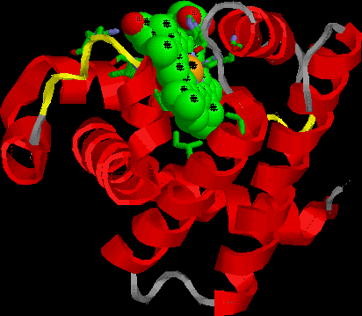
Pathophysiology
CONTRIBUTORS:
Dehydration (hypovolemia)
Aciduria
Renal vasoconstriction
Cast formation
Heme-induced toxicity to tubule cells
Not reabsorbed
Binds Tamm-Horsfell proteins
Notes:
Myoglobin degradation product causes obstruction of the renal tubules and altered renal blood flow.
? Alkalinsation of urine prevents breakdown of myoglobin, increases solubility of myoglobin and dcreases cast formation – but can lead to drop in calcium.

Slide 58
Interventions: iodinated contrast agents in adults
Offer intravenous volume expansion to adults having iodinated contrast agents if at increased risk of contrast-induced AKI because:
They have any of the risk factors from slide 12 | Or they have an acute illness
Discuss care with a nephrology team before offering iodinated contrast agent to adults with contraindications to IV fluids if they:
Are at increased risk of contrast-induced acute kidney injury | Have an acute illness
Are on renal replacement therapy
Notes:
Presenter notes:
Key points to raise
Offer either isotonic sodium bicarbonate or 0.9% sodium chloride for IV volume expansion.
Consider temporarily stopping ACE inhibitors and ARBs in adults having iodinated contrast agents if they have chronic kidney disease with an eGFR less than 40 ml/min/1.73 m².
Details of the evidence base and cost modelling for this recommendation can be found in the full guideline, available from http://guidance.nice.org.uk/CG169
Some patients from high-risk groups may require admission for intravenous volume expansion before receiving iodinated contrast.

Slide 59
Top 10 causes of CKD:
1. Diabetes
2. Glomerulonephritis
3. Chronic Pyelonephritis
4. Polycystic Kidney Disease
5. 1º Hypertension
6. Small smooth kidneys
7. Analgesic nephropathy
8. Vasculitis
9. Calculi
10. Other Drugs

