Slide 1
AIRWAY INFORMATION

Slide 2
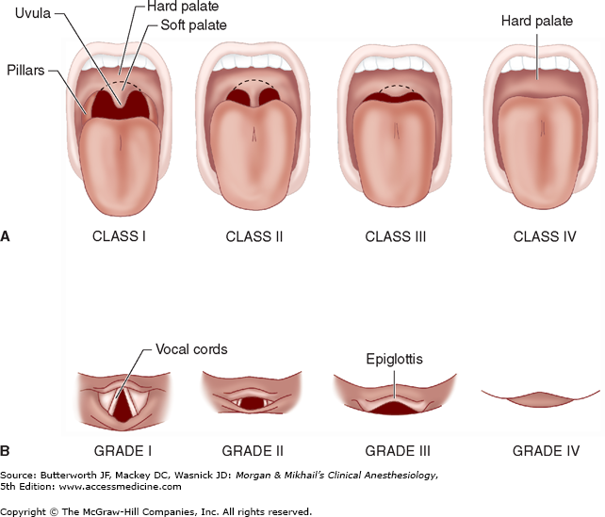
Intubation Grading

