Slide 1
Nutrition in the ICU Setting
Jen Wetherden
Specialist Dietitian – Major Trauma
Acknowledgements: Beth Viner Smith, Catherine Collins, Catherine Jones

Slide 2
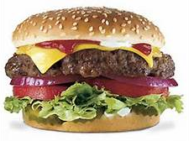
Overview of Presentation:
Why is nutrition important?
Nutrition requirements in critical care
Oral nutrition
Types of feeds
Gastric residual volumes/fasting
Refeeding syndrome
ERAS

Slide 3
Malnutrition

Slide 4

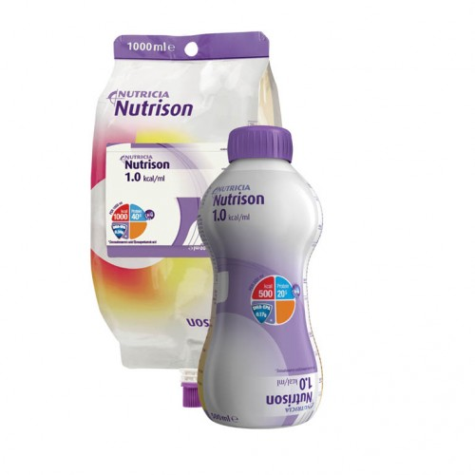
‘Under’ Nutrition or ‘Over’ Nutrition
Macro or micro nutrient malnutrition
Up to 40% of patients admitted to hospital are at risk of malnutrition
70% of patients weigh less on hospital discharge
Malnutrition cost England along £19.6 billion annually
In many cases it is preventable
(BAPEN, 2016)

Slide 5

Nutrition support:
  Oral
  Enteral
  Parenteral
Proven to reduce calorie deficits
Leading to:
  reduced infection rates
  improved functional outcomes
  shorter LOS
  reduced burden and cost for the NHS
For every $ spent on nutrition support $50 is saved
(BAPEN, 2016; Wischmeyer, 2017)

Slide 6
Nutritional Requirements

Slide 7
Metabolic response to injury, trauma and sepsis
 | Starvation | Injury / Disease
Metabolic rate
Body fuels | Conserved | Wasted
Body protein | Conserved | Wasted
Urinary nitrogen
Weight loss | Slow | Rapid
The body adapts to starvation, but not in the presence of critical injury or disease
Popp MB, et al. In: Fischer JF, ed. Surgical Nutrition. 1983

Slide 8
Nutrition and Critical Illness
METABOLIC
RESPONSE
Critical illness stress on body
Critical illness reduced/ABSENT intake
= MALNUTRITION

Slide 9
Metabolic response to injury, trauma and sepsis
Ebb phase – occurs 24-48hrs post injury
  metabolic activity, glycogen (liver), FFA (adipose tissue) mobilised – impaired utilisation
Flow phase
  Hypermetabolism, catabolism, O₂ consumption
  Driven by pro-inflammatory cytokines (IL-6, TNFα), adrenalin, glucagon and cortisol
  => Glucose intolerance, gluconeogenesis, net protein catabolism respectively

Slide 10
Effects of Malnutrition
Depression/
low mood
↓Respiratory function
↓Immunity
↑ risk of infection
↓ Cardiac output
Anorexia
↓ Renal function
Impaired gut
integrity : ↑ nutritional deficiencies
Impaired thermoregulation
Impaired wound
healing
↓ muscle function
& ↑ fatigue
↓Recovery

Slide 11
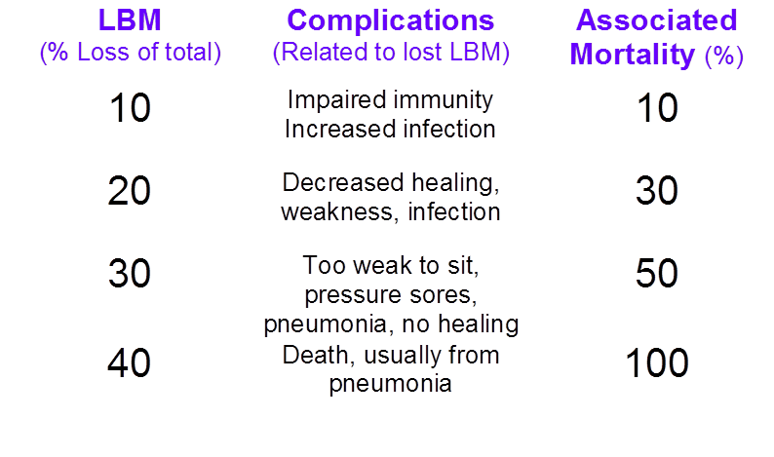
Complications Relative to loss of Lean Body Mass (LBM)
Notes:
26% lean muscle mass loss over 10 day ICU day for pt in multiorgan failure. Detected through USS measurement

Slide 12
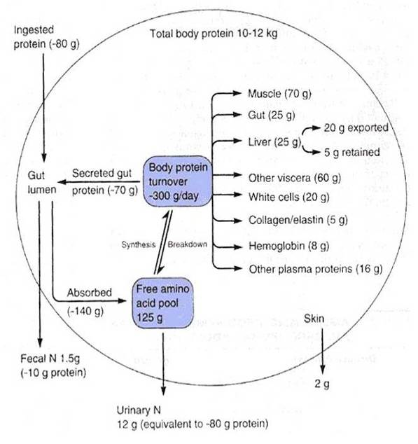
Body protein turnover
ALL protein is ‘functional’

Slide 13
Rapid Loss of LBM
Major elective surgery
~ 43g protein/day in 1st 2 weeks post-op (Hill, 1992)
Trauma and brain injury
~ 110g protein/day in 1st 10 days post trauma (Monk, et al, 1996)
Serious sepsis
~ 150g protein/day (Streat, et al, 1987)
1-2% LBM/day (Gamrin et al, 1997, Plank and Hill, 2000)

Slide 14
From: Acute Skeletal Muscle Wasting in Critical Illness
JAMA. 2013;310(15):1591-1600. doi:10.1001/jama.2013.278481
Study Aim:
A comprehensive prospective characterization of skeletal muscle wasting, defining the pathogenic roles of altered protein synthesis and breakdown
Criteria:
63 critically ill patients (59% male; mean age: 54.7 years)
APACHE II score of 23.5
Prospectively recruited within 24 hours following ICU admission (England)
>18 years, anticipated to be intubated > 48 hours & LOS >7 days in critical care
Method:
Muscle loss was determined through serial ultrasound measurement of the rectus femoris cross-sectional area (CSA) on days 1, 3, 7, and 10. In a subset of patients, the fibre CSA area was quantified along with the ratio of protein to DNA on days 1 and 7.
Notes:
Study Aim:
A comprehensive prospective characterization of skeletal muscle wasting, defining the pathogenic roles of altered protein synthesis and breakdown
63 critically ill patients (59% male; mean age: 54.7 years [95% CI, 50.0-59.6 years]) with an APACHE II score of 23.5 (95% CI, 21.9-25.2) were prospectively recruited within 24 hours following ICU admission from August 2009 to April 2011 at a university teaching and a community hospital in England. >18 years and were anticipated to be intubated > 48 hours, to spend more than 7 days in critical care, and to survive ICU stay.
Main Outcomes and Measures Muscle loss was determined through serial ultrasound measurement of the rectus femoris cross-sectional area (CSA) on days 1, 3, 7, and 10. In a subset of patients, the fiber CSA area was quantified along with the ratio of protein to DNA on days 1 and 7.

Slide 15

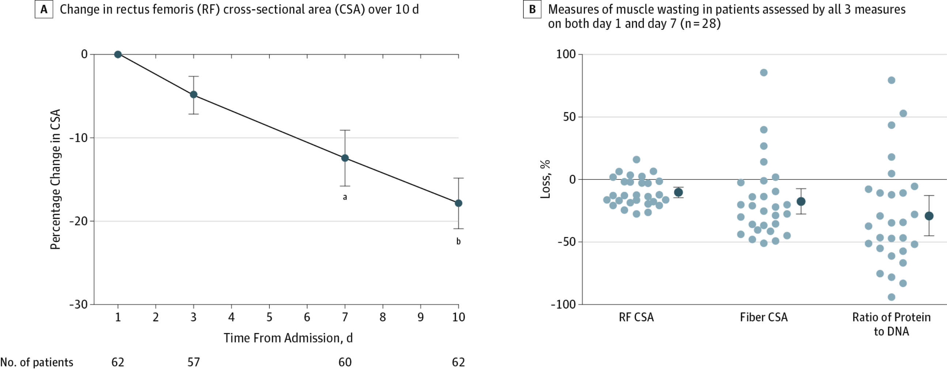
From: Acute Skeletal Muscle Wasting in Critical Illness
JAMA. 2013;310(15):1591-1600. doi:10.1001/jama.2013.278481
Notes:
Measurements of Muscle Wasting During Critical Illness: Summary data (dark circles) are expressed as means and 95% confidence intervals. ªP=.002 for change from day 1 to day 7 by repeated measures 2-way analysis of variance. ^{b}P<.001 for change from day 1 to day 10.

Slide 16
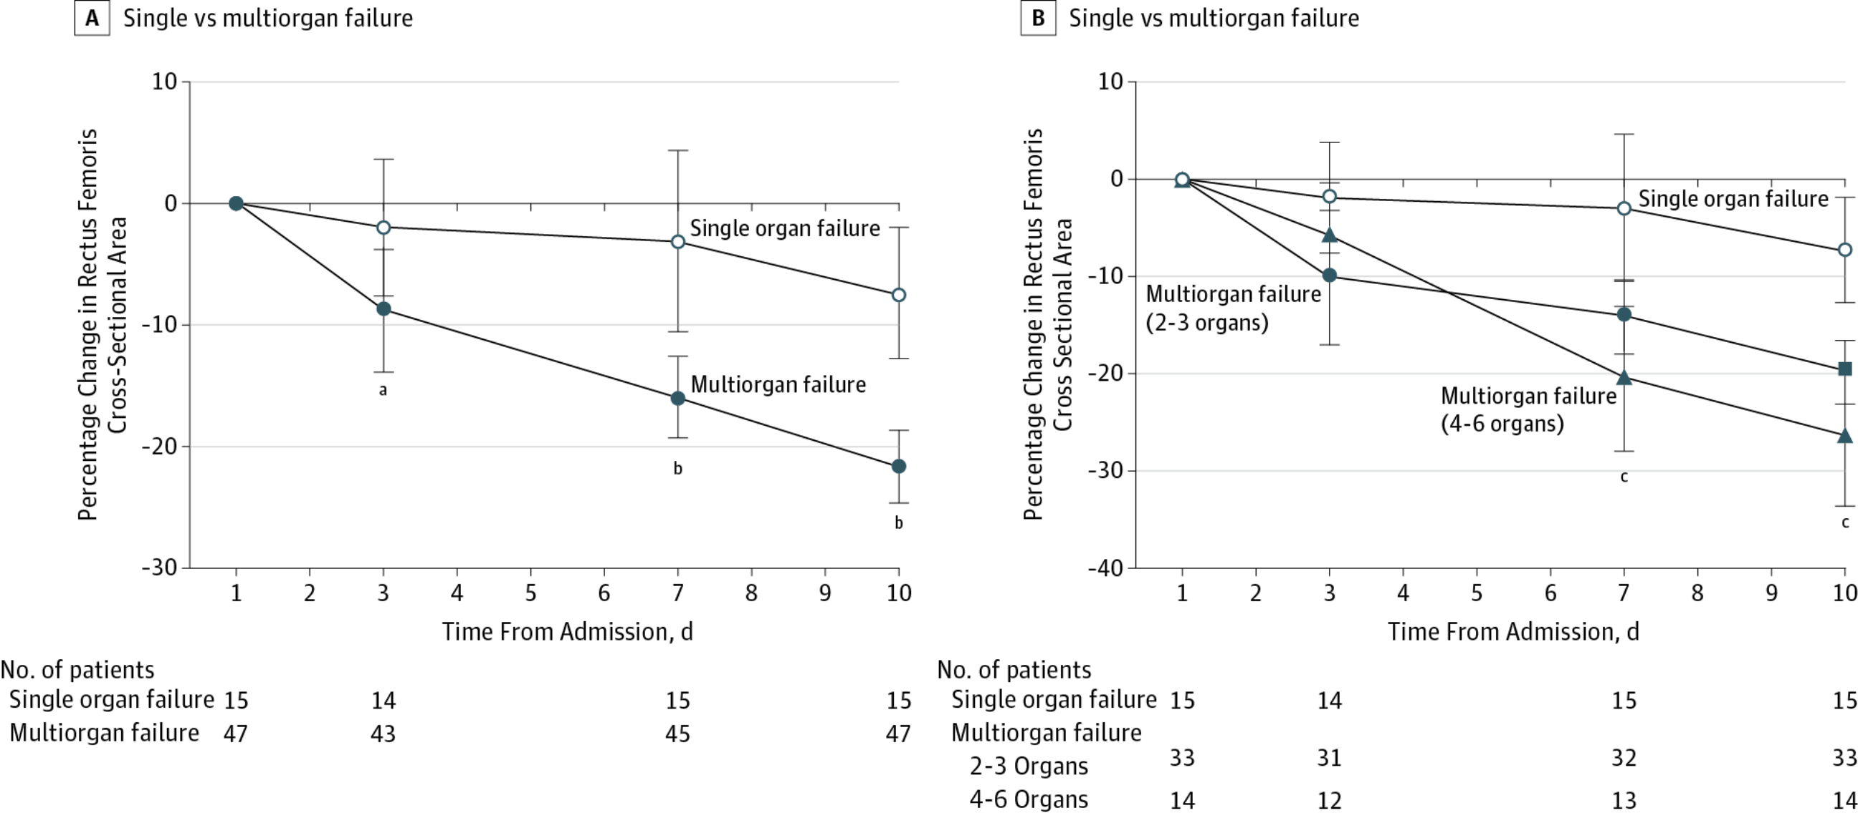
From: Acute Skeletal Muscle Wasting in Critical Illness
JAMA. 2013;310(15):1591-1600. doi:10.1001/jama.2013.278481
Notes:
Measurements of Muscle Wasting During Critical Illness by Organ FailureData are expressed as means and 95% confidence intervals. ªP=.03 for change from day 1 to day 3 in multiorgan failure vs single organ failure. ^{b}P<.001 for change from day 1 to day 7 and day 1 to day 10 in multiorgan failure vs single organ failure. ^{c}P<.001 for difference between failure of 2-3 organs and 4-6 organs from day 1 to day 7 and day 10.

Slide 17
Energy Requirements
Indirect calorimetry: gold standard for measured energy expenditure
  Metabolic cart vs FitMate
Weight (ideal) based equation: 25-30kcal/kg (SCCM/ASPEN 2016)
Predictive equations (tested in hospital patients): Penn State, Ireton-Jones
Predictive equations (tested in healthy volunteers): Harris-Benedict, Mifflin
Accuracy with obese and underweight patients?
Sedation, mode of ventilation, clinical illness

Slide 18




Slide 19
Protein Requirements
Protein requirements are proportionally higher than energy requirements in critically ill patients
Weight based equations: 1.2 – 2.0g/kg/d
Patient groups: renal replacement therapy, burns, decompensated liver disease, obese.
Serum protein markers (albumin, prealbumin) do not reflect adequacy of protein provision

Slide 20
Protein Prevision – adequacy
Nicolo M, et al, 2016, Clinical outcomes related to protein delivery in a critically ill population: a multicentre, multinational observation study, JPEN; 40
Retrospective analysis from International Nutrition Survey 2013
n = 2824 patients with LOS ≥ 4 days, n = 1584 patients with LOS ≥ 12 days
Achieving ≥ 80% of prescribed protein was associated with reduced mortality
Achieving ≥ 80% of prescribed energy was not associated with reduced mortality

Slide 21
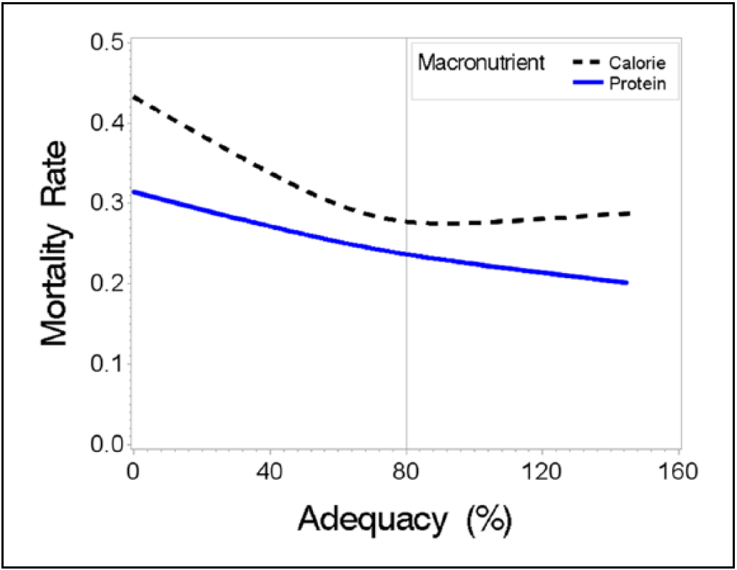
Protein Prevision – adequacy
Figure 1: Rate of mortality relative to adequacy of energy and protein intake delivered
(Nicolo et al, 2016)

Slide 22
Overfeeding
Carbohydrate:
Hypercapnia (excessive CO₂ retention)
Hyperglycaemia
Hypertriglyceridaemia
Accumulation of fat in the liver
Protein:
Azotaemia & uraemia (increase urea / N₂ compounds in blood secondary to inadequate renal filtration.
Hypertonic dehydration
Metabolic acidosis
Notes:
Azotemia is a medical condition characterized by abnormally high levels of nitrogen-containing compounds in the blood. It is largely related to insufficient or dysfunctional filtering of blood by the kidneys. It can lead to uremia and acute kidney injury if not controlled.

Slide 23
Overfeeding: Non–feed energy sources:
Dextrose: 5%,10%, 20%
Provides approx 4kcal/g
1L 20% dextrose = 800kcal
Propofol: Lipid base – Intralipid
1.1kcal/ml
200mg/hr = approx 480kcal/day
= >1000kcal/day
Consider:
Re-feeding risk

Slide 24
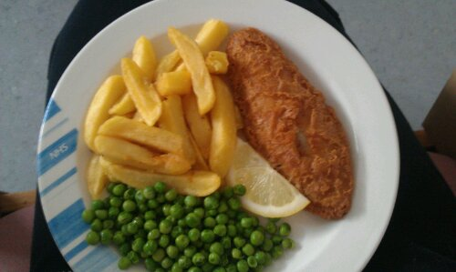
Oral Nutrition

Slide 25
Oral Nutrition
First preference
Need to consider the patient’s level of consciousness, swallow & motivation.
  All can be impaired in critical illness…
  If oral feeding is not sufficient to meet energy requirements within 3 days then enteral feeding should be initiated
  Kreymann et. Al. (2006) ESPEN Guidelines on Enteral Nutrition: Intensive Care Clinical Nutrition 25 pp. 210-223

Slide 26
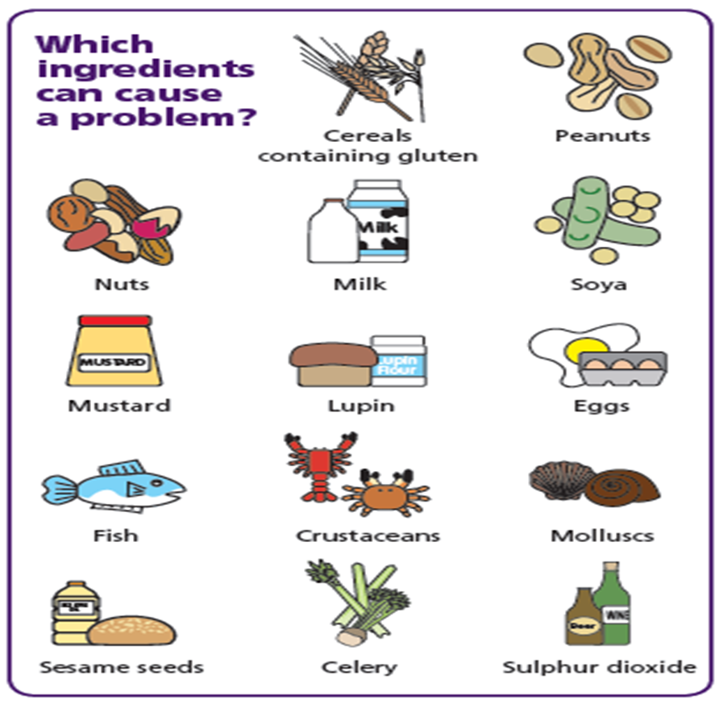

The EU law has listed 14 allergens that need to be identified if they are used as ingredients in a dish

Slide 27
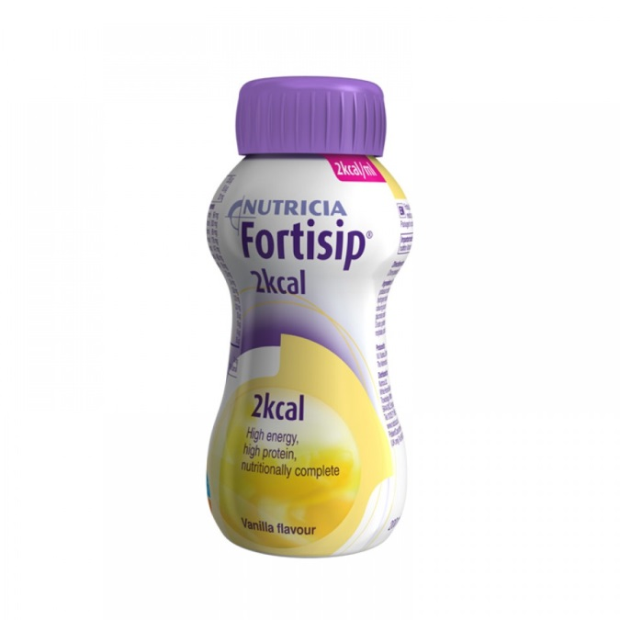
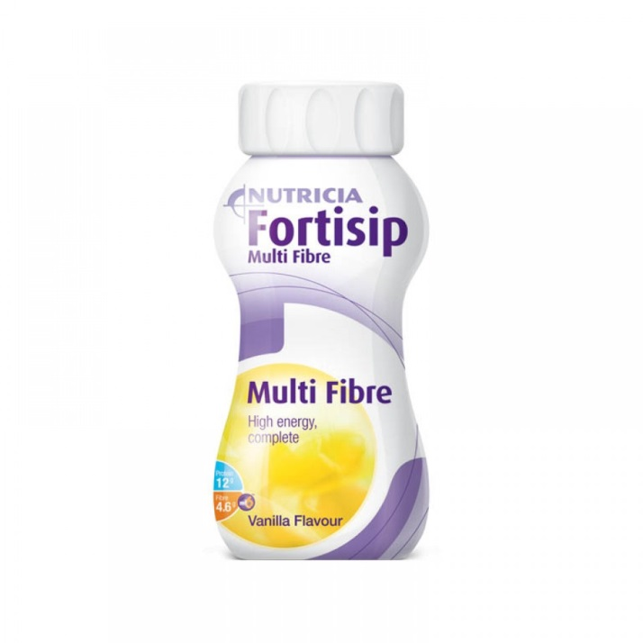
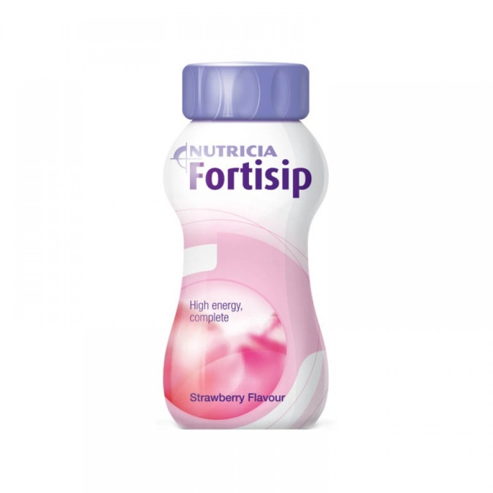
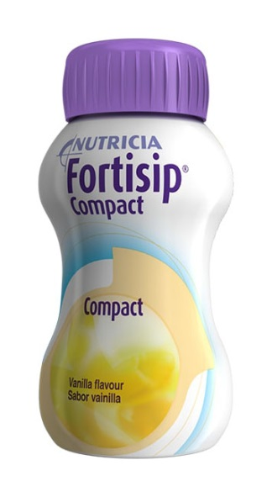
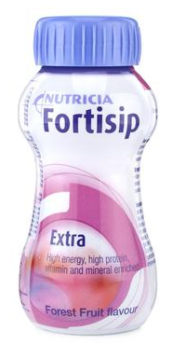
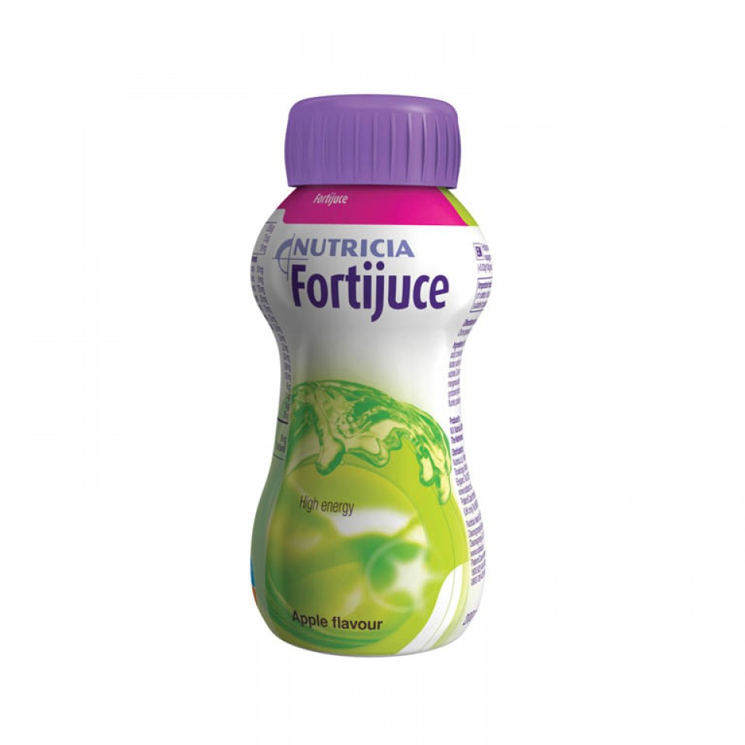
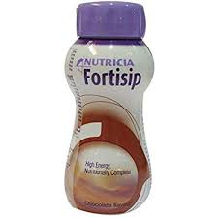
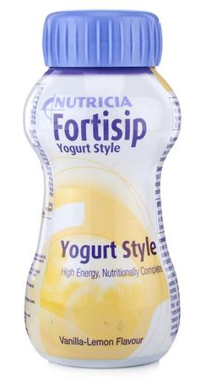
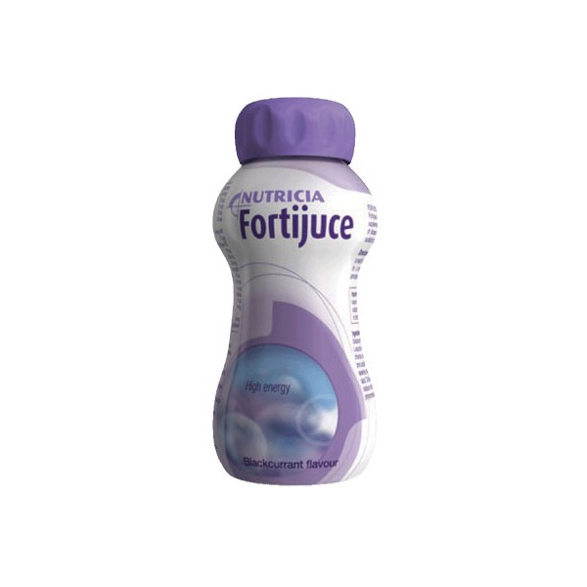

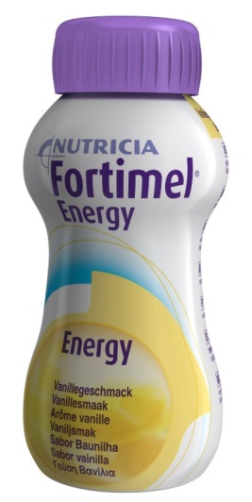
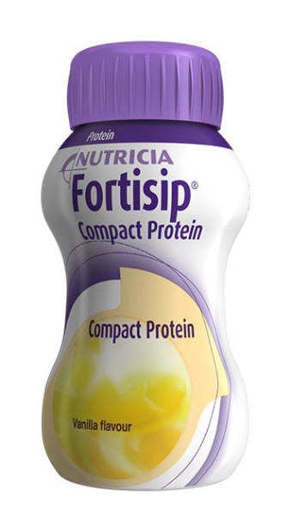
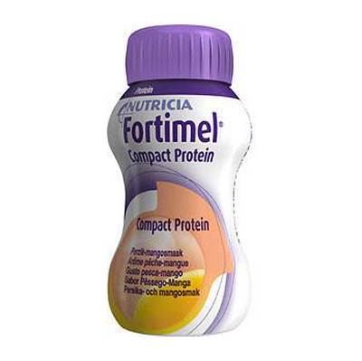
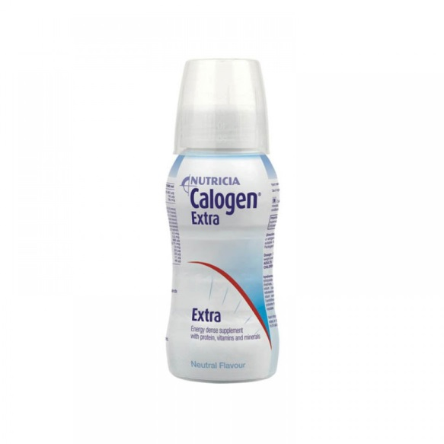
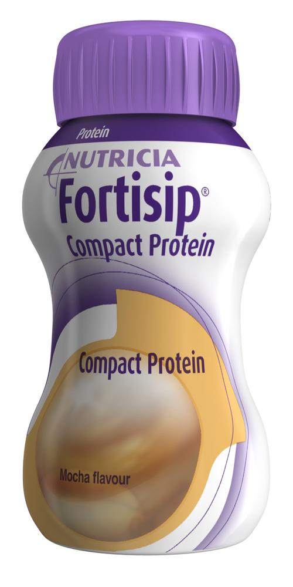
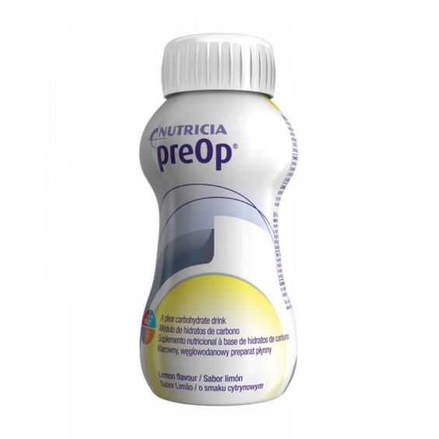
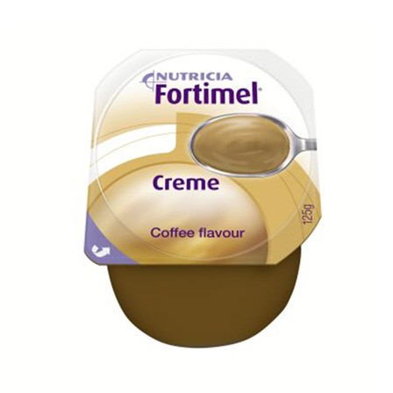
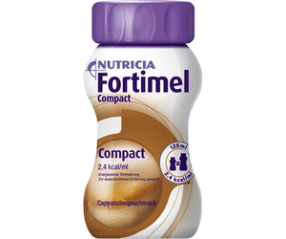
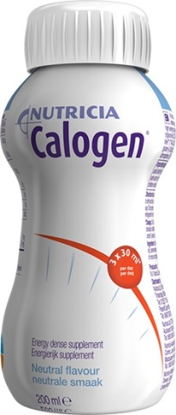
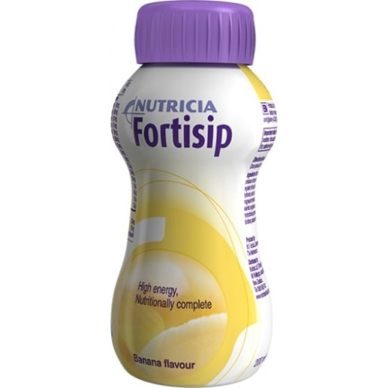
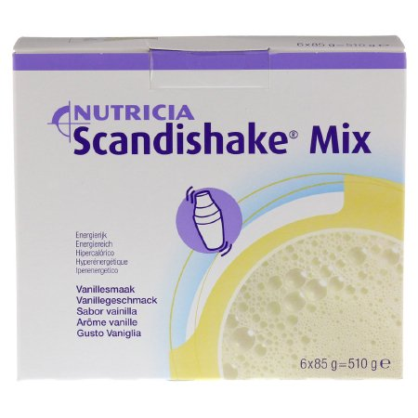


Slide 28
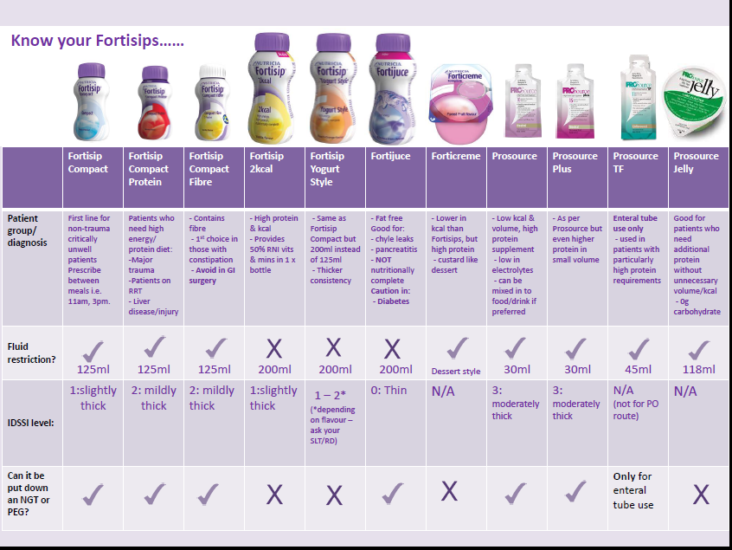

Slide 29
A Brief Overview to Feed Types

Slide 30
Biochemistry
Respiratory status
Weight
GIT Function
Nutritionally complete
Renal function
Fluid balance
Considerations
Enzyme production
Bolus vs Continuous
Aspiration risk
Hydration/IVT
Nutritional status
Estimated nutritional requirements
Blood sugar levels
Available products (tender)
Osmolality/osmolarity

Slide 31
Macro-Nutrients:
Constitution:
Polymeric:
- macro-nutrient in their whole polymer form
- ‘standard’ closest to eating & drinking whole products
Semi-elemental:
- partially hydrolysed macro-nutrients
- poor GI tolerance, inadequate enzyme production
Elemental:
- full hydrolysed macro-nutrients
- simplest form – used in allergies, GIT dysfunction/failure

Slide 32
Macronutrients:
Concentration:
1.0kcal/mL vs 1.2kcal/mL vs 1.25kcal/mL vs 1.28kcal/mL vs 1.5kcal/mL vs 2kcal/mL
Ratio:
CHO:N:lipid
Different disease states, co-morbidities, clinical parameters require emphasis on different macro-nutrients
Renal failure: worsened by high doses of protein, however, high likelihood of malnutrition
Obesity: require low calorie, high protein to protect muscle wastage and encourage adiposity use

Slide 33
Micronutrients:
Micronutrient Profile:
All feeds contain micro-nutrients (vitamins and minerals) in various concentrations
Nutritionally complete at varying volumes e.g. 1000ml versus 1500ml.
Again, different disease states, co-morbidities, clinical parameters require emphasis on different micro-nutrients
Fibre vs Fibre-free
Soluble fibre vs insoluble fibre

Slide 34
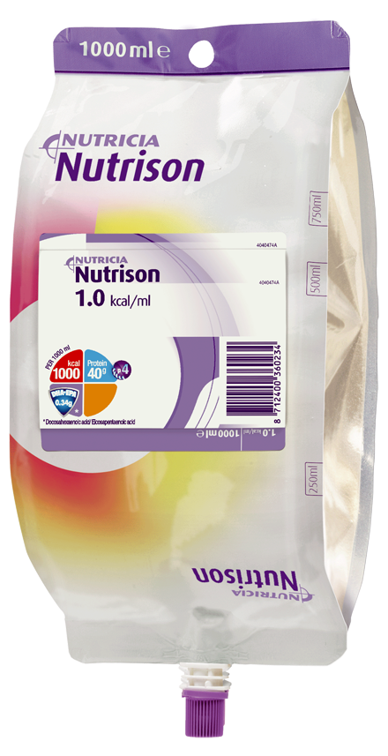
Polymeric
1kcal/mL
40g protein/L
Current enteral nutrition starter regime feed

Slide 35
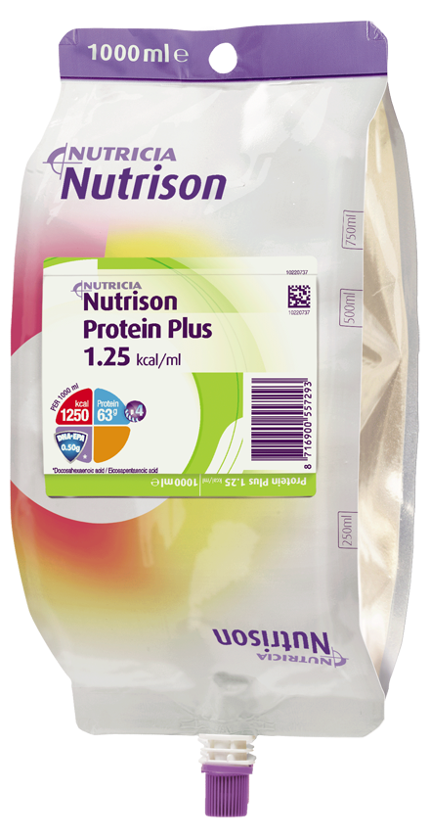
Polymeric
1.25kcal/mL (with multi-fibre 1.28kcal)
63g protein/L
Commonly used in critical care/trauma/filtration/obesity
Often remains inadequate in protein

Slide 36
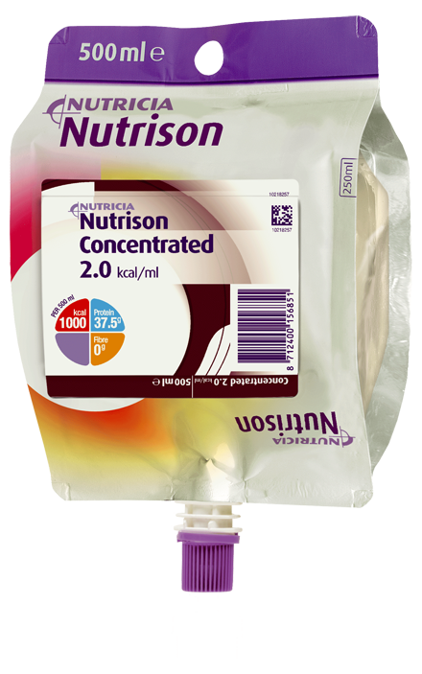
Polymeric
2.0kcal/mL
75g protein/L
Commonly used for fluid restrictions, bolus feeding, overnight feeding, high aspiration risk, low rate feeding

Slide 37
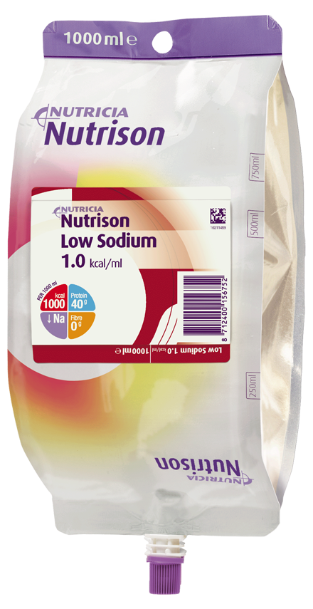
Polymeric
1.0kcal/mL
40g protein/L
Commonly used for patients with high sodium levels
NB: absorption, nutrition profile

Slide 38

Polymeric
1.5kcal/mL
63g protein/L
Lower percentage of calories from CHO
Commonly known as a ‘respiratory feed’
Limited evidence

Slide 39

Respiratory quotient (RQ)
The amount of CO₂ produced  to O₂ consumed  :
1 kcal of carbohydrate:           
           
RQ = 1.0
1 kcal of protein:            
         
RQ = 0.8
1 kcal of fat:            
        
RQ = 0.7

Slide 40
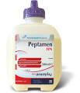
Peptamen
Semi-elemental
1.0kcal/mL
40g protein/L
Commonly used in poor GI tolerance or inadequate enzyme production
Peptamen HN
Semi-elemental
1.3kcal/mL
66g protein/L
Commonly used in poor GI tolerance or inadequate enzyme production
More concentrated than Peptamen

Slide 41
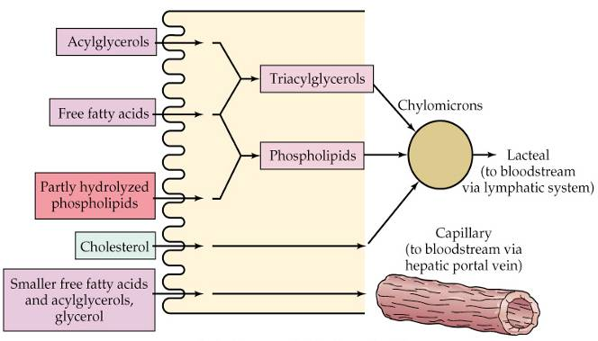

MCT fats: absorptive and metabolic fate
Delay gastric emptying
Negative inflammatory influence of omega-6 PUFA : corn, soybean, sunflower oils
LCT
MCT
No impact on gastric emptying delay
Passive uptake: initial malabsorption
Neutral inflammatory effect

Slide 42


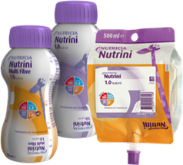
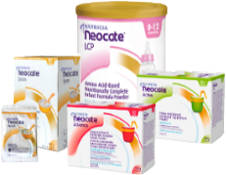

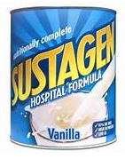
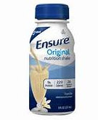

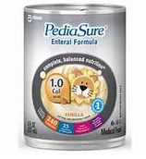
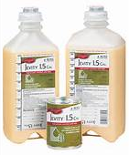
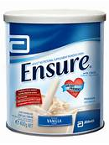
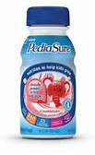

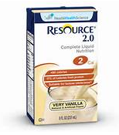
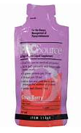

Slide 43
Gastric Residual Volumes

Slide 44
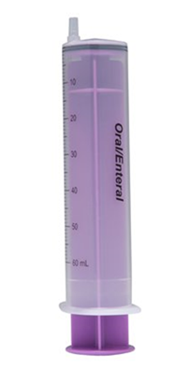
Gastric Residual Volumes
Gastric aspirates obtained every 4 hours
Mr X: Volumes of 300ml & 350ml recorded

Slide 45
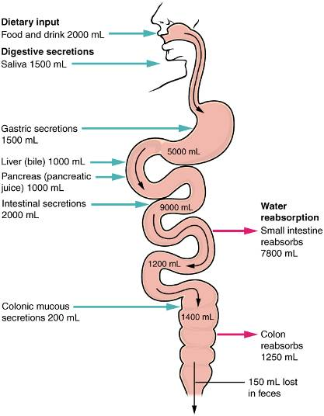
Feeds start at 30ml/hr
= 0.5ml/min
Adults produce >1ml saliva per minute
Is volume an issue?

Slide 46
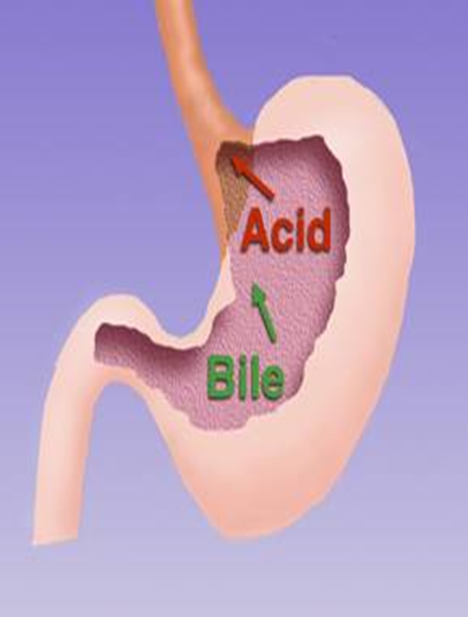
3L secretions from above the
Pylorus / 24 hours (= 125ml/hr)
Feed @ 100ml/hr x 24hr
Exclude meds and water flushes
for simplicity
125ml + 100ml = 225ml/hr x 4hr
(standard aspirate duration)
Parrish & McClave, 2008
= 900ml of GRV if NO EMPTYING
had occurred

Slide 47
Factors influencing gastric emptying rate
Patient factors: | diabetes, obesity, increasing age, stress, elderly, female vasopressors, dehydration
Food characteristics: | Liquid, small particle size, low molecular weight, low viscosity, low calorie density, low fat, delivered at body temperature
Warren et al (2011). Nutr Clin Pract 26:115-125

Slide 48
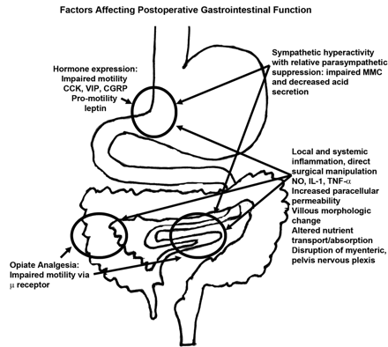

Slide 49
Resumption of ‘normal’ motility post surgery
24 hours
Stomach…
Small intestine…
Large intestine…
Warren et al (2011). Nutr Clin Pract 26:115-125

Slide 50
REGANE study (Montejo, et al. 2010)
28 ICUs in Spain (n = 329): GRV: 200ml vs 500ml
Large aspirates experienced in 42% control (≥ 200ml) and 26% intervention (≥ 500ml)
Incidence of regurgitation, aspiration & ICU acquired pneumonia was similar across groups
Increasing cut off volume was not associated with worse complications or outcomes
EN delivery was significantly higher in intervention group (mean intake significantly greater)

Slide 51
Prokinetic Agents:
Erythromycin and Metoclopramide
Shown to increase gastric emptying and improve feed tolerance
Tachyphlaxis by day 7 for both
Erythromycin has greater benefit, but safety issues include antibiotic resistance, arrhythmias, N&V and drug interactions
Start with a single agent:
  Metoclopramide 10mg IV TDS
  Erythromycin 250mg IV BD
Notes:
Tachyphlaxis: acute, sudden decrease in response to a drug after its administration, i.e. a rapid and short-term onset of drug tolerance

Slide 52

Prokinetics improve feed absorption
Chapman et al; Crit care med (2010)

Slide 53

How effective are prokinetics?

Slide 54
Parenteral Nutrition (PN)

Slide 55

Parenteral Nutrition
Indications:
  Unable to use gut – abdominal trauma, extensive abdominal resection.
  Unable to achieve adequate enteral nutrition within 3 days of admission to critical care (ESPEN 2009).

Slide 56

Complications:
  Infection – catheter related sepsis
  Hyperglycaemia
  Liver dysfunction
  Refeeding syndrome
  Electrolyte disturbances
  Volume overload

Slide 57
To PN or not to PN?

Slide 58
Refeeding Syndrome
Severe metabolic disturbance caused by the introduction of feed to starved or severely malnourished patients.
Profound electrolyte disturbances –
    Phosphate, magnesium, potassium
Can be fatal

Slide 59
Refeeding syndrome: Criteria
  One or more:
BMI < 16kg/m
Unintentional weight loss ≥ 15% over past 3-6 months
Little/no nutritional intake > 10 days
Low levels of K+, phosphate, magnesium before feeding starts
    Two or more:
    BMI < 18.5kg/m2
    Unintentional weight loss
    ≥10% over past 3-6 months
    Little/no nutritional intake
    ≥ 5 days
    History of alcohol/drug dependency
    Medications – insulin, chemo, antacids, diuretics
NICE (2006) Nutrition Support in Adults

Slide 60
Refeeding syndrome
Plan:
  Conservative introduction of nutrition
  Restore & monitor circulating volume
  Thiamine OD & Vit B co strong 1-2 tablets TDS.
  Multivitamin OD
  Monitor & replace potassium, phosphate & magnesium
NICE CG32 (2006) Nutrition Support in Adults

Slide 61
Early Recovery After Surgery (ERAS)

Slide 62
Early Recovery After Surgery (ERAS)
avoidance of extensive pre-operative fasting – 50-70g carbohydrate drink 2 hours before surgery (!!NOT practice on ICU)
Re-establishment of oral/initiation of enteral feeding as early as possible after surgery (ward to remove NGT to avoid drip-and-suck)
Integration of nutrition into the overall management of the patient
Interventive metabolic control e.g. blood glucose levels
Reduction of factors which exacerbate stress-related catabolism or impair GI function
Early mobilisation
ESPEN guidelines on enteral nutrition
DGEM group; Clin Nutr 25:224 2006

Slide 63

Notes:
Home page - > units & departments -> N -> Nutrition and dietetics

Slide 64

Thank you!

