Slide 1

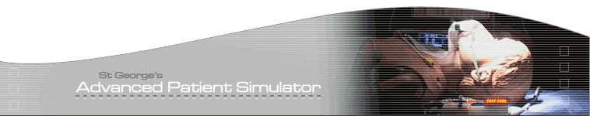






GAPS
St. George’s Advanced Patient Simulation
& Skills Centre
Notes:
What ideas of safety underpin your use of SBT?

Slide 2
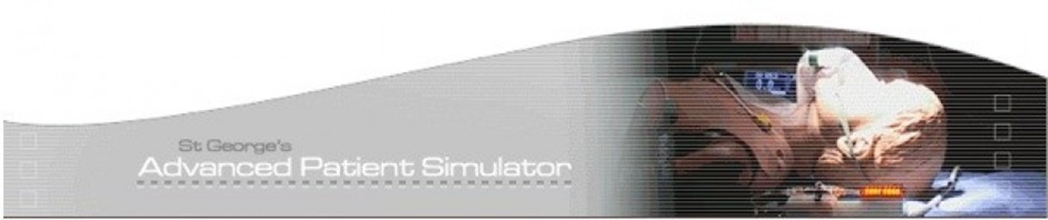

What does fidelity mean to you?
How do we use it to enhance learning & teaching?
www.gapssimulation.com

Slide 3
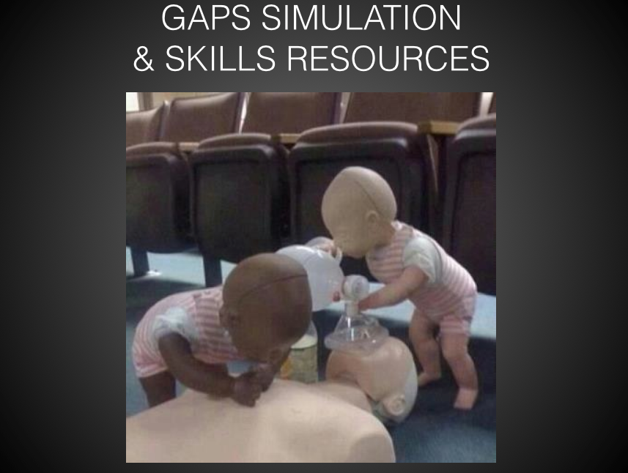
Notes:
WE HAVE OVER A DECADES WORTH OF RESOURCES THAT WE HAVE BUILT UP THROUGH CAPITAL PROJECTS, SHA / STELI FUNDING AS WELL AS INDIVIDUAL DESIGN MODIFICATIONS BY LEADING CONSULTANT FACULTY
ONE OF THE 1ST PAPERS ON SIMULATION BY PROFESSOR DAVID GABBA STATED THAT SIMULATION IS AND SHOULD BE CONSIDERED A TECHNIQUE RATHER THAN A TECHNOLOGY. HOWEVER THE CORRECT USE OF THE TECHNOLGY CAN BE AN ART IN ITSELF. MAKING THE TECHNOLOGY FIT FOR PURPOSE BY ALIGNING ITS USE TO THE LEARNING OBJECTIVES WHILST REMAINING INVISIBLE IS THE CHALLENGE.

Slide 4
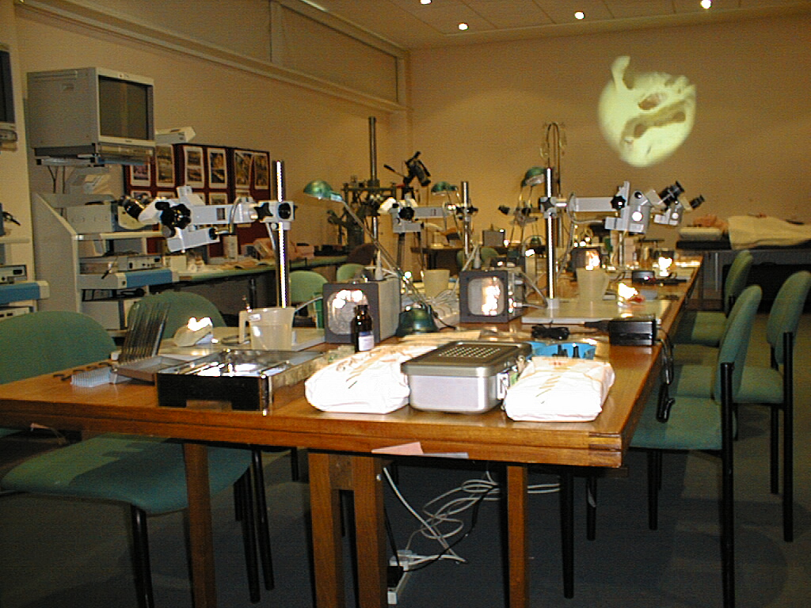
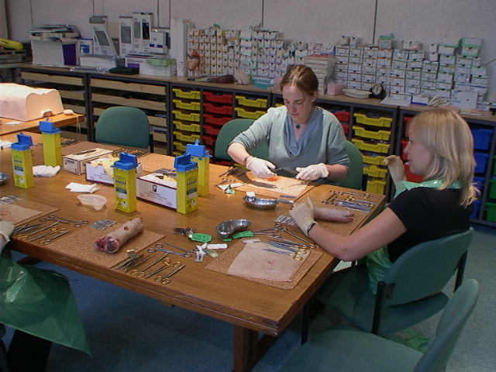
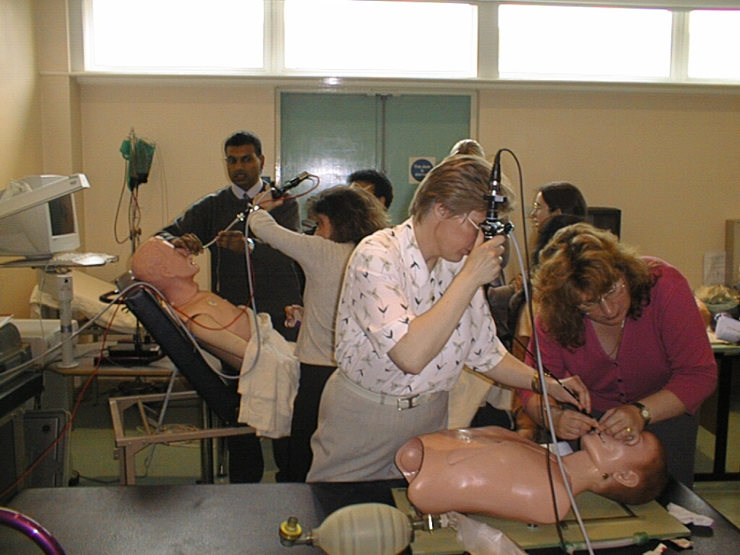
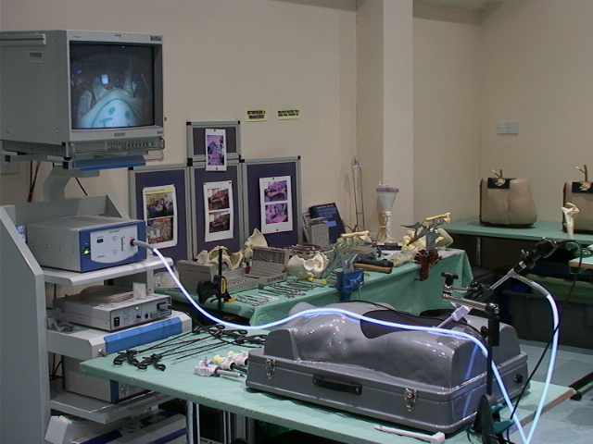
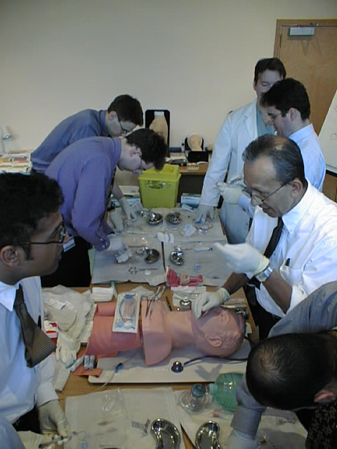
CLINICAL SKILLS 1999
Notes:
THE SKILLS LAB
RESPONDING TO NEED
RCS – BSSC, ATLS, LAPAROSCOPIC TRAINING
RCA – DIFFICULT AIRWAY MANAGEMENT / SIMULATORS
CLINICAL GOVERNANCE – TIME TO STOP PRACTICIING ON PATIENTS

Slide 5
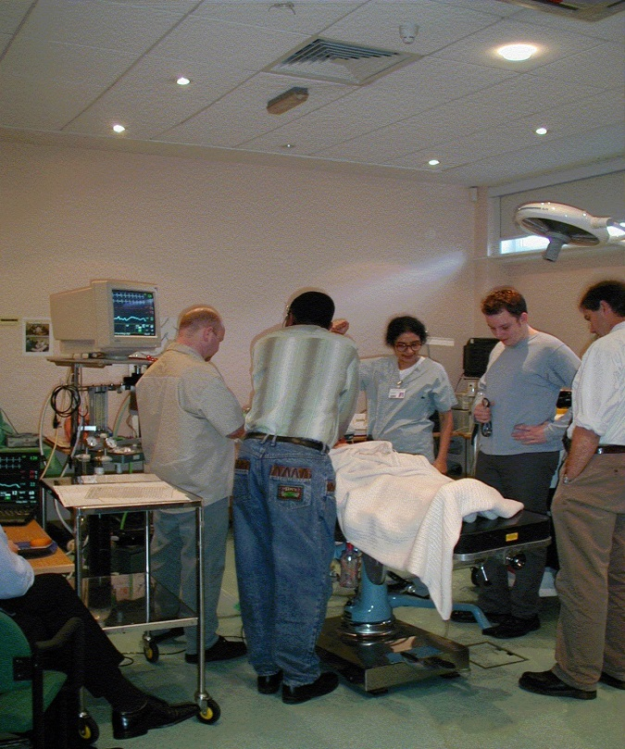
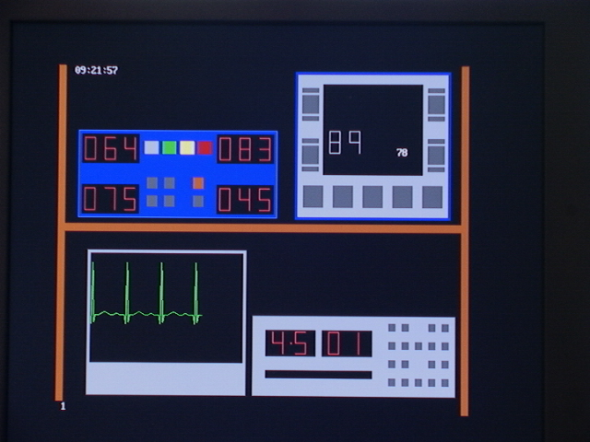
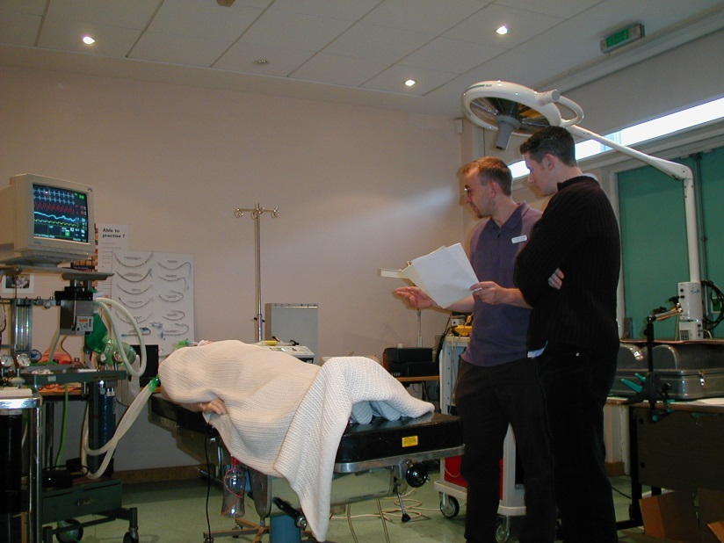
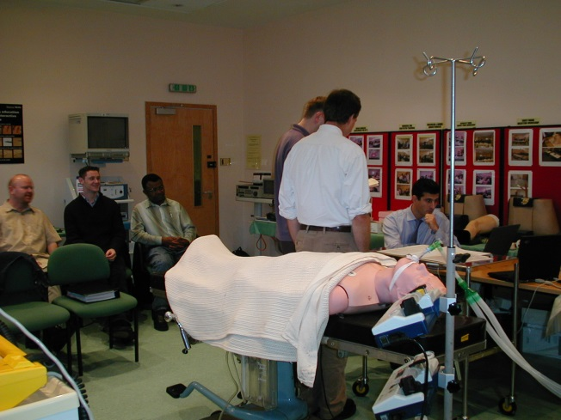
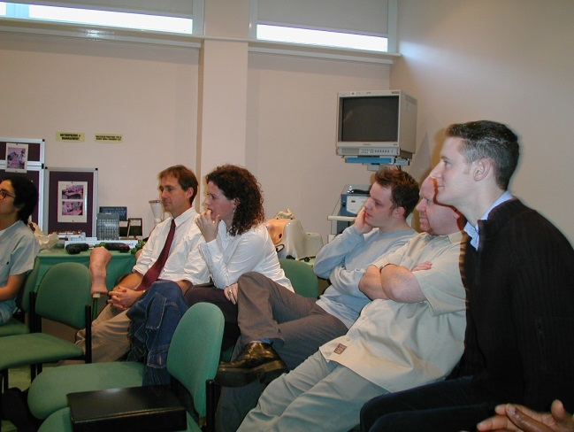
2000 LAB BASED SIMULATION
Access Computer Simulator
Notes:
ACCESS
Computer scenario simulator - Unrealistic monitor - Large amount of role play required - Not possible to have two problems occurring at same time
Not linked to a manikin

Slide 6
Simulators in Training?
Environment fidelity
Psychological
fidelity
Equipment
fidelity
Rehmann A, Mitman R, Reynolds M. A handbook of flight simulation fidelity requirements for human factors research. Technical report No. DOT/FAA/CT-TN95/46.
Notes:
THIS TYPOLOGY OF FIDELITY IS BASED ON THE TRAINER’S PERSPECTIVE.
THE REQUIRED OVERALL FIDELITY CONFIGURATION IS BEST DETERMIINED BY THE LEARNING OUTCOMES.

Slide 7
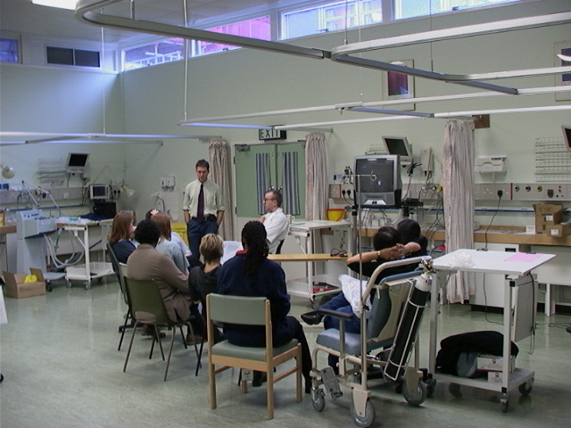
2001 WARD BASED SIMULATION

Slide 8
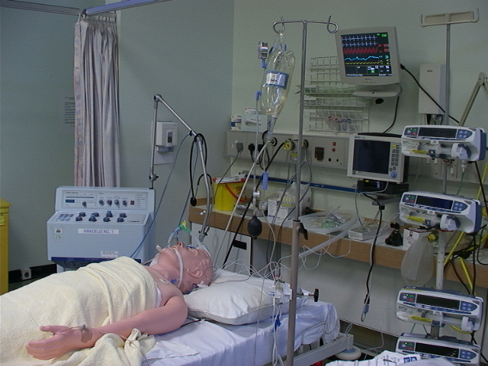
Notes:
HIGH ENVIRONMENT
HIGH EQUIPMENT
HIGH PSYCHOLOGICAL FIDELITY

Slide 9
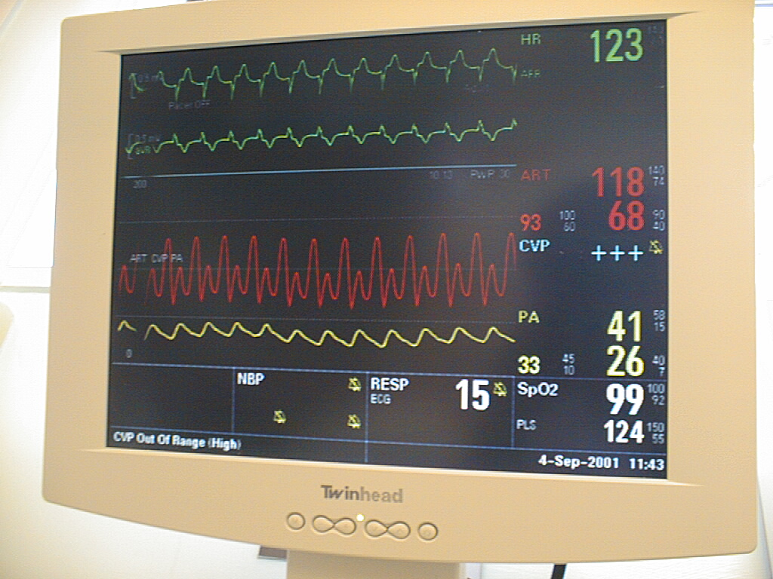
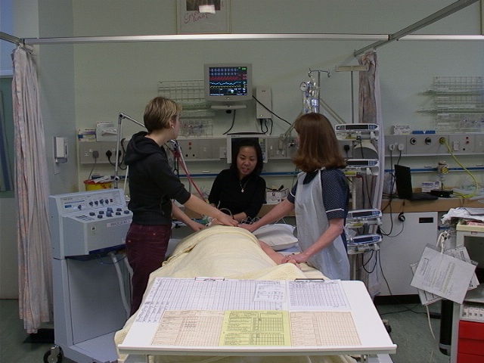
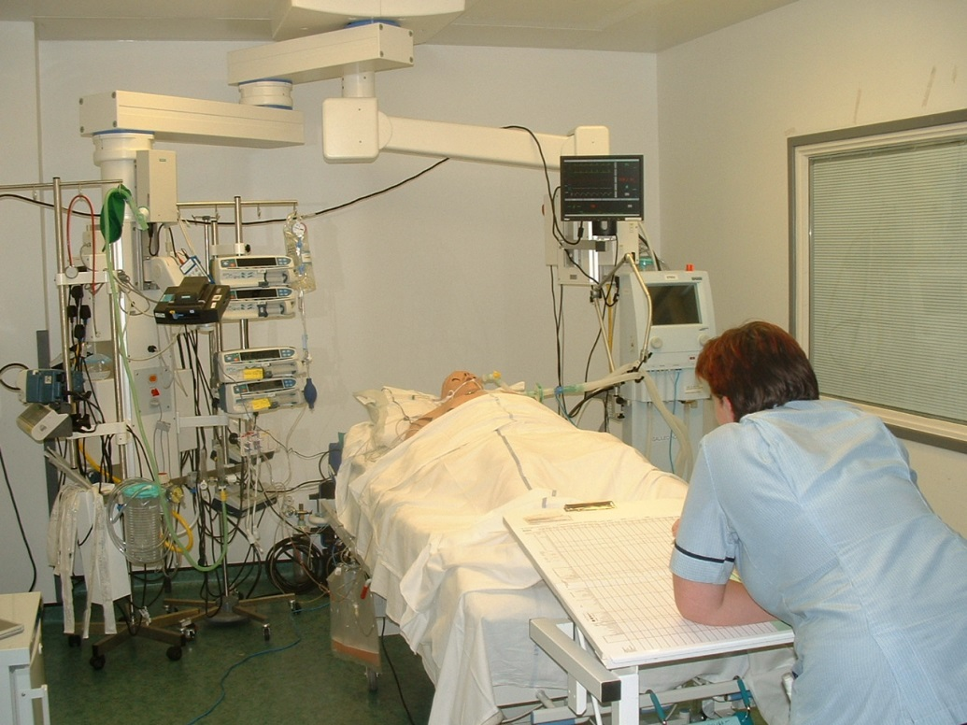
Notes:
FEM STOP MEDICAL ERROR & PACING ERROR X4 SI’S
SIMULATION TO RETRAIN STAFF
INTRODUCE NEW CONCEPTS ON EDUCATION

Slide 10
Low Fidelity ?

Slide 11
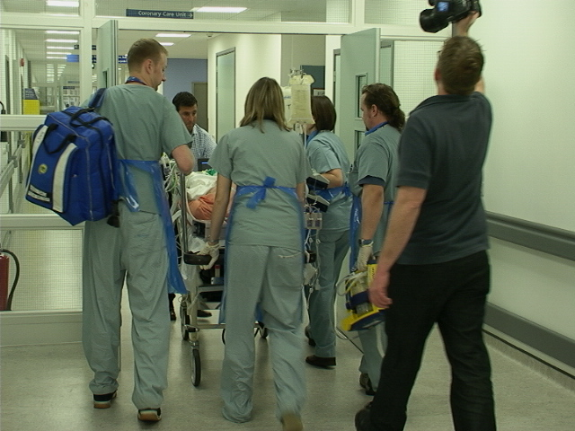
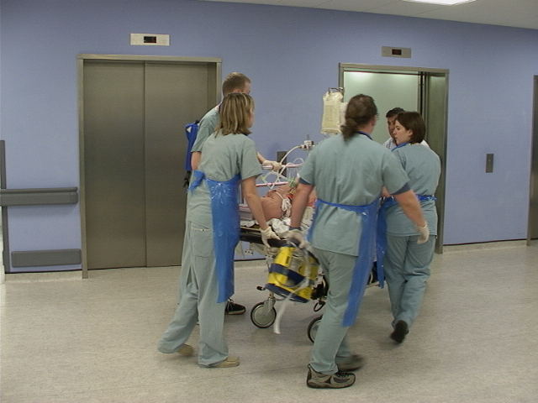
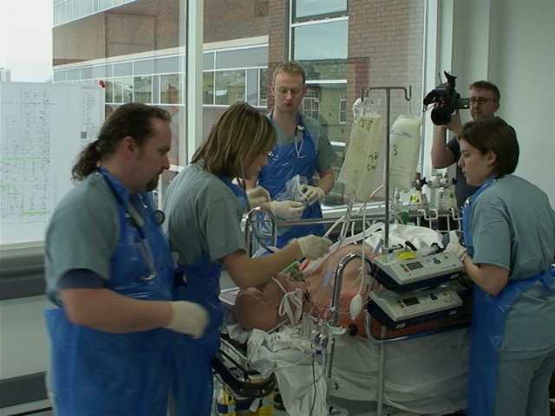
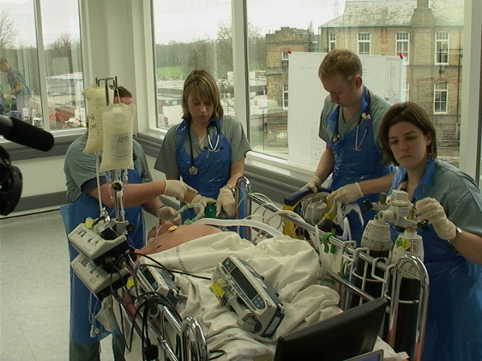
FULL EMERSION MULTIPROFESSIONAL TRAINING
M
O
B
I
L
E

Slide 12
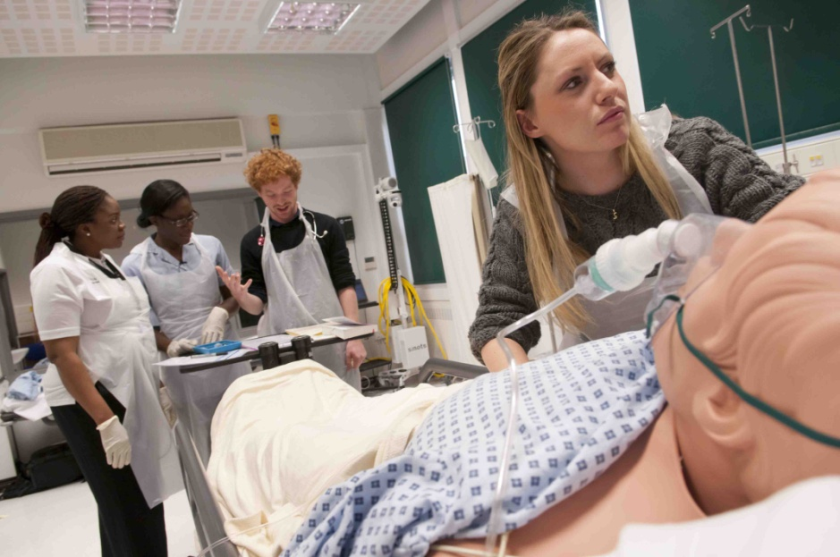
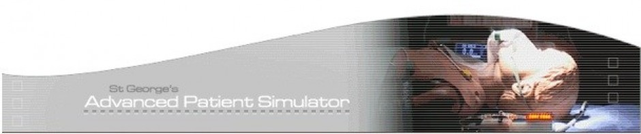
St Georges Advanced Patient Simulator, Clinical Skills & Dental Lab
Here at the GAPS centre our focus is on using Technology Enhanced Learning to provide an Inter-professional stance on Health Education.
High To Low Fidelity Simulation
Part Task Skills Practice & Training
Open Forum and Seminar Lectures
Self-reflection and peer-reviewed feedback in a psychologically & clinically safe environment.
Notes:
With over 20 years of experience, the centre has designed and delivered a full range of simulation and skills courses to thousands of healthcare professionals, in the continuing hope to reduce error, improve practice and increase Patient Safety.
Learning occurs before & after the event. Simulation is merely a vehicle to professional discussion
Mission Statement :
GAPS enhances patient care through learner-centred simulation and skills training. We design and deliver high quality programmes which recognise the essential place of multi-professional teams in the delivery of healthcare.

Slide 13
Fidelity
  Psychological
  Physical ( engineering )
Miller RB (1953) Handbook on training and training equipment design.
Air research & development command, United States Air Force
Notes:
PSYCHOLOCIAL - DEGREE TO WHICH THE SKILLS IN THE REAL TASK ARE CAPTURED IN THE SIMULATED TASK
PHYSICAL - DEGREE TO WHICH THE DEVICE OR ENVIRONMENT REPLICATES THE PHYSICAL CHARACTERSITICS OF THE REAL ENVIRONMENT

Slide 14
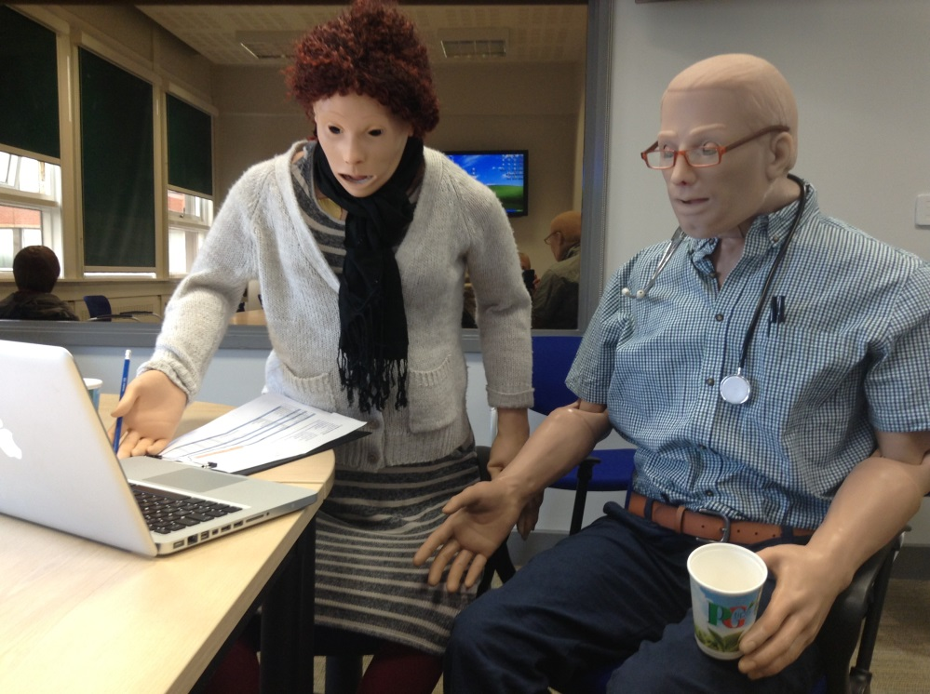
Medium - High Fidelity Simulation at St.George’s
The GAPS Model

Slide 15
Simulator Fidelity in Training?
  Low Fidelity
  Medium Fidelity
  High Fidelity
Notes:
SIMULATION CAN BE VIEWED AS A CONTINUUM THAT RUNS FROM FROM LOW TO HIGH LEVELS OF FIDELITY AND FROM LOW TO HIGH LEVELS OF AUTHENTICITY, DEPENDANT ON THE LEARNERS AND LEARNING OUTCOMES
OFTEN INCORRECTLY USED TO DETERMINE LEARNING OUTCOMES
MILLER DECRIBES

Slide 16
Is simulation is not the focus?
we try to create the ideal clinical teaching environment
the clinical context dictates the simulation environment be that . . . . . . .part-task, medium-fidelity, full-immersion, work-place simulation

Slide 17
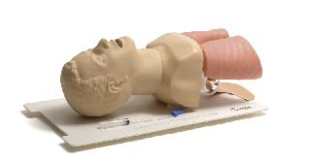

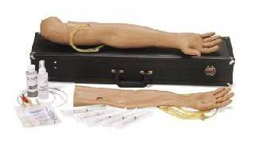
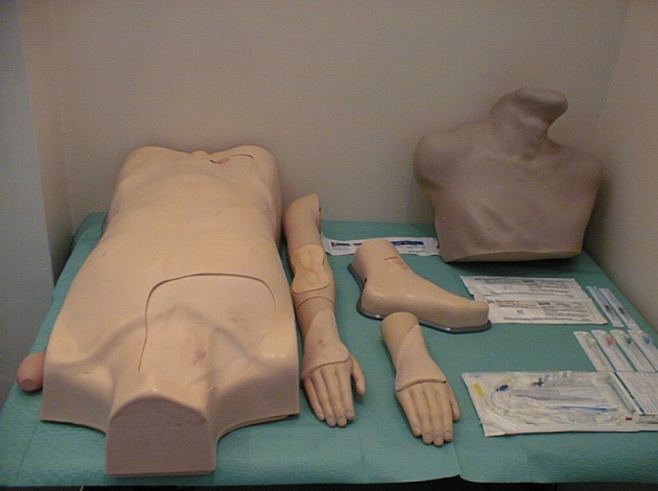
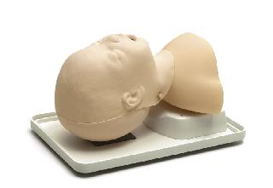
LOW FIDELITY
PART TASK TRAINERS
Notes:
TEACH PSYCHOMOTOR, PROCEDURAL AND TACHNICAL SKILLS
SIMPLE VERY COMMON PART TASK TRAINER THAT ALL ARE FAMILIAR WITH TO
LIKE HARVEY

Slide 18
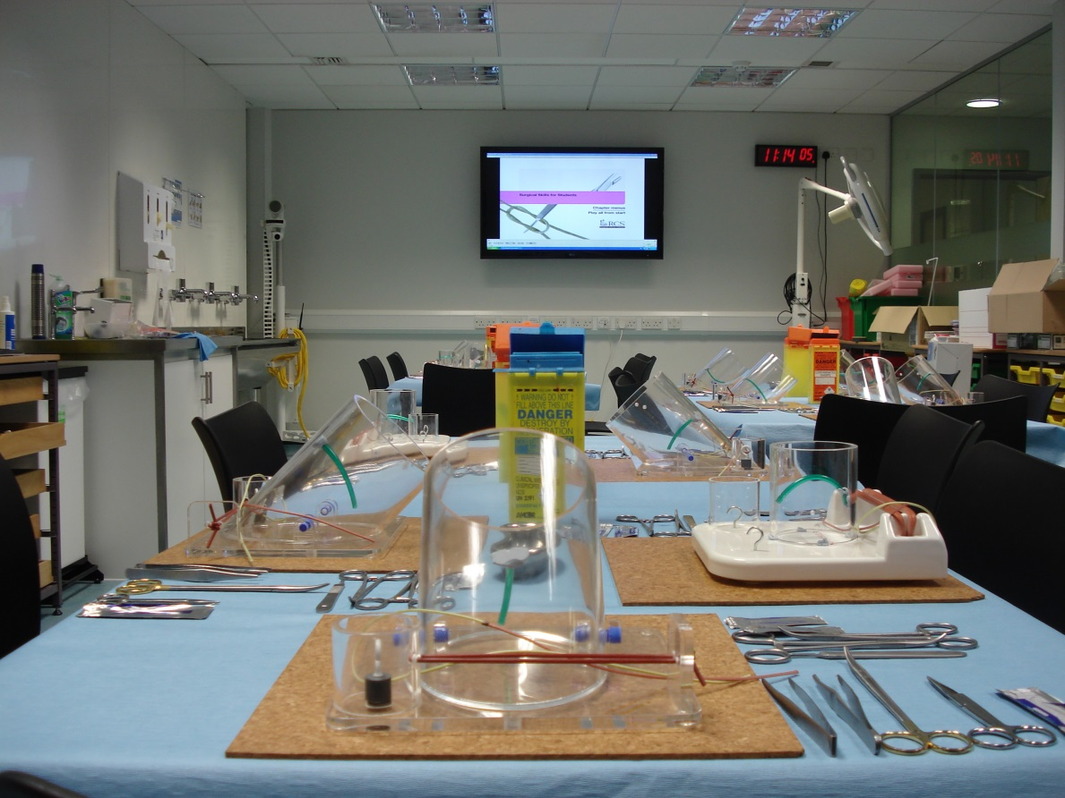
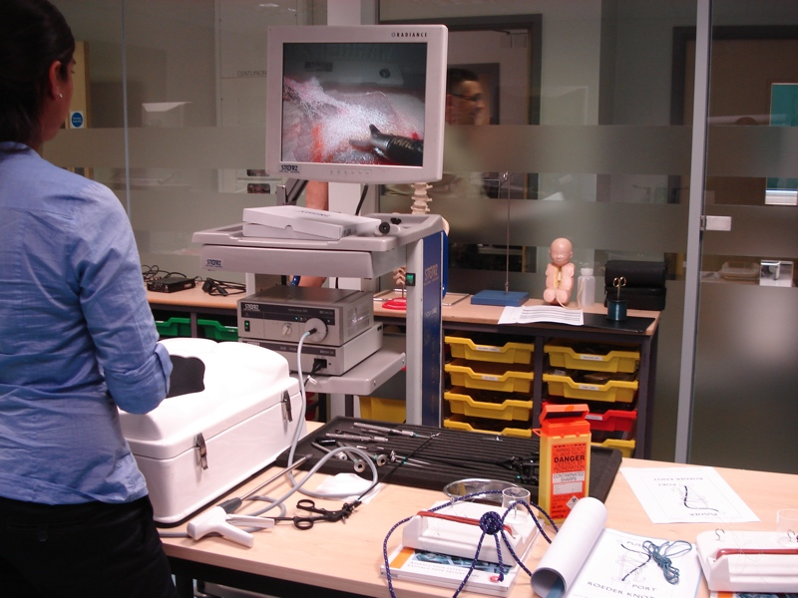
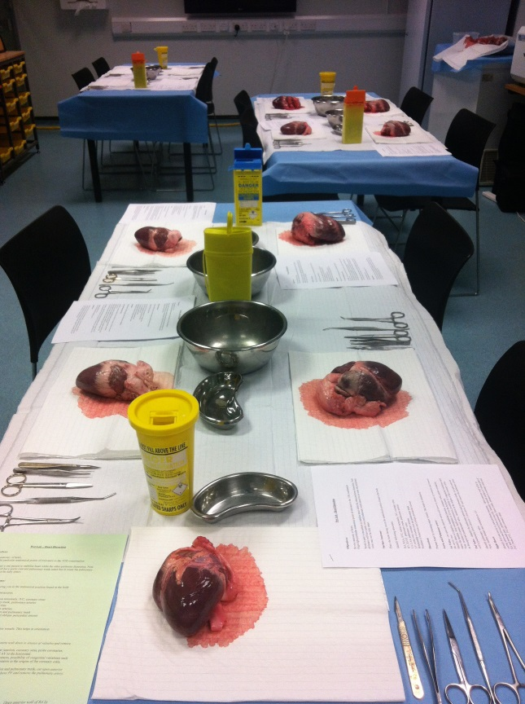
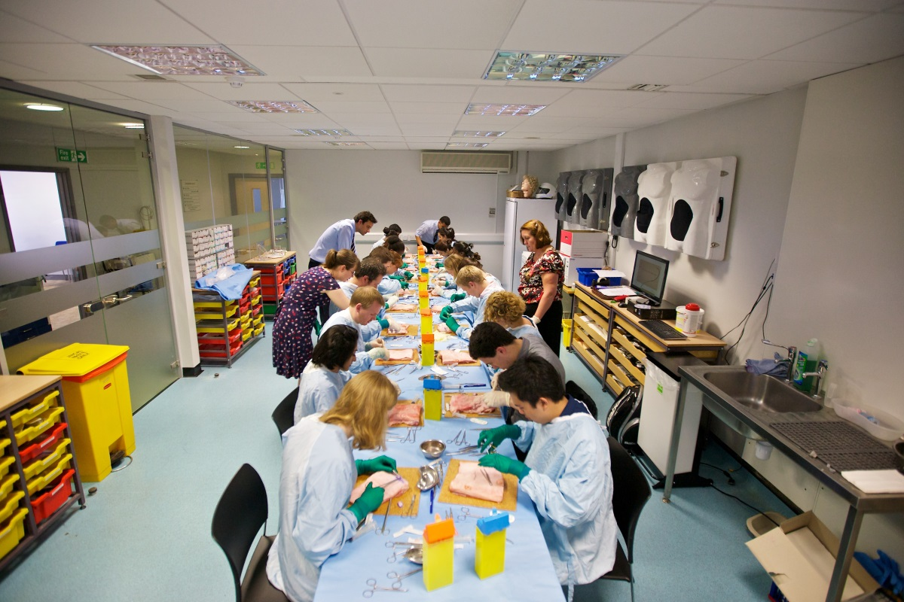
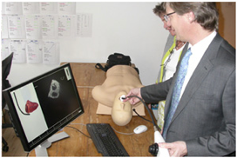
Notes:
SURGICAL SKILLS FOR STUDENTS – R.C.S
A FULLY EQUIPED SURGICAL SKILLS FACILITY THAT CAN ACCOMODATE A MAXIMUM OF 25 PARTICIPANTS DEPENDING ON CLINCIAL SKILLS TAUGHT.
PART TASK SURGICAL TRAINERS TO FULL IMMERSION VIRTUAL REALITY LAPROSCOPIC TRAINERS WITH ‘HAPTIC’ FEEDBACK
I BELIEVE THAT PIPPA WILL BE RUNNING A WORKSHOP LATER THIS MORNING WHERE YOU WILL SEE THE FACILITITES 1ST HAND

Slide 19
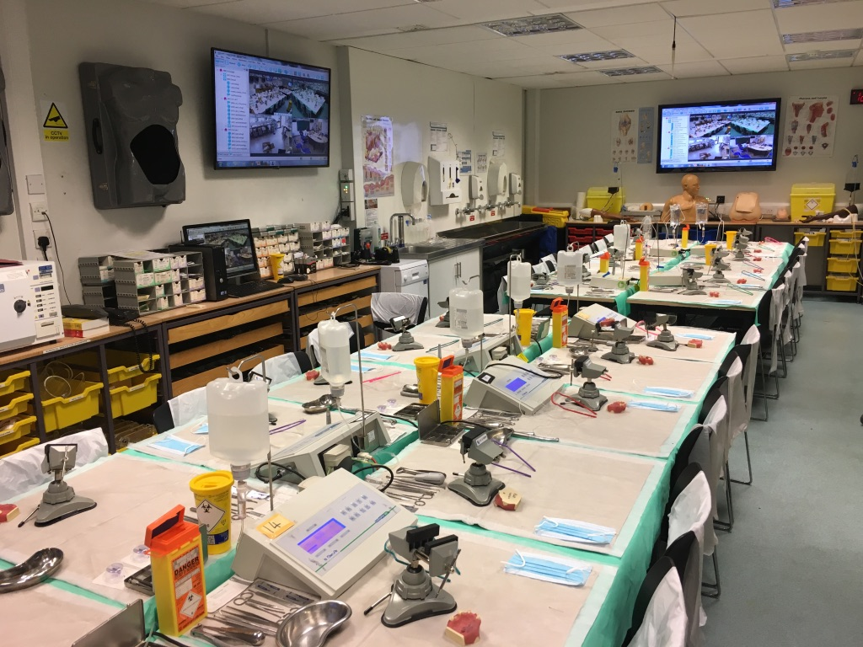

Slide 20
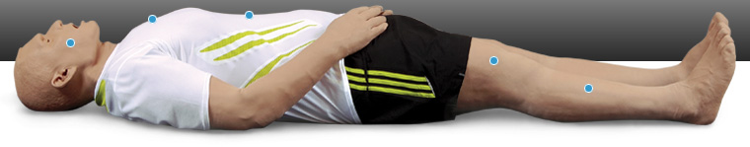
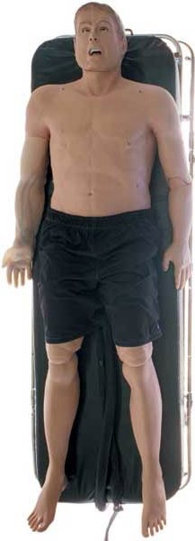
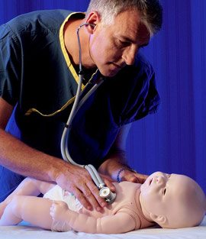
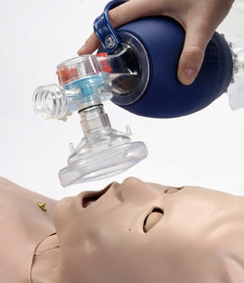
MEDIUM FIDELITY
PORTABLE HUMAN PATIENT SIMULATORS
Notes:
ADVANCES IN TECHNOLOGY OVER 5 YEARS
INSTRUCTOR DRIVEN VRS MODEL DRIVEN

Slide 21
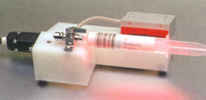
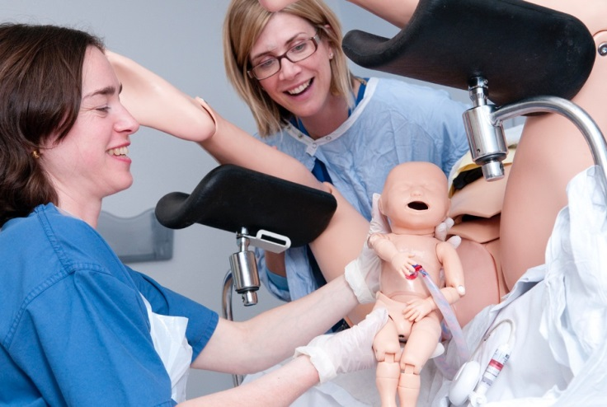

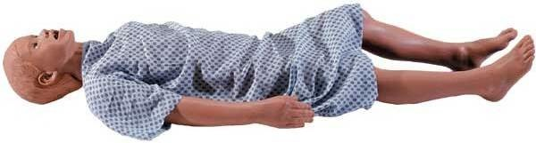
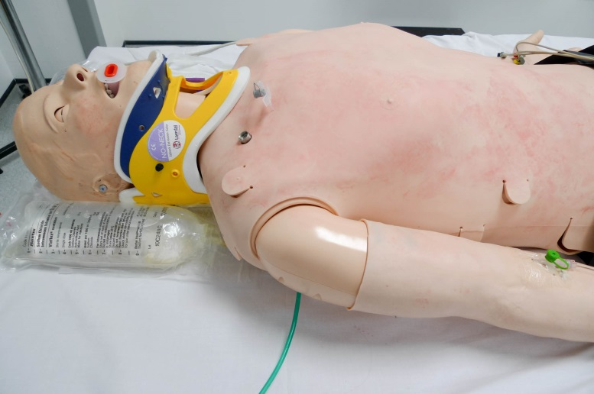

Slide 22
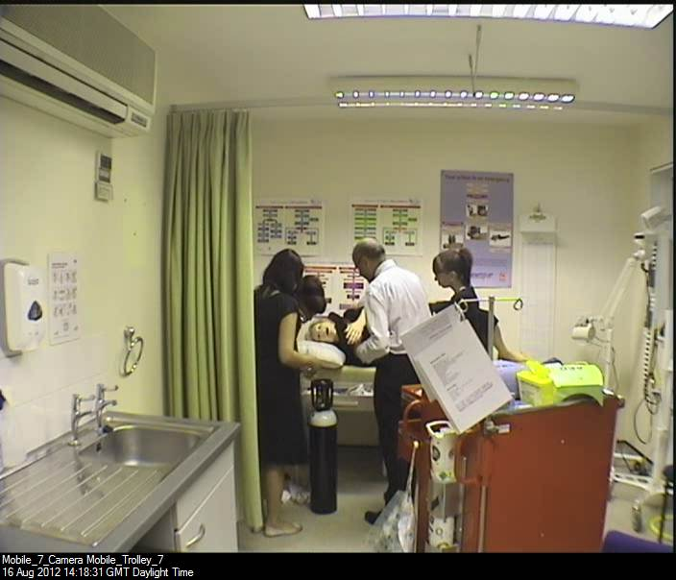
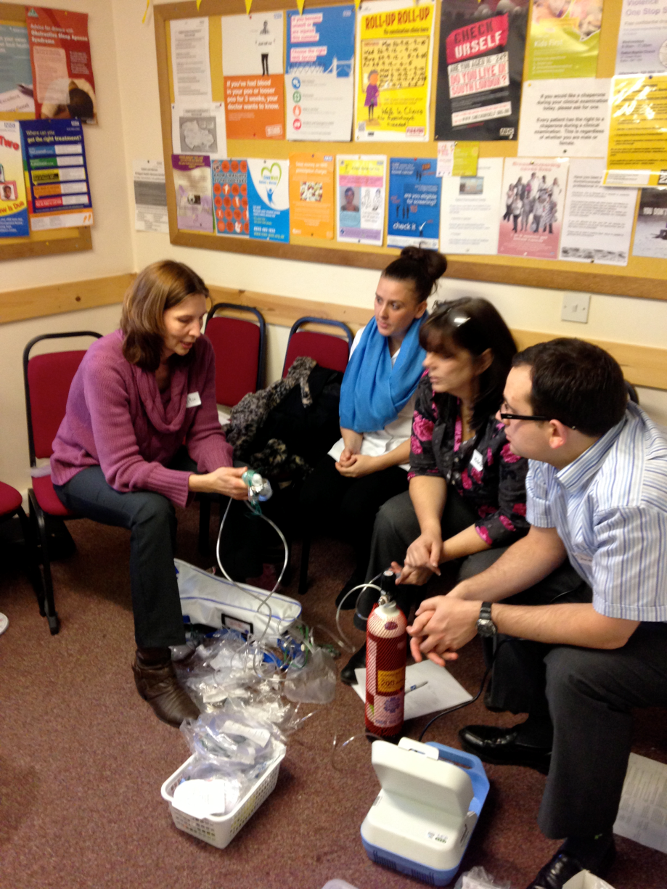
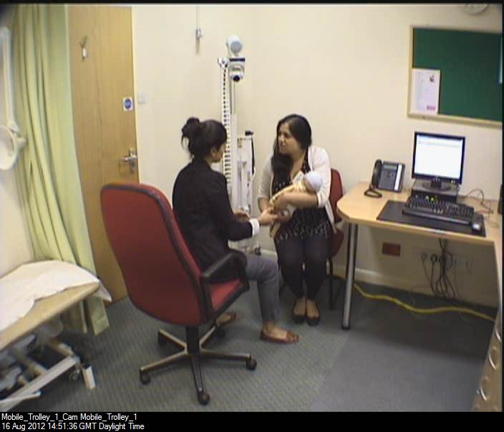
Off Site Mobile Initiatives
Notes:
WE USED THIS MODEL FROM MOBILE SIMULATION TO BREAK INTO OTHER TEAMS AND ENVORONMENTS FOR GENERAL PRACTIOTIONERS IN THE COMMUNITY HEALTHCARE ENVORONMENT
HIEC - WOMBATS

Slide 23
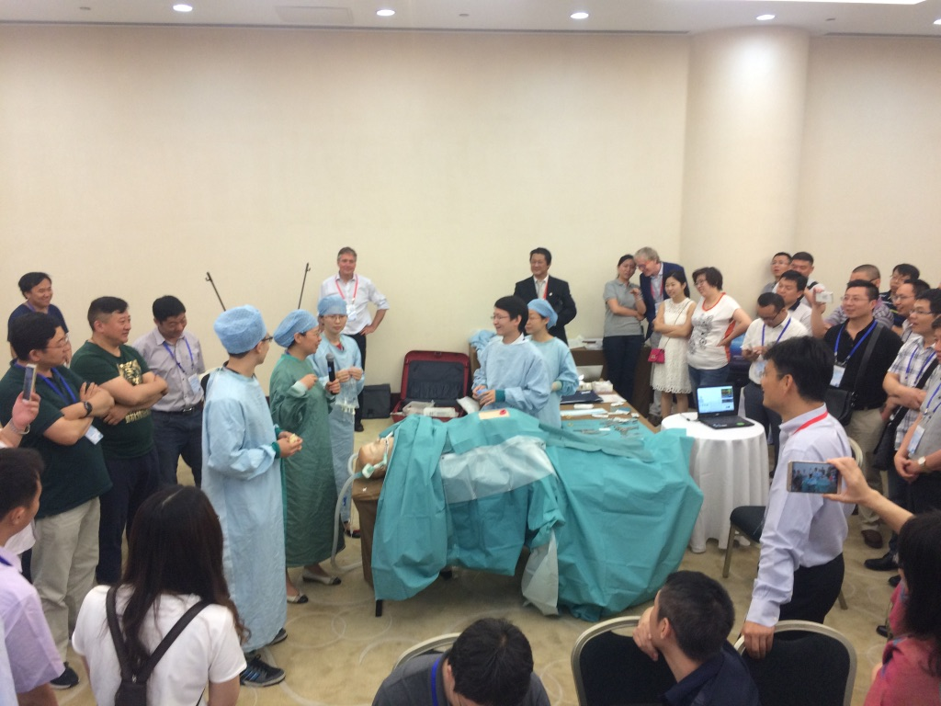

Slide 24
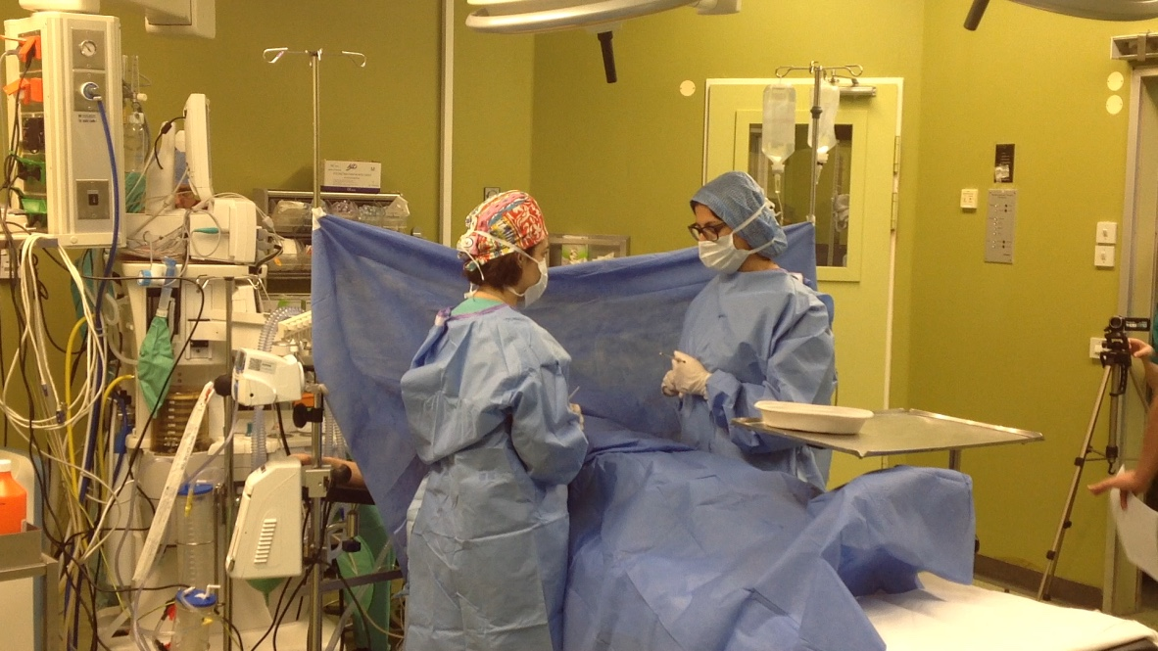
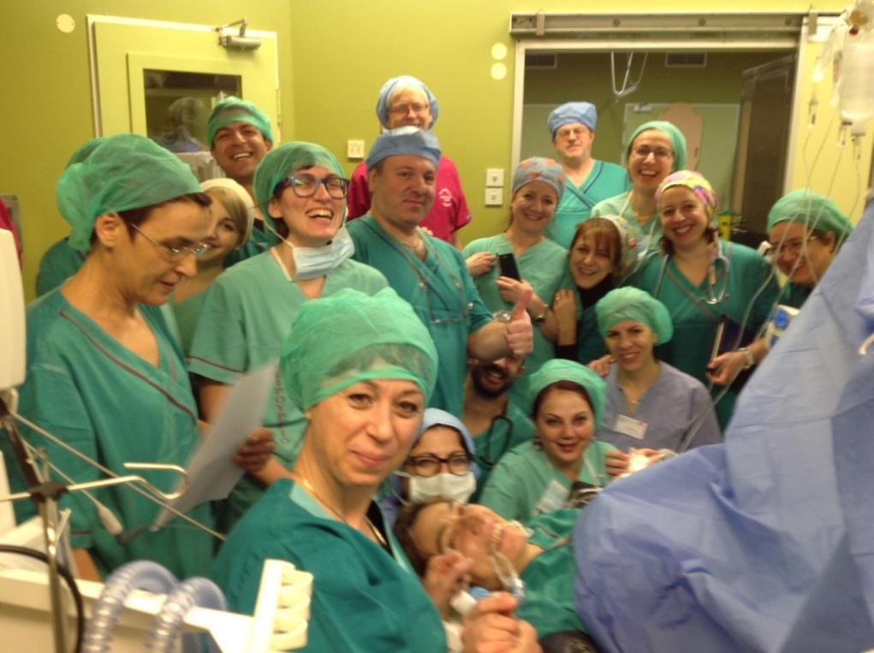
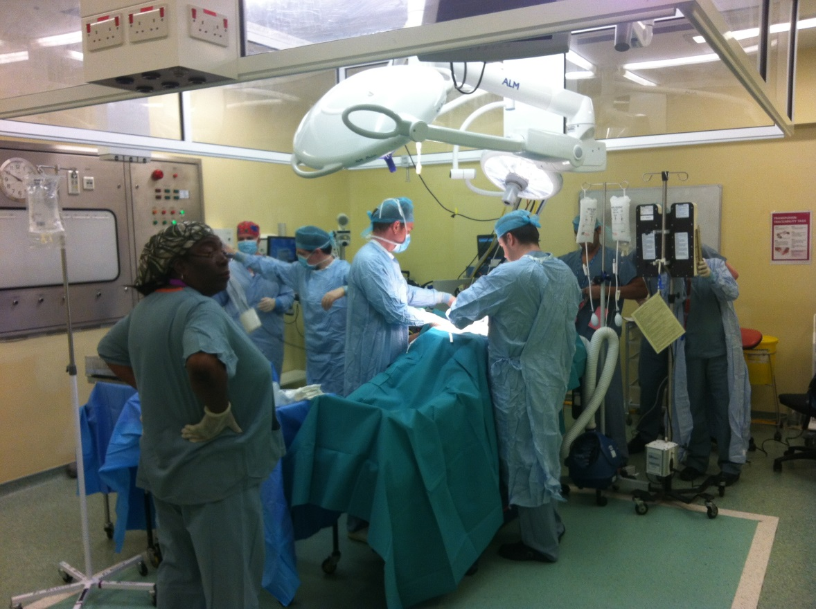

Off Site & Mobile
Notes:
WE USED THIS MODEL FROM MOBILE SIMULATION TO BREAK INTO OTHER TEAMS AND ENVORONMENTS
HIEC - WOMBATS

Slide 25


INTERGRATED OR HIGH FIDELITY
HUMAN PATIENT SIMULATORS
MODEL DRIVEN
DRUG RECOGNITION SYSTEM
OPERATES PRECISE COMPUTER
MODELING OF HUMAN PYSIOLOGY
AND PHARMACOLOGY
IT WILL REACT TO ITS OWN
ENVIRONMENT
FULLY COMPATIBLE WITH ALL
HOSPITAL INTERFACES

Slide 26

SIMULATION
FOR REAL TEAMS, IN REAL TEAMS
INTER-PROFESSIONAL
STUDENTS, POSTGRADUATE TRAINEES, TRAINED NURSES, DOCTORS AND ALLIED HEALTH PROFESSIONALS
Notes:
WE DELIVER Multi-professional team training
WE DELIVER Multi-professional skills training
All our courses look to re-create the ‘real team’ in order to look at the non bias human factors / non technical skills required in routine and complex clinical management
We train teams to work and look at team performance
FEEDBACK
Mission Statement :
GAPS enhances patient care through learner-centred simulation and skills training. We design and deliver high quality programmes which recognise the essential place of multi-professional teams in the delivery of healthcare.

Slide 27


Slide 28





Slide 29


Slide 30
Realism
may be micro (part-task) or macro (full-immersion)
centred around learning objectives
DANGER…

Slide 31


Slide 32


Slide 33

Using Fresh Tissue to create anatomy for fidelity?

Slide 34


Notes:
Danger
Teaching what we can simulate is all too common - ie tension pneumothorax in asthma scenarios

Slide 35




Slide 36



ETC Extremity Workshop https://vimeo.com/230727193

Slide 37


Slide 38



Slide 39



Slide 40


Equipment
Notes:
Gabba – Simulation is a technique not a technology!
. . . However since the change from the first simulator which focused on the patient and not the rest of the environment . . So lets explore this other dimension that has now become entwined in teaching and learning, and is now perhaps the more measurable component of simulation education.

Slide 41
Main Driver for providing mobile simulation within the clinical environment = FIDELITY
Environment fidelity
Psychological fidelity
Equipment
fidelity
Rehmann A, Mitman R, Reynolds M. A handbook of flight simulation fidelity requirements for human factors research. Technical report No. DOT/FAA/CT-TN95/46.

Slide 42
Simulation is not the focus?
we try to create the ideal clinical teaching environment
the clinical context dictates the simulation environment be that . . . . . . .part-task, medium-fidelity, full-immersion, work-place simulation

Slide 43


SBL -Teaching Methods
IS IT FIT FOR PURPOSE ?
Gordon et al., 2012 Medical Education, 46:1042-1054

Slide 44
WHAT DOES INTER-PROFESSIONAL SIMULATION TRAINING HAVE TO DO WITH FIDELITY?
Simulation is learner-centered rather than patient-centered and therefore the learner’s needs are given highest priority (Ziv, 2000).
Simulation is consistent with very different ways of conceptualising learning (Crotty 1998)
Simulation training proves to be relevant and accessible to a wide variety of staff, from different professions, with different preferred learning styles (Honey & Mumford, 1986)
Some learners prefer the immersion, some the feedback and debrief (Kolb 1984)
This is only part of the experience……We need to consider reflective analysis – both ‘on action’ and ‘in action’ (Schon 1987, Moon 1999)
Notes:
Having REAL team work together is far more realistic than faculty pretending to be assistants and supportive colleagues.

Slide 45




Slide 46




MEERKATS
Medical Emergencies: Evaluation, Response and Keeping Attention on Team Communication and Patient Safety
St George's acute care inter-professional courses for Doctors, Nurses, HCA’s, Medical & Nursing Students.
Notes:
We look after patients in multi-professional teams but we rarely learn in inter-professional groups.
Inter-professional Patient Safety Programme for Final Year Medical Students & Staff Nurses.

Slide 47
Main Driver for providing mobile simulation within the clinical environment = FIDELITY
Environment fidelity
Psychological fidelity
Equipment
fidelity
Rehmann A, Mitman R, Reynolds M. A handbook of flight simulation fidelity requirements for human factors research. Technical report No. DOT/FAA/CT-TN95/46.

Slide 48
GET READY AND GO FOR IT
6 month starting pistol – ideally go fast and fail quickly rather than making slow progress

