Slide 1

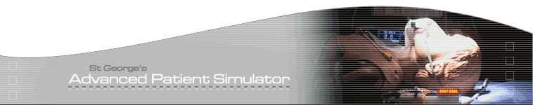






INTERPROFESSIONALISM
Working Better Together at the
MENTAL- PHYSICAL INTERFACE
Dr Asanga Fernando – GAPS Clinical Co-Director

Slide 2
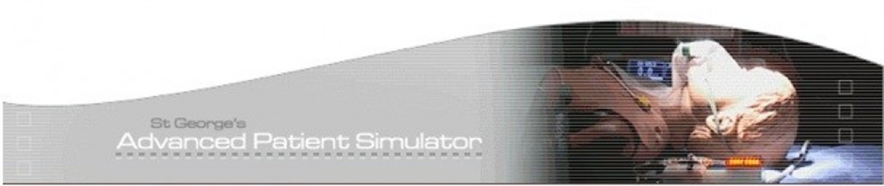



Challenges at the Mental Physical Interface
Systems structures – Acute/ MH/ community
Awareness – the scale of the problem - comorbidity
Stigma and attitudes
Training structures (e.g RGN, RMN)
Culture (silo)
Informatics
Financial & Participant recruitment
Faculty recruitment and development
Leadership
@GAPSsimulation
www.gapssimulation.com

Slide 3





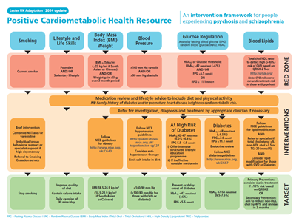








Integration
Working to deliver excellence in mental health simulation as part of South London and Maudsley NHS Foundation Trust
Notes:
The future NHS will need a workforce that is effective in integration – across traditionally distinct subject areas
The 5YFV highlights the need to bridge -1. Physical health and mental health 2. Primary care and secondary care 3. Health and social care
We need to do this in clinical practice – but to do this – we need to do this in learning. In Simulating. In practicing. In recognising the importance of culture change.

Slide 4
Inter-professional simulation should be:
Learner led (Ziv, 2000).
Appropriate for all (Honey & Mumford, 1986)
Integrative
Reflective (Schon 1987, Moon 1999)
Empowering
to ‘work better together’ – and help to build an effective workforce for the future NHS.
@GAPSsimulation
www.gapssimulation.com

Slide 5
We use simulation to learn inter-professional learning……
By thinking about:
Inter-professional educational design
Inter-professional faculty development
Inter-professional experience
Inter-professional leadership
@GAPSsimulation
www.gapssimulation.com
Notes:
Inter professional experience meaning in simulation – the simulation and the feedback
Inter professional leadership meaning further capacity building and an inter professional culture of recognising the importance of a shared vision and allocation of resources to achieve this. Interprofessional leadership requires having an inter-professional commitment to TEAM based success criteria to enhance patient care that are drawn up by the TEAM. These must be SMART.

Slide 6



INNOVATIVE, INTERPROFESSIONAL SIMULATION WORKSHOPS AT THE MENTAL-PHYSICAL INTERFACE : SWAMPI - A novel mixed methods effectiveness study
Asanga Fernando et al 2017

Slide 7
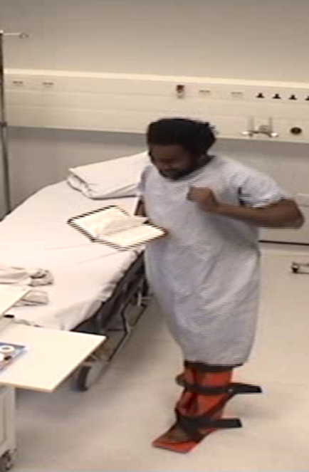
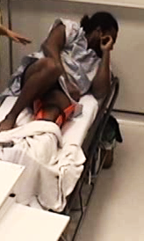
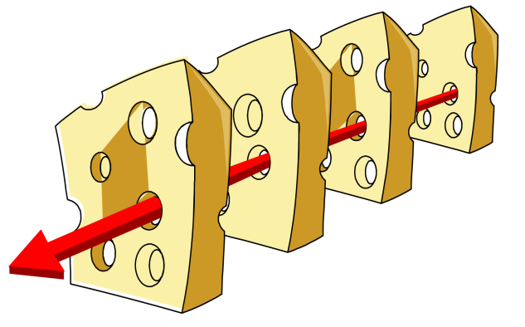
4. No medical review at weekend
Increasingly immobile due to inadequate analgesia
Staff worried about MS
=Patient develops a DVT, PE
Paranoid, distressed patient admitted to ED. Box splint, Tx to Ortho
2. Isolated side room in Ortho ward.
Increasing Agitation, Aggression.
No de-escalation, security called
3. Tx to Psych at weekend to stabilise MS first
No handover or TTO with transfer/details about ortho F/U
Reason J. Human error: models and management. BMJ 2000;320(7237):768-70

Slide 8
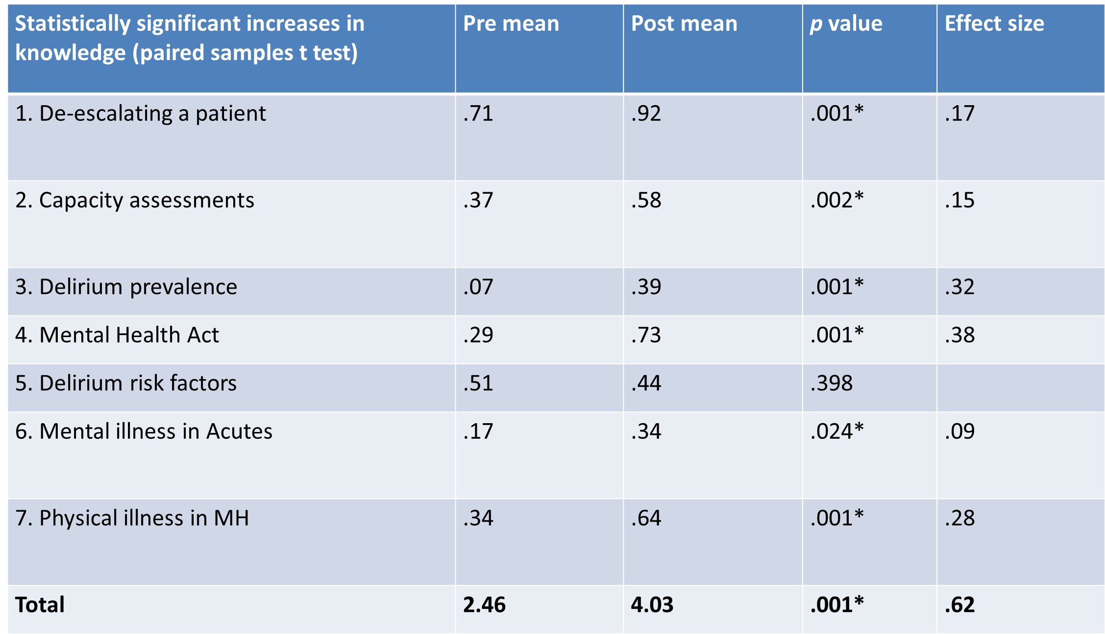

Slide 9
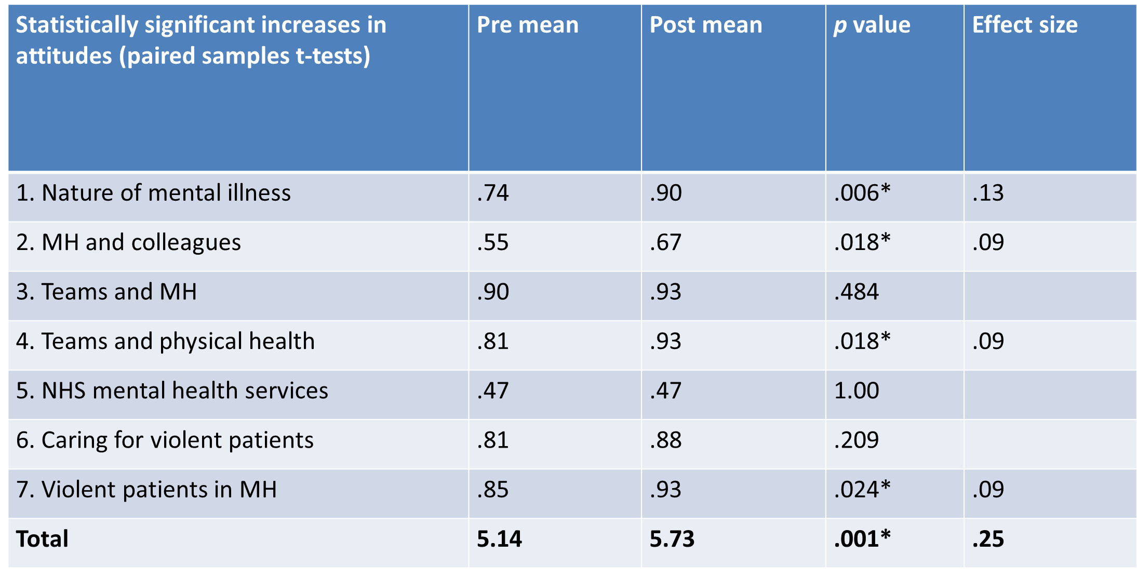

Slide 10
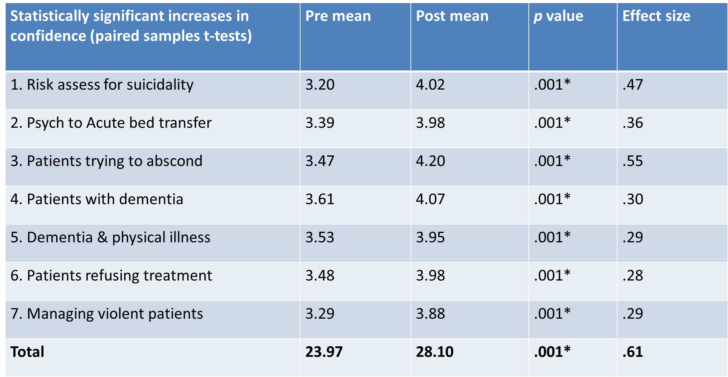

Slide 11
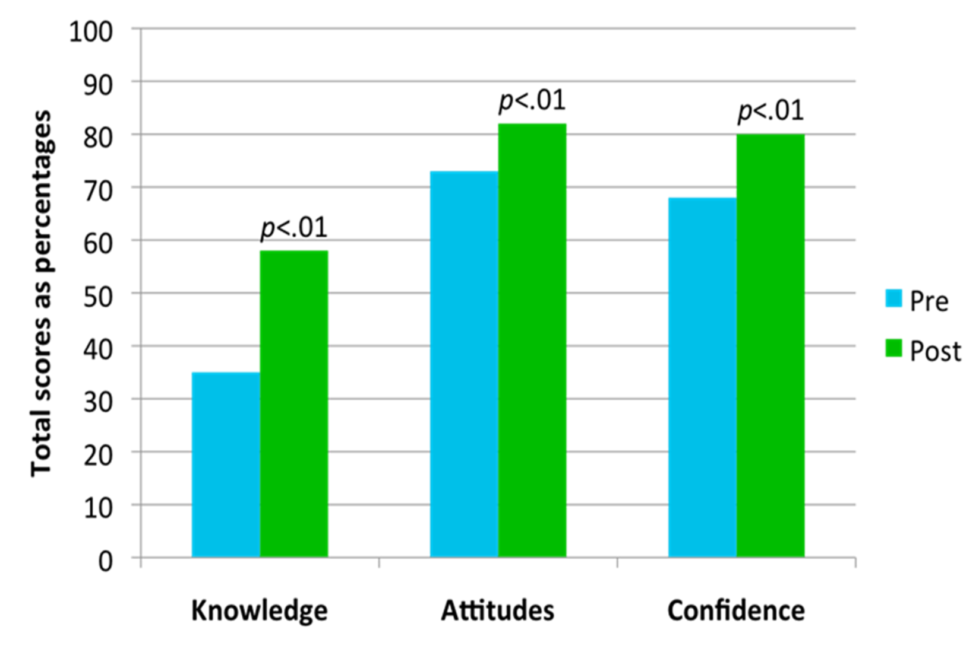

Slide 12
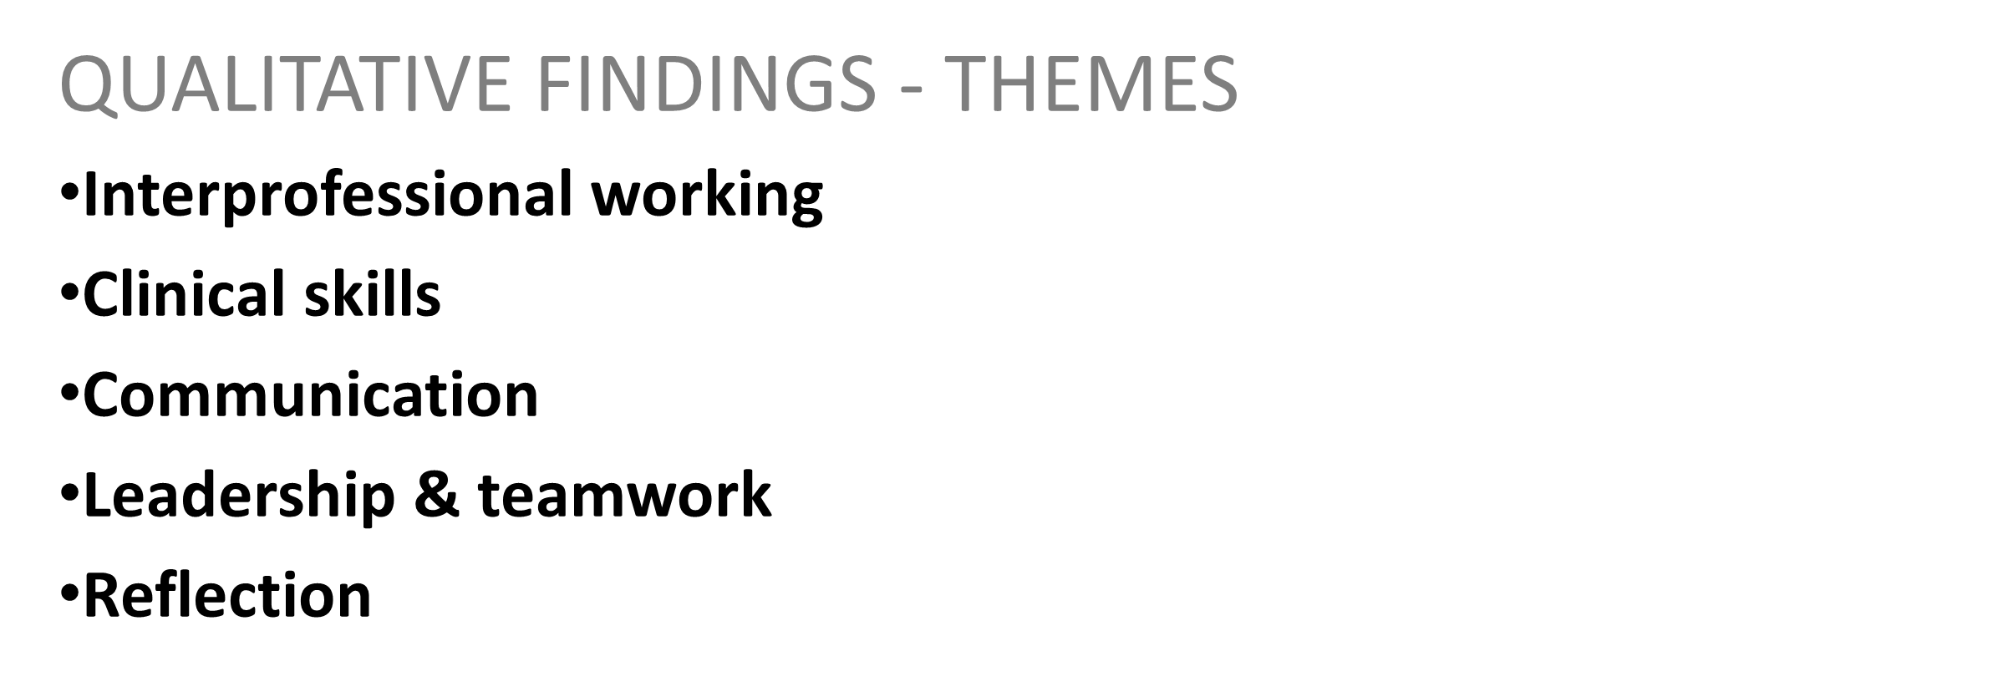
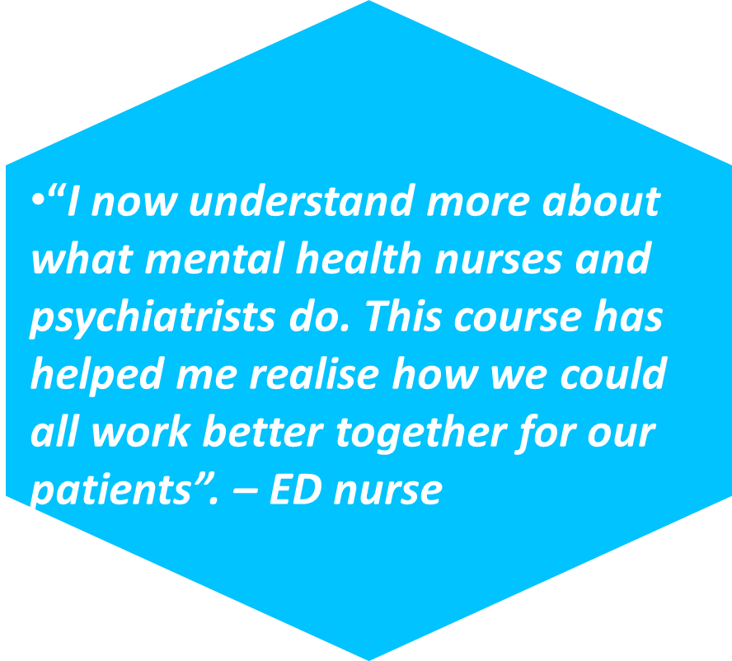

Slide 13
Inter-professional
Evidence Based
Informed by real practice situations
Evolved
Tangible changes Post intervention
Replicable
Sustainable
@GAPSsimulation
@asangafern
www.gapssimulation.com

Slide 14
Could this approach work at your trust/place of work?
What ideas do you have about interprofessional working at the Mental-Physical Interface?
How can we help ?
@GAPSsimulation
@asangafern
www.gapssimulation.com

Slide 15

We would love to discuss your thoughts afterwards, and possible collaborations including your ideas of best practice
Please stay in touch!
Details below
Asanga.fernando@kcl.ac.uk
@GAPSsimulation
@asangafern
www.gapssimulation.com

