Slide 1





PRACTICE EDUCATORS
Huon Snelgrove – Medical Educationalist
Greg McAnulty – Director of GAPS
Nicholas Gosling – Head of Simulation GAPS
Jasmine Burnett – Clinical Simulation Specialist
Christopher Broom – Clinical Simulation Specialist
Andrew Sykes – Senior Technician GAPS
Jessica Style – Practice Nurse Educator
Chido Muchanet – Clinical lead for skills training and development
@GAPSsimulation
www.gapssimulation.com

Slide 2
What we know -
  Financial restrictions have severely reduced the opportunities for non-mandatory nursing training (CPD)
  Sim centre based inter-professional learning becomes difficult to provide
Known knowns –
  Commitment of sustainable healthcare education providers
  Practice Nurse Educators provide local, clinical area specific training for nurses and clinical teams.
Notes:
Financial restrictions have severely reduced opportunities for non-mandatory nursing training (CPD)
Inter-professional learning becomes difficult to provide which is highly advocated by our simulation department as part of a safety culture, becomes very challenging to provide, and professional development for our nurses is at stake.
Successful in-situ simulation based learning requires committed clinicians and healthcare providers to take ownership of and enthusiasm to provide local ward orientated mobile based training (WOMBATS).

Slide 3
Results from questionnaire and focus group
Challenges
To the PNE
Experience
Technology Enhanced Learning is not something embedded into the nursing curriculum or training (cultural implications)
Financial
- Training cuts (eMAST)
- External training costs
- Covering shifts
Staffing
- Recruitment /retention
- High turnover
- Training exposure
Time
- Other commitments
Resources
- Work in isolation
- Lack of support
Eg. 6 wards/300 nurses
Responsibilities
- Supernumerary
- Overseas recruits
- CPPD
- Competencies
7.5 managerial
7.5 clinical
22.5 teaching

Slide 4
Will teaching someone to “turn it on and get it out of the box” increase use of simulation in clinical areas?
Notes:
Strategy - to work with Practice Nurse Educators (sustainable trainers with
continuity in their post) to identify whether Simulation & Technology
could be used to enhance the teaching programmes already in place or to develop new ways of learning in clinical environments.

Slide 5
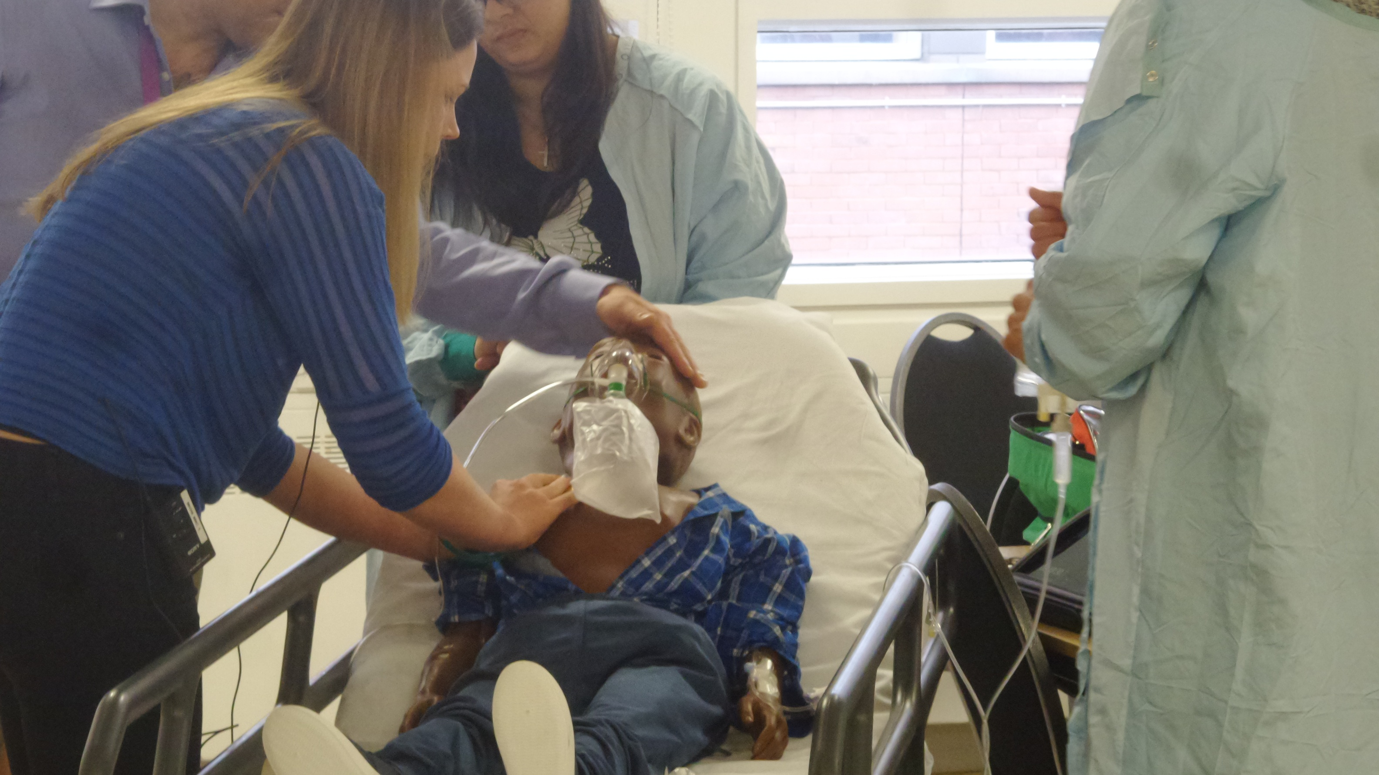
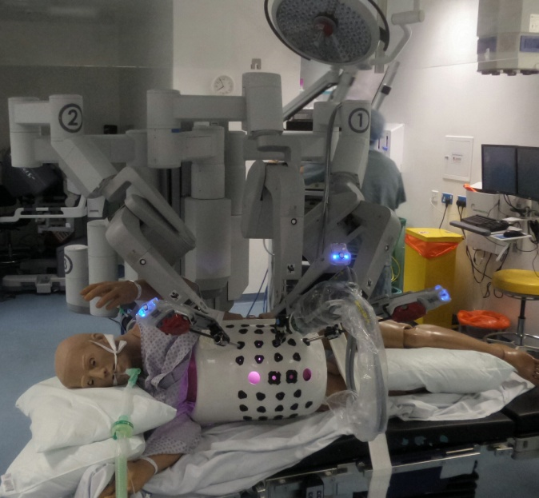
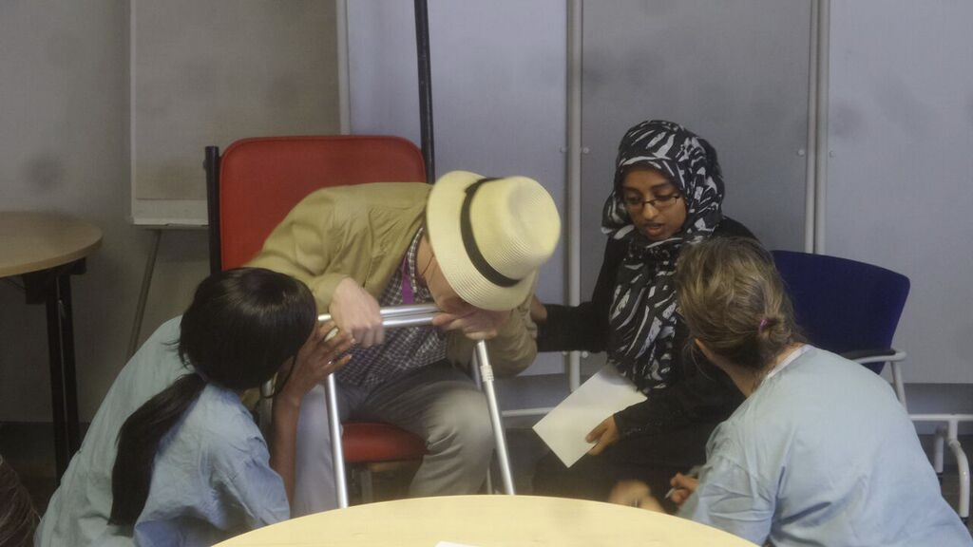
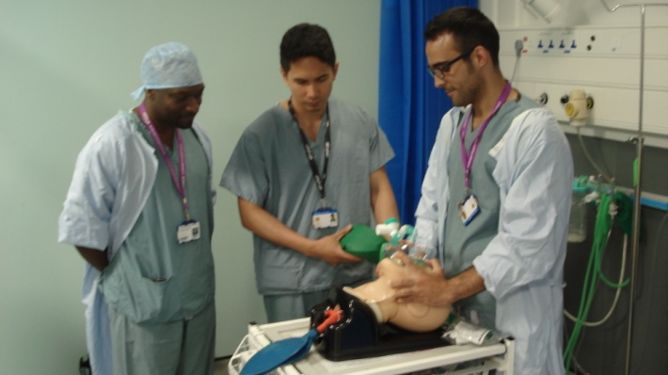
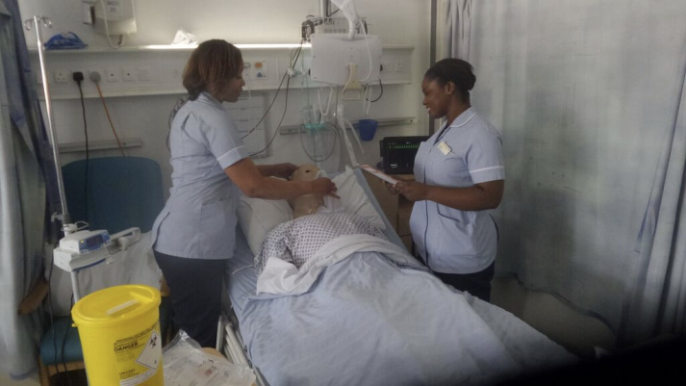
Goal
To train Practice Nurse Educators to use Technology Enhanced Learning (Simulators/Role Play/Part-Task) as an Educational Tool to provide a sustainable training model for in-situ, reusable programmes.

Slide 6
Objectives of the Course
to be able to pick up, turn on and use various modalities of simulation independently from the Simulation team.
to design, develop and deliver simulation exercises to nurses in their clinical area aligned to their service needs and local training requirements
To be able to conduct debriefing sessions with groups of learners, using constructive feedback to allow participants to reflect on their practice.

Slide 7
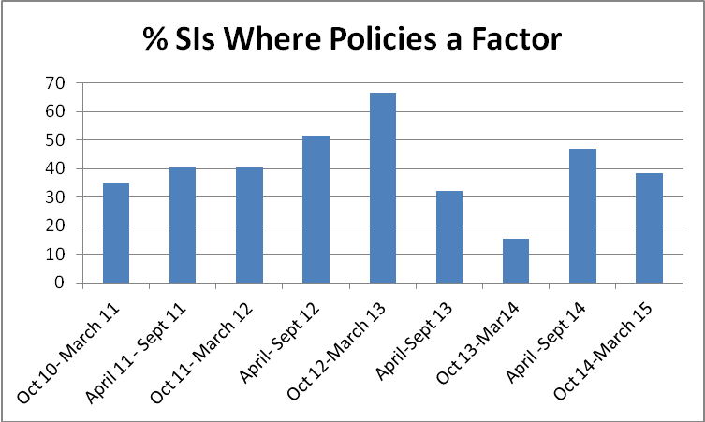
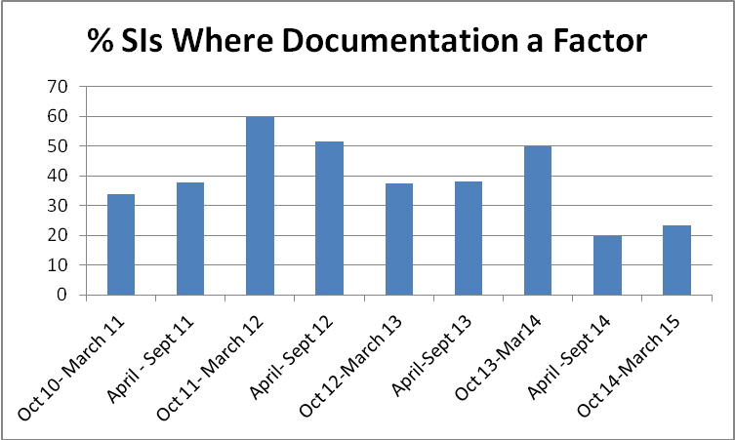
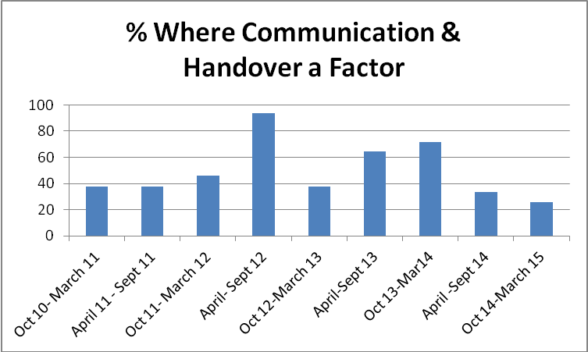
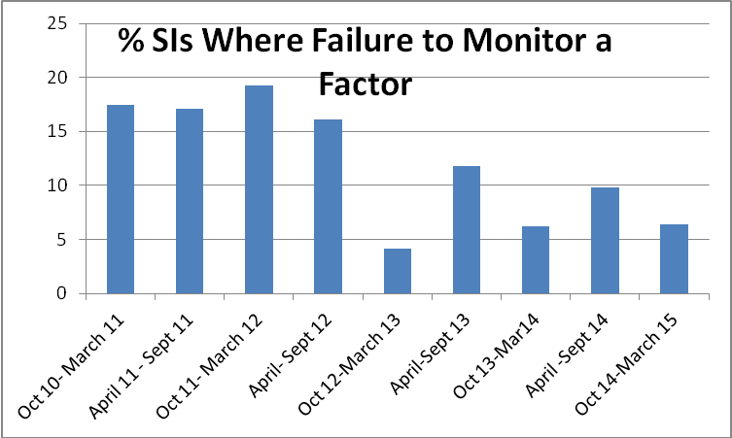
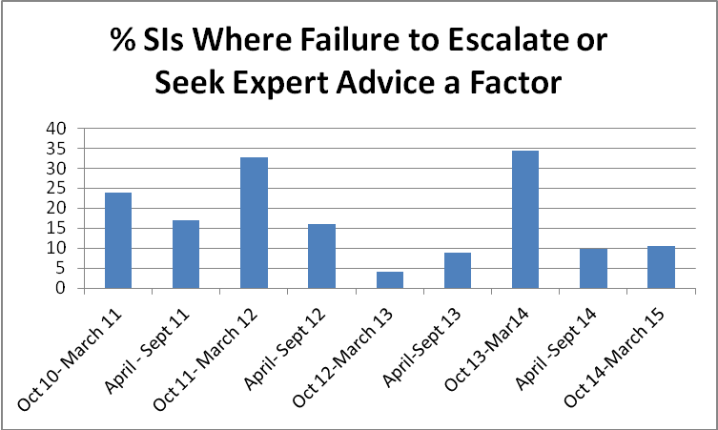
…Objectives…
Technology Enhanced Learning– How does TEL interface with Healthcare Education, Human Factors & Local Serious Incidents.
Serious Incidents (SIs) St Georges Healthcare NHS (2011-15)

Slide 8
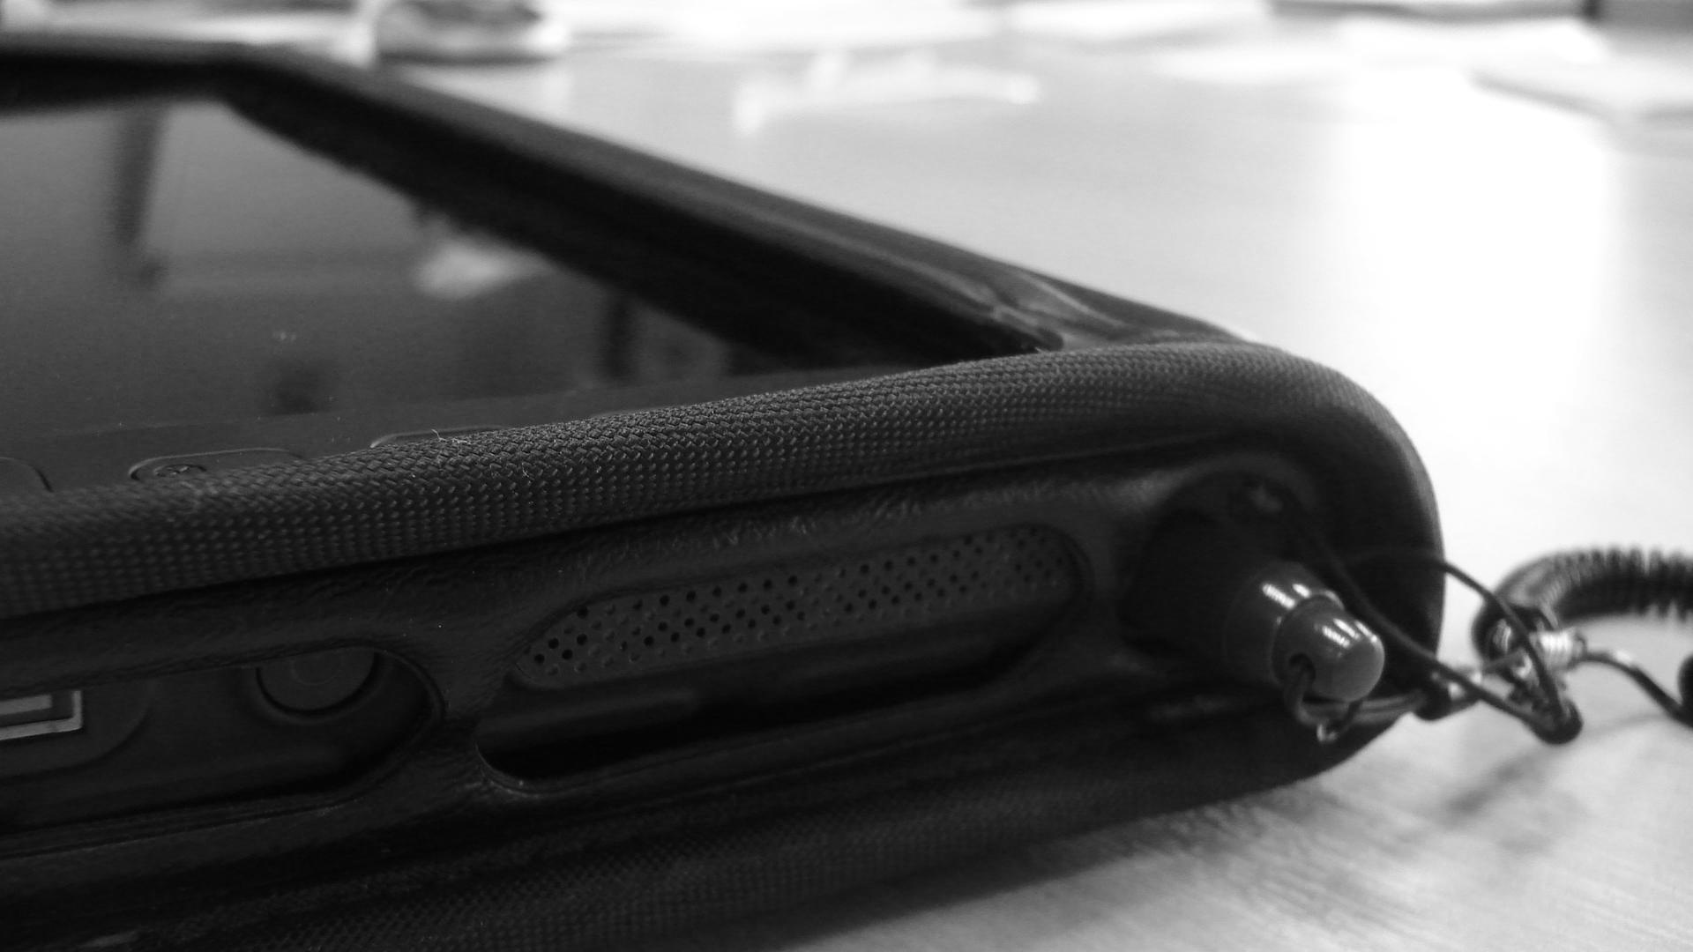
Trainers & Technology –
Introduced to using the mannequins. Anatomy & Physiology vs Technology. Triaging/Assessing a Simulator.

Slide 9
Scenario Design
Designing Mobile Simulation to meet the needs of your environments and learner groups.
Outcomes | Activity | Measure

Slide 10
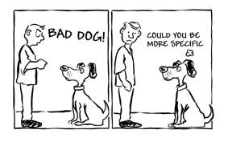
Simulation a “Vehicle to Professional
Discussion about Practise”
Feed Up Feed Back Feed forward
What are our expectations?
What might happen?
What did we
find problematic
or challenging?
What did we do well?
What could we improve?
What would we do differently?
Who likes Feedback?
Notes:
In Healthcare we quite often discuss what went wrong (root cause analysis)…
What we don’t do very well is talk about what went well (celebration of our successes)
Setting the Standard – What are our expectations?
What are the risks/what might go wrong? & What are our contingency plans?
10

Slide 11
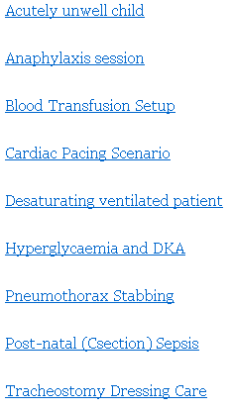
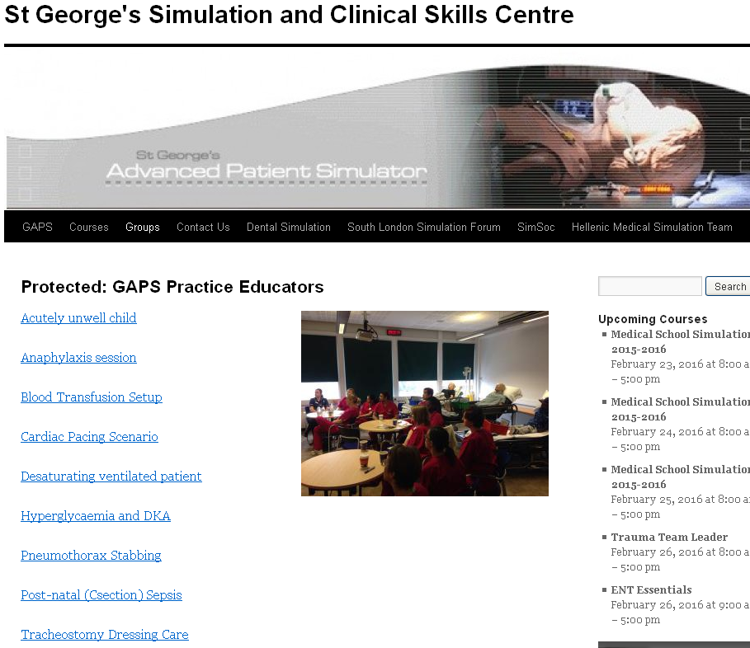
Accessible, Shared, Re-usable
Scenario Designs
www.gapssimulation.com

Slide 12


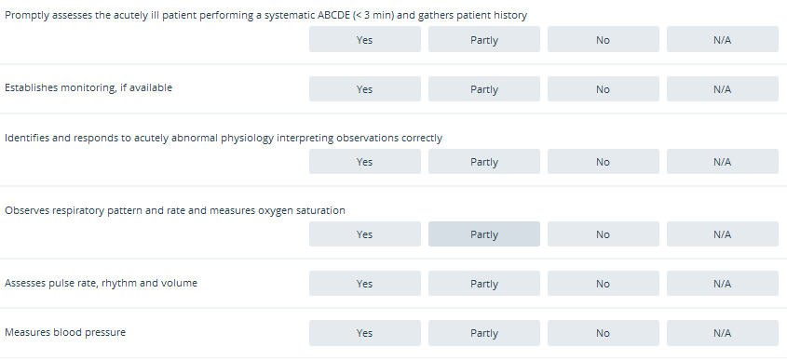
Design your own checklists and observer forms that can be downloaded and used on electronic devices ie. Smartphones etc.
Backlit observer forms which produce exportable PDF reports…

Slide 13
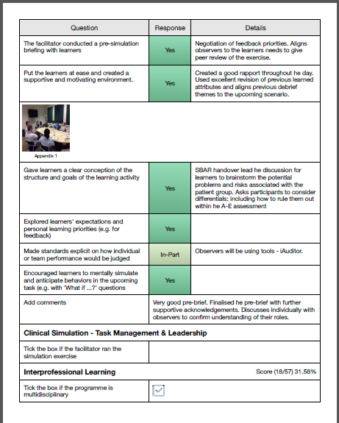
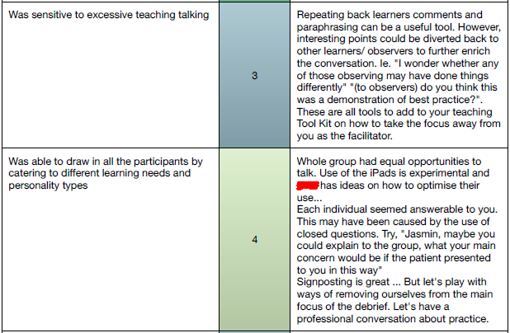
They can also be used for Peer review of clinical teaching and facilitation…

